Slide 1
What’s the law got to do with me?
Taster activity
Sponsored by

Slide 2
A national campaign to teach children about the law.
Over 2,500 teachers and 200,000 young people have taken part so far. Now it’s your turn to get involved.
Join the conversation
@YoungCitizensUK #TheBigLegalLesson
2
© Young Citizens

Slide 3
What’s the law got to do with me?
You might think that the law has nothing to do with you, because you are still a child.
But you’re wrong!
The law affects everyone,
including you!
3
© Young Citizens
Notes:
h

Slide 4
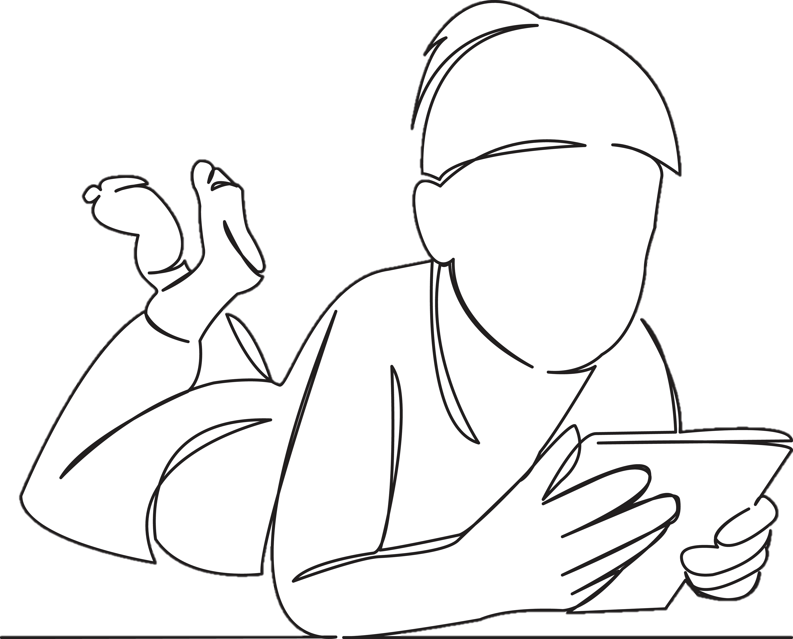
Meet Sammy. Sammy is 8. They live at home with their grandad.
Sammy wakes up, gets out of bed and heads downstairs to eat some chocolate cereal.
Once they’ve got dressed, they get into the car with their grandad and are driven to school. They stop to fill up with petrol on the way.
4
© Young Citizens

Slide 5
At school Sammy does some numeracy and literacy work. In the afternoon they have PE, which is their favourite lesson! Once the day has finished, they wait in their classroom with their teacher until they are picked up.
5
© Young Citizens

Slide 6
On the way home Sammy heads to the shops to buy a new computer game with some birthday money. They play their new game with their granddad, before getting ready for bed and having a nice long sleep.
Talk to a partner. How many times do you think the law has affected Sammy’s day?
6
© Young Citizens
Notes:
https://

Slide 7
Eating breakfast:
The law says how much tax must be paid on sugary products, which can make them more expensive.
The law stops supermarkets from offering price promotions on certain foods that are high in fat and sugar.
There are also laws about where these products can be placed in shops.
7
© Young Citizens

Slide 8
Getting to school
Sammy and their grandad both have to wear a seatbelt.
Sammy’s grandad has to stick to the speed limit and can’t hold his mobile phone when driving.
The law says you cannot sell petrol to anyone under the age of 16, or even let them use the pump.
8
© Young Citizens

Slide 9
At school
The law says you have to stay in some sort of education until you’re 18. It also tells some schools what should be taught.
Schools have to stick to lots of other laws. They must not discriminate pupils on the grounds of some protected characteristics (e.g. disability, race or religion.)
9
© Young Citizens

Slide 10
Buying a game
Some video games have age limits. It is against the law to sell these games to someone under this age.
The law says the game must be of satisfactory quality. If Sammy found the game was broken when he got home the law says he can get a refund.
10
© Young Citizens

Slide 11
The Big Legal Lesson Big Challenge!
Draw a timeline of your day. Where have you come into contact with the law?
Have
breakfast
Walk
to
school
School
starts
Lunch
Pick
up
Swim
Dinner
and
Bed
English
and
maths
Art
11
© Young Citizens

Slide 12
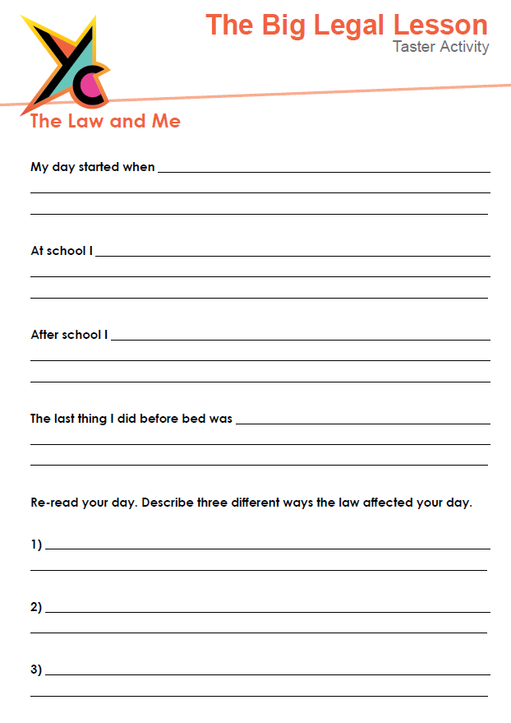
The Big Legal Lesson
Big Challenge!
Use the worksheet provided to tell
us all about your day.
How is the law affecting you?
12
© Young Citizens

Slide 13
Share your involvement
@YoungCitizensUk #TheBigLegalLesson
13
© Young Citizens

