Slide 1
What’s the law got to do with me?
Taster activity
Sponsored by

Slide 2
A national campaign to teach young people about the law.
Over 2,500 teachers and 200,000 young people have taken part so far. Now it’s your turn to get involved.
Join the conversation
@YoungCitizensUK #TheBigLegalLesson
2
© Young Citizens

Slide 3
Some young people think that the law has nothing to do with them, because they are not able to do lots of the things that adults can.
But they’re wrong.
The law affects everyone,
including you!
3
© Young Citizens

Slide 4
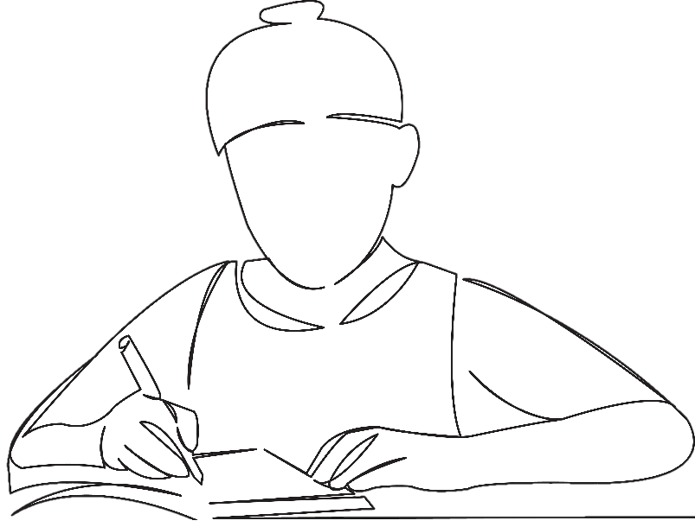
Meet Sammy. Sammy is 16.
Sammy wakes up, eats some chocolate cereal and gets ready for the day.
At 8.00 Sammy gets ready to
leave the house and catch
the bus to school.
4
© Young Citizens

Slide 5
The school day starts with tutor time and then Sammy heads off for double maths, followed by English, history, and PE.
At lunch time Sammy attends an event organised by the careers office. There are lots of different people at the event including someone from the local college, someone from the local university and a range of different employers.
5
© Young Citizens

Slide 6
After school Sammy gets on the bus and heads to the café where they work.
On the way Sammy stops at a shop to look at options for a new mobile phone. Whilst in the shop Sammy also purchases a new game.
6
© Young Citizens

Slide 7
After work Sammy heads home and tries out the new game before spending some time online.
Sammy has some dinner and heads to bed.
Q: How do you think the law has affected Sammy’s day?
7
© Young Citizens

Slide 8
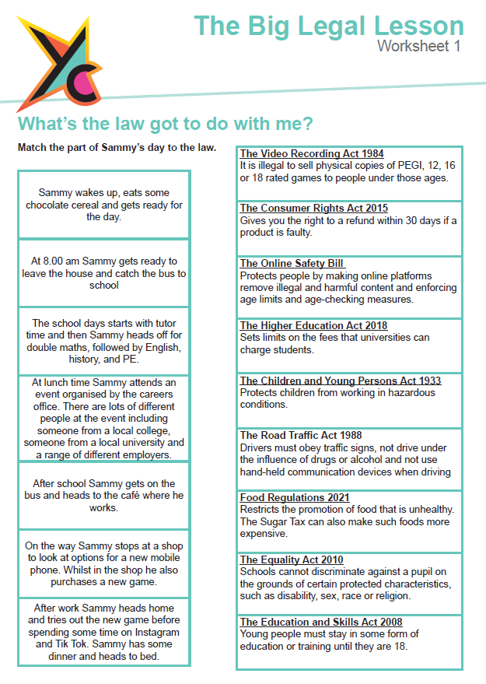
The Big Legal Lesson
Big Challenge
Use worksheet 1 to explore all the ways that the law impacted
Sammy’s day.
8
© Young Citizens

Slide 9
The Big Legal Lesson Big Challenge
Q: How does the law affect your daily life?
Challenge: Draw out a timeline of your day today. Highlight all the ways you will interact with the law.
Interests?
Travel?
Education?
Socialising?
9
© Young Citizens

Slide 10
Share your involvement
@YoungCitizensUk #TheBigLegalLesson
Tell us what you thought of the lesson
10
© Young Citizens

