Slide 1
What’s the law got to do with me?
Sponsored by

Slide 2
A national campaign to teach children about the law.
Thousands of teachers and 200,000 children have taken part so far. Now it’s your turn to get involved.
Join the conversation
@YoungCitizensUK #TheBigLegalLesson
2
© Young Citizens

Slide 3
Today we will be exploring:
What the law is.
How the law affects you.
Who makes the law.
3
© Young Citizens

Slide 4
What do we already know?
Q: Has anyone heard of the law?
Q: What do you know about it?
Q: Can you give me an example
of a law?
4
© Young Citizens

Slide 5
Meet Snippet
He is about to find out all about the law.
Watch Chapter 1
Tell a partner something new you learnt in this chapter.
The law is for everyone!
5
© Young Citizens

Slide 6
Watch Chapter 2
Q: Have you learnt anything new?
Imagine you saved up your money and went to the shops to buy a tasty treat. When you got home it was all mouldy!
Q: How would you feel?
Q: What should happen next?
Q: How can the law help you?
6
© Young Citizens

Slide 7
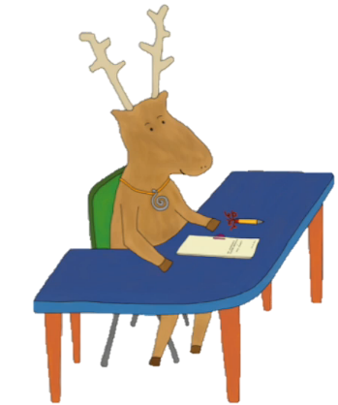
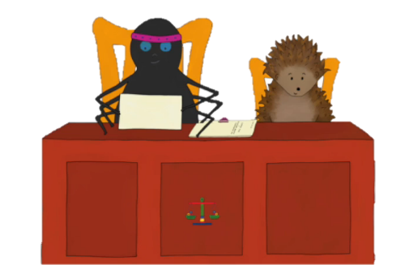
Watch Chapter 3
Q: What does Ms Doodles do as a
job?
Q: Who could help you if
you didn’t know what to do
about your mouldy treat?
Q: Where does Judge Hoop-lah
work?
7
© Young Citizens

Slide 8
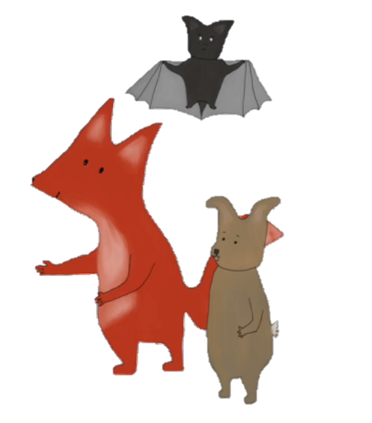
Watch Chapter 4
Talk to a partner:
Q: What new things did you
learn?
Let’s find out who our
Members of Parliament are.
8
© Young Citizens

Slide 9
The Big Legal Lesson Big Challenge
An alien has landed in the playground.
You need to explain to them what the law is.
Q: What information do they need?
Q: How will you share it with them?
9
© Young Citizens

Slide 10
The Big Legal Lesson Big Challenge
Read through the example rules and laws on worksheet 1.
Colour school rules in blue
Colour home rules in red
Colour laws in green
10
© Young Citizens

Slide 11
The Big Legal Lesson Big Challenge
Draw or write a time-line of your day. Where have you come into contact with the law?
Have
breakfast
Walk
to
school
School
starts
Lunch
Pick
up
Swim
Dinner
and
bed
English
and
maths
Art
11
© Young Citizens

Slide 12
The Big Legal Lesson Big Challenge
Q: If you could introduce a new law what would it be?
Q: Why is it needed?
Q: Who would it affect?
Tell your MP about your idea
using worksheet 3.
12
© Young Citizens

Slide 13
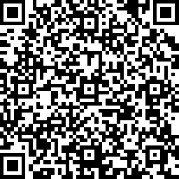
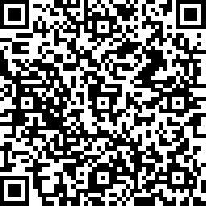
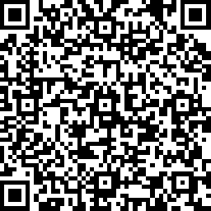
Share your ideas for new laws! Take a photo and send it to
@YoungCitizensUK #TheBigLegalLesson
Tell us what you thought by filling in a short survey
Pupil Survey
Legal Volunteer Survey
Teacher Survey
13
© Young Citizens

