Slide 1
What’s the law got to do with me?
Taster activity
Sponsored by

Slide 2
A national campaign to teach children about the law.
Thousands of teachers and 200,000 children have taken part so far. Now it’s your turn to get involved.
Join the conversation
@YoungCitizensUK #TheBigLegalLesson
2
© Young Citizens

Slide 3
What’s the law got to do with me?
You might think that the law has nothing to do with you, because you are still a child.
But you’re wrong!
The law affects everyone,
including you!
3
© Young Citizens
Notes:
h

Slide 4
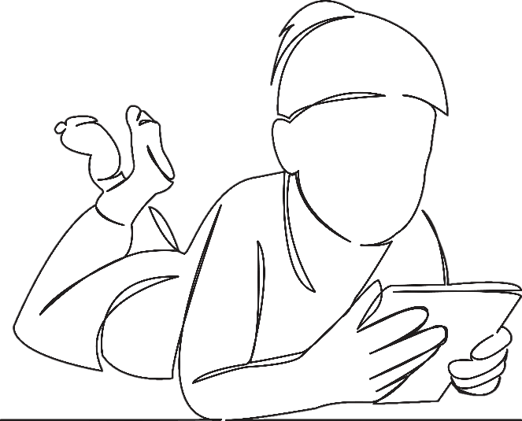
Meet Charlie. Charlie is 8. He lives with his grandad and dad.
Charlie wakes up early, gets out of bed and heads downstairs to eat some chocolate cereal.
Whilst Charlie is eating he watches some cartoons on TV.
4
© Young Citizens

Slide 5
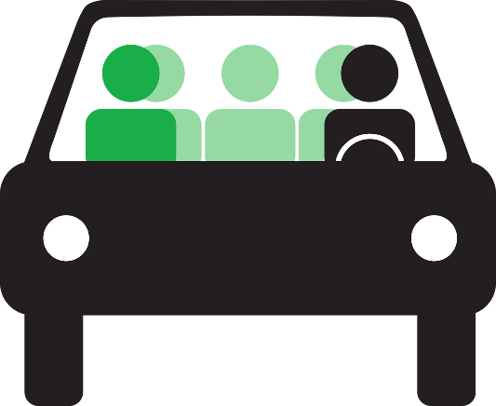
At 8 o’clock Charlie’s dad pops his head around the door and tells him to go and get ready for school.
Charlie gets driven to school by his grandad. On the way they stop to fill up with petrol. Charlie wants to help but grandad says no.
5
© Young Citizens

Slide 6
At school Charlie has maths, followed by a spelling test, then it is break time. After break Charlie has English. It’s hungry work, he’s happy when lunch time arrives.
Charlie is having a school dinner today, it’s roast dinner on the menu.
6
© Young Citizens

Slide 7
In the afternoon it’s Charlie’s favourite lesson, PE. The school day finishes with music.
On the way home Charlie begs his dad to take him to the shops. He’s got some birthday money to spend and there is a new game out for his Switch.
7
© Young Citizens

Slide 8
When they get home Charlie’s dad says that he can’t play his new game until he’s done his homework.
Charlie has some dinner, plays a bit of his game and then goes online to play Roblox before heading to bed.
Talk to a partner. How many times do you think the law has affected Charlie’s day?
8
© Young Citizens

Slide 9
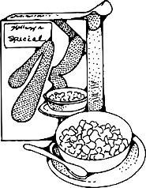
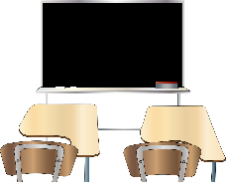
Let’s see if you found them all …
Eating
breakfast
Watching
TV
Going to
school
In the car
Getting petrol
9
© Young Citizens

Slide 10
Learning
Lunch time
PE
Buying a game
Playing Roblox
10
© Young Citizens

Slide 11
The Big Legal Lesson Big Challenge!
Draw a time-line of your day. Where have you come into contact with the law?
Have
breakfast
Walk
to
school
School
starts
Lunch
Pick
up
Swim
Dinner
and
bed
English
and
maths
Art
11
© Young Citizens

Slide 12
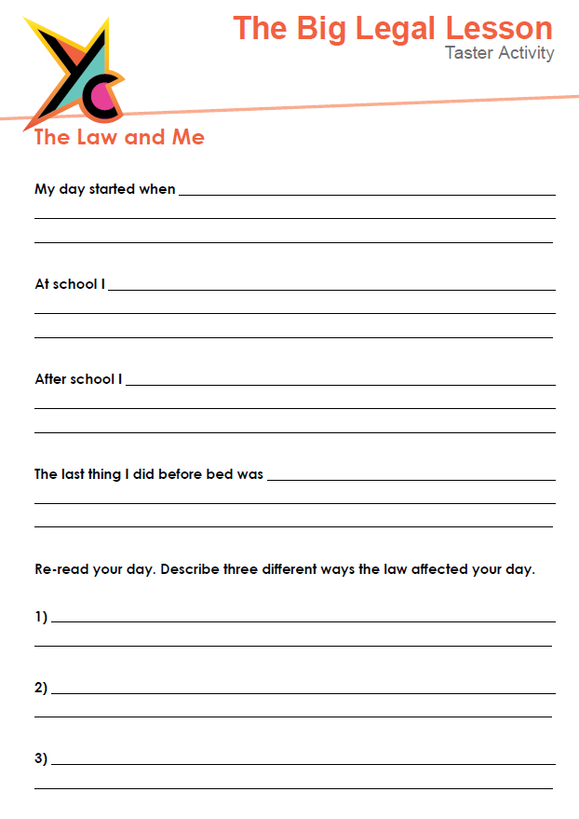
The Big Legal Lesson
Big Challenge!
Use the worksheet provided to tell
us all about your day.
How is the law affecting you?
12
© Young Citizens

Slide 13
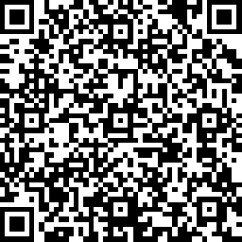
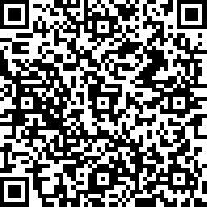
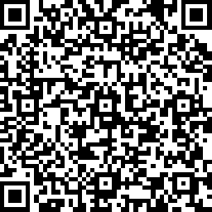
Share your involvement!
@YoungCitizensUK #TheBigLegalLesson
Tell us what you thought by filling in a short survey
Pupil Survey
Legal Volunteer Survey
Teacher Survey
13
© Young Citizens

