Slide 1
What’s the law got to do with me?
Taster activity
Sponsored by

Slide 2
A national campaign to teach young people about the law.
Thousands of teachers and 200,000 young people have taken part so far. Now it’s your turn to get involved.
Join the conversation
@YoungCitizensUK #TheBigLegalLesson
2
© Young Citizens

Slide 3
Some young people think that the law has nothing to do with them, because they are not able to do lots of the things that adults can.
But they’re wrong.
The law affects everyone,
including you!
3
© Young Citizens

Slide 4
Meet Marley. Marley is 16 and has recently started year 11.
It’s Monday morning. Marley gets woken by their alarm, heads downstairs, pours a bowl
of chocolate cereal and finishes off
their homework.
At 8am Marley heads out and walks to the bus stop, then catches the bus to school.
4
© Young Citizens

Slide 5
The school day starts with tutor time and then Marley heads off for maths followed by PE.
After PE, it’s break time followed by science, then lunch.
5
© Young Citizens

Slide 6
After school Marley attends an event organised by the careers office.
There are lots of different people at the event including someone from a local college, someone from a local university and a range of different employers.
6
© Young Citizens

Slide 7
Marley can’t stay long at the careers event as they have to get to their part-time job. Marley works in a local café for a couple of hours after school on a Monday and all day on a Saturday.
7
© Young Citizens

Slide 8
Marley’s step-dad collects them after work. Once Marley gets home, they spend some time browsing social media, then grab a quick dinner before heading to bed.
8
© Young Citizens

Slide 9
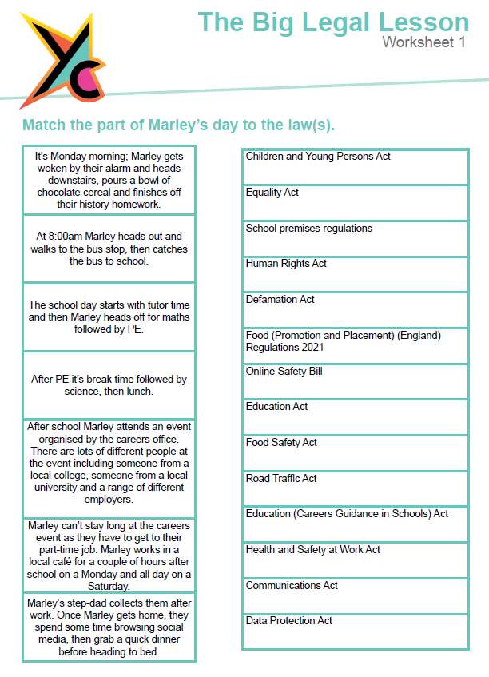
The Big Legal Lesson
Big Challenge
Use worksheet 1 to explore all the ways that the law impacted
Marley’s day.
9
© Young Citizens

Slide 10
The Big Legal Lesson Big Challenge
Q: How does the law affect your daily life?
Challenge: Draw out a time-line of your day today. Highlight all the ways you will interact with the law.
Interests?
Travel?
Education?
Socialising?
10
© Young Citizens

Slide 11
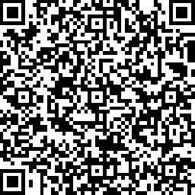
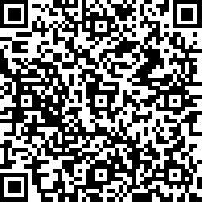
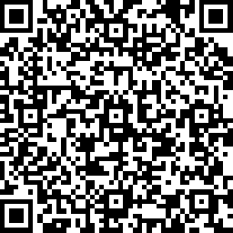
Share your involvement!
@YoungCitizensUK #TheBigLegalLesson
Tell us what you thought by filling in a short survey
Student Survey
Legal Volunteer Survey
Teacher Survey
11
© Young Citizens

