Slide 1


The Big
Democracy
Lesson
Key Stage 3
Lesson Plan & Slides
Notes:
The Big Democracy Lesson: Key Stage 3 Lesson Plan & Slides
For more Big Democracy Lesson resources and information, please head to www.youngcitizens.org/bigdemocracylesson
To find out more information about Young Citizens, find out more on our website at www.youngcitizens.org.

Slide 2


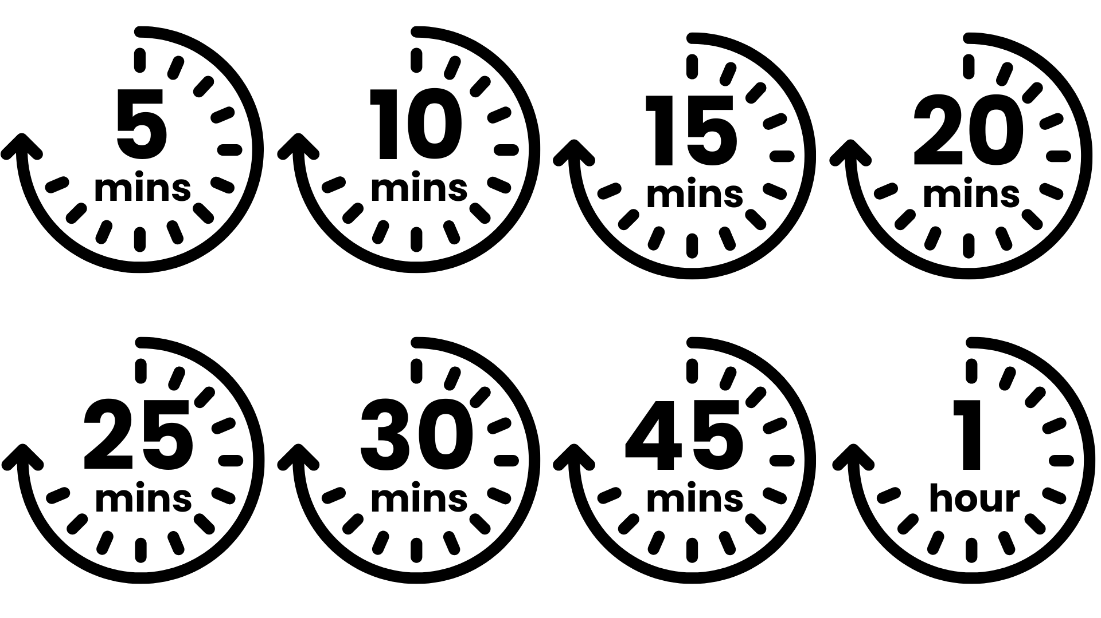




Lesson Preparation
Teacher Checklist
Keyword Definitions
Why Teach
The Big Democracy Lesson?
Allow a minimum of 45
minutes to deliver the
lesson.
Familiarise yourself with Lesson Overview (Slide 3) and slides.
Read the Top Tips & Democracy 101 (Slide 4 and 5).
Read the 'Notes' in each slide which have more information.
There are 2 extra Shorechester residents (Slide 15 and 16) - choose the ones that resonate most with your classroom.
National Government - has responsibility for the issues that affect everyone across the UK.
Local Government* - usually split
into two, a county council and a district council.
County Council - takes responsibility for issues relevant to the whole county like school, transport, libraries.
District Council** - takes responsibility for issues at a much smaller, local level, like bin collections, recycling and housing.
Local Councillors - appointed by us in the same way that we appoint our MPs, by voting in an election.
Ofsted***
Personal Development & Wellbeing
Curriculum***
Citizenship
Spiritual, Moral, Social and Cultural development (SMSC)
RSE
English
Skills
Critical thinking
Communication
Oracy
Pedagogical Principles
Support on making learning locally relevant and impartiality
Notes:
*In London and some other areas, there is just one tier of local government – often called a Unitary Authority, or known in London as a London or Metropolitan Borough.
**sometimes called a borough or city council instead – you may want to check which name is used in your school's location.
***Full Ofsted and Curriculum References:
Ofsted Personal Development & Wellbeing, Page 44: Ensuring the curriculum contributes to pupils’ personal and SMSC development, supports them to become responsible, respectful and active citizens, and develops their understanding of fundamental British values.
SMSC, Page 5: Contribute positively to the lives of those living and working in the locality of the school
RSE, Page 25 and 35: 'the contribution that...participation in their own communities can make to overall wellbeing...outward-facing activity, especially that with a service focus'
Citizenship, Page 2: roles of citizens, ways in which citizens work together to improve their communities
English: Written English, Page 5, 'narrative and non-narrative texts, including arguments' and Spoken English, Page 6, 'speak confidently and effectively; https://assets.publishing.service.gov.uk/media/5a7b8761ed915d4147620f6b/SECONDARY_national_curriculum_-_English2.pdf

Slide 3
Lesson Overview
Activity 1
Activity 2
Activity 3
What is local government?
Slide 6
Introduce the lesson using the starter prompt on the slide and invite pupils to share thoughts.
Slide 7
Introduce the learning objectives of the session.
Slide 8 – Slide 10
Ask students to work in pairs and consider which issues on the slide are handled by Local or National government.
Reveal answers and accept student feedback as time allows.
Explain the keywords used and what they mean.
Life in Shorechester
Slide 11
Introduce the fictional town of Shorechester.
Slide 12 – Slide 16
Meet 3 of Shorechester's residents and find out what they feel about where they live.
Support students to spot which issues local government can support residents with.
Find out how Shorechester residents tackled these issues as inspiration for Activity 3.
Our Neighbourhood: Our School
Slide 17
Working in groups, students draw a map of the area round their school.
Challenge them to label three things in the area they'd like to see improved, identifying which issues could be tackled by local, rather than national government.
Slide 18
Students create a 30 second pitch about their issue which they will deliver to the class.
Slide 19
Scan the QR code/click the link and submit your class reflections (do this as an activity as part of the lesson). Reflect and record what students have learnt because of the lesson.
Notes:
Lesson Length
This lesson can be run as a 45 minute lesson or a 60 minute lesson.
Activity 1 remains the same for both versions.
Activity 2 can be extended by including 4 or 5 residents from Shorechester to talk about, from Slides 12 to 16.
Activity 3 can be extended by increasing the feedback time of the our neighbourhood map activity on Slide 17.

Slide 4
Top Tips
Local Relevance
Preparation
Impartiality
This resource is designed to create a space where students can practice respectful discussion and options for response to local issues.
There are a few ways to make it relevant to your students.
Choose to focus on a selection of Activity 2: Life in Shorechester (Slides 11-16) that are most likely to resonate with your students
Change some character names and issues on Activity 2 to be more representative of your area.
Swap the picture of Shorechester for a visual that looks more similar to your school's location.
List any local community organisations or charities that could support in tackling the issues in Activity 3: Our Neighbourhood, Our School.
Consider differentiating so EAL and SEND students can access the learning and express their ideas.
Identify existing resources you can repurpose such as class agreements or existing practices such as respectful listening, the right to pass, the right to have opinions respected.
Identify potential 'hot spots', based on knowledge of your students and their experiences, which may trigger an emotional impact or response. Can you adapt the lesson to consider their needs?
Identify any topics that may come up that cause you to feel uncomfortable – acknowledge these to yourself and consider how you will equip yourself to handle these.
Impartiality doesn't mean avoiding certain subjects – even ones you have strong beliefs about.
Impartiality does mean:
Avoiding promoting partisan political views
Providing a balanced presentation of views
Challenging extremist or discriminatory views
Addressing misinformation, supporting students in distinguishing fact from opinion
Support respectful discussion using:
I think that… It looks like… Because …
My view of this is…
I agree/disagree with… Because
I appreciate this view however...
It is my opinion that... however others may think that...

Slide 5
Democracy 101
UK Government & Devolution
The UK government has responsibility for the issues that affect everyone across the UK. These include foreign policy, international trade, and the constitution. It also has responsibility for areas such as health, education, housing and transport in England. However in Scotland, Wales and Northern Ireland, these responsibilities are held by the Scottish Government, Welsh Government and Northern Ireland Executive, known collectively as the Devolved Administrations.
Each of these governments is formed after an election (held every few years) to the UK Parliament, Scottish Parliament, Welsh Assembly or Northern Ireland Assembly. Representatives in the UK Parliament are known as Members of Parliament (MPs) and represent constituencies across all of the UK. Different people can vote in different elections e.g. in UK-level elections you have to be over 18 and a British, Irish or qualifying Commonwealth citizen, but in some elections 16-year-olds can vote.
The rules for who can vote are set by the UK Parliament for General Elections and English local authority elections, and by the devolved legislatures for their own elections and for local authority elections in their jurisdictions.
Local Government
Local government is usually split into two: a county council (which takes responsibility for issues relevant to the whole county like school, transport, social care and libraries), and a district council (sometimes called a borough or city council instead) which takes responsibility for issues at a much smaller, local level, like bin collections, recycling and housing.
In London, and some other areas there is just one tier of local government – often called a Unitary Authority or known in London as a London or Metropolitan Borough.
Local Councillors are appointed by us in the same way that we appoint our MPs – by voting in an election. In England, Wales and Northern Ireland the voting age for local elections is 18; in Scotland it is 16. EU citizens can vote in local elections across the UK.

Slide 6
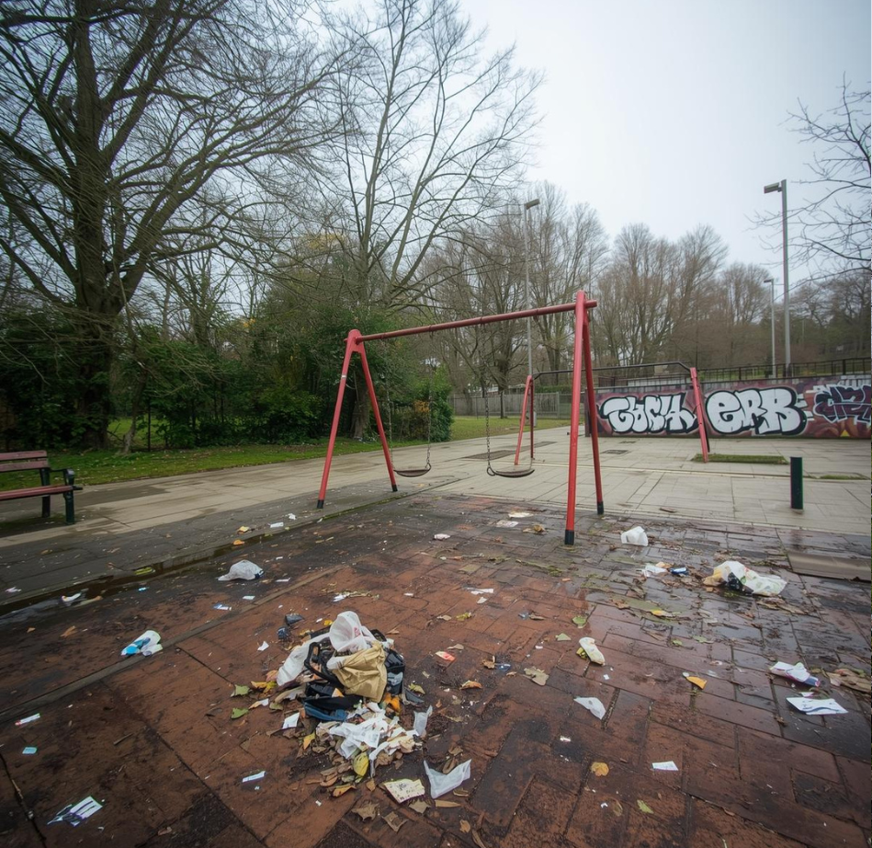
The Big Democracy Lesson
[
Picture this:
The local park is falling apart - broken swings, no bins, graffiti everywhere.
Think about these questions:
Who should fix it?
What would be the first three things you would do?
Who would you need to talk to or ask for help?
Image Here
Notes:
Starter Activity
Spend 2 minutes on this slide.
Additional Notes:
Local Councils: Local councils (not national government) are usually responsible for parks and other public spaces. Councillors are elected to make decisions for the local area.
Community Action: Communities can work together to improve their neighbourhoods by organising clean-ups, fundraising, or starting petitions.
Citizen Influence: Individuals and groups can influence local decisions through democratic processes: contacting councillors, attending meetings, or campaigning for change.
Note: This is an AI generated image.

Slide 7


Lesson Objectives
By the end of the lesson, I will be able to...​
Explain what local government does and how it affects my community.
Think critically about things that need improvement in my community.
Speak up and make a difference in my community.
Notes:
Lesson Objectives
Spend 1 minute on this slide.
Read through the objectives and check students' understanding.
Flag that you will be asking them to reflect on how they achieved these at the end of the lesson.

Slide 8
What do we mean by local government?
A Local bus services | B Noisy neighbours | C Deciding how much money the UK gives as international aid
D Reducing the speed limit in the centre of town | E Increasing the speed limit on motorways | F Number of places at local secondary schools
G Number of people applying to be maths and science teachers | H Dustbins being emptied | I More cycle lanes
J Street drinking around the shopping centre | K Welfare benefits | L Vandalism in the local park
Talk to your partner.
Which government is responsible?
Local
or
National
Notes:
Activity 1
Spend 5 minutes on this slide.
Invite students to discuss with their partner using the prompt on screen.
After 3 minutes move on to the next slide to reveal the answers.

Slide 9
What do we mean by local government?
A Local bus services | B Noisy neighbours | C Deciding how much money the UK gives as international aid
D Reducing the speed limit in the centre of town | E Increasing the speed limit on motorways | F Number of places at local secondary schools
G Number of people applying to be maths and science teachers | H Dustbins being emptied | I More cycle lanes
J Street drinking around the shopping centre | K Welfare benefits | L Vandalism in the local park
L
L
N
Talk to your partner.
Which government is responsible?
L
N
L
Local
N
L
L
or
National
L
N
L
Notes:
Activity 1
Spend 1 minute on this slide
Reveal the answers in turn.
Extension Suggestion
Discuss as a class: What are the benefits and challenges of dividing responsibilities in this way? Are there any surprises on this list? Would you allocate anything differently? Why?

Slide 10



What do we mean by local government?
Keywords
Local Government: Looks after services in your area, such as parks, rubbish collection, libraries, and planning decisions (e.g. building new houses).
Local Council: A group that makes decisions for the community. Most areas have a local council made up of councillors.
Councillor: A person elected by the public in local elections to represent the community and help make decisions. Many councillors work full or part-time in other jobs on top of their work as a councillor. Councillors receive some money to cover costs but are mostly unpaid.
Notes:
Activity 1
Spend 1 minute on this slide
Keyword and Consolidation
This slide consolidates the previous activity where students sorted local vs national government responsibilities. Use this point to reinforce that local councils manage most community services. You can also introduce information about your local councillor (Find your local council - GOV.UK) and when the next local election is (Elections in your area | Electoral Commission).

Slide 11
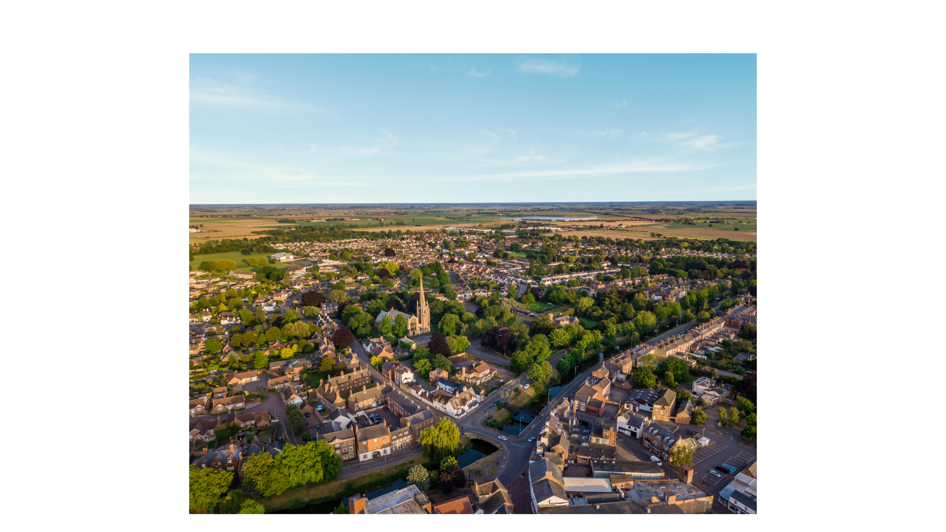







Life in Shorechester
The Smiths
Taylor
Oli
Zainab
Remi
Notes:
Activity 2
Spend 1 minute on this slide.
Explain that Shorechester is a fictional (made-up) town.
On the following slides we will meet some of Shorechester's residents.
45 minute lesson: Invite 3 students to pick one resident each, skip to the relevant slide and carry out the activities indicated. Allow students to spend around five minutes on each slide.
60 minute lesson: Work through 3 – 4 slides in turn. Allow students to spend around five minutes on each slide.
The picture used to represent the fictional town of Shorechester here shows Spalding, a market town in Lincolnshire, England.

Slide 12

Life in Shorechester: The Residents
Get To Know Them
A family of 5: Sam, Anna, plus 3-year-old twins and a new baby on the way.
Parents both work part-time and share childcare.
They are finding it hard to make ends meet and look after their children.
The Smiths
Talk to your partner:
What issue might they feel strongly about?
What action can they take to resolve this issue? Who else could help them?
We took a look at our local council website – turns out they do lots of stuff for kids, and a lot of it was free – even better! I have been taking them to a club every week where they get to play and we can meet other families. Plus, Anna got lots of information on the council website about how to apply for the twins' school place – we need to do that pretty soon even though they're only little right now!
Notes:
Activity 2
Spend 5 minutes on this slide
Invite a student to read out the details about this resident.
In pairs, students should try and identify which issues this resident might feel strongly about and whether Local Government can help.
After a few minutes discussion, bring the class back together and click on the slide to find out more.

Slide 13
Life in Shorechester: The Residents
Get To Know Them
Sustained life-altering injuries during his service in the Army.
Moved back to Shorechester to be closer to family.
Enjoys getting out on his adapted bike but finds the volume and speed of traffic in the town centre makes it tricky.
Remi
Talk to your partner:
What issue might they feel strongly about?
What action can they take to resolve this issue? Who else could help them?
I was sick of vans flying past me when I was on my bike. Then I chatted to a delivery guy who felt the same – so it wasn’t just me! I put up posters and now I ride my bike with a group of mates every Monday. Last week someone suggested we go to the next council meeting so we can talk about lowering the speed limit permanently. That way, it’s safe for everyone, and not just on Mondays.
Notes:
Activity 2
Spend 5 minutes on this slide
Invite a student to read out the details about this resident.
In pairs, students should try and identify which issues this resident might feel strongly about and whether Local Government can help.
After a few minutes discussion, bring the class back together and click on the slide to find out more.

Slide 14
Life in Shorechester: The Residents
Get To Know Them
Recently moved to Shorechester.
Wants to make new friends.
Loves being outdoors.
Local park and river are clogged with rubbish like shopping trolleys, and Taylor feels unsafe.
Taylor
Talk to your partner:
What issue might they feel strongly about?
What action can they take to resolve this issue? Who else could help them?
I thought, hang on - maybe I can actually do something about this. I emailed the councillor responsible for the environment at Shorechester Council, and she linked me to a group that removes old trolleys from rivers - who knew? I put up posters in the park and organised a cleaning up day - about 20 people came! I couldn’t believe the difference we made. Now we’re doing it every month - so I’ll make new friends while transforming the park!
Notes:
Activity 2
Spend 5 minutes on this slide
Invite a student to read out the details about this resident.
In pairs, students should try and identify which issues this resident might feel strongly about and whether Local Government can help.
After a few minutes discussion, bring the class back together and click on the slide to find out more.

Slide 15
Life in Shorechester: The Residents
Get To Know Them
Grew up in Shorechester and likes living here.
Has just left school and been offered an apprenticeship with an IT company based just outside the town.
It's a great opportunity but he would need a car to get there, which will be impossible to afford on his wages.
Oli
Talk to your partner:
What issue might they feel strongly about?
What action can they take to resolve this issue? Who else could help them?
I thought that was it – no way I could take the job. Then I searched online and found out a new law gives local councils more power over buses. Makes sense – they know what we need here. So I started an e-petition on the council’s website for a new bus route. Got all my mates to sign it, and I’m planning to share it at my new workplace too. If enough of us speak up, we can make it happen.
Notes:
Activity 2
Spend 5 minutes on this slide
Invite a student to read out the details about this resident.
In pairs, students should try and identify which issues this resident might feel strongly about and whether Local Government can help.
After a few minutes discussion, bring the class back together and click on the slide to find out more.

Slide 16
Life in Shorechester: The Residents
Get To Know Them
Mum to a 6-month-old baby.
Lives in a block of flats near the centre of Shorechester - recently some new
residents have moved in who make a lot of noise and often wake her and the baby up.
She has thought about asking them to keep the noise down but is worried about how they'll react.
Zainab
Talk to your partner:
What issue might they feel strongly about?
What action can they take to resolve this issue? Who else could help them?
Honestly, I felt stuck. Then I got a leaflet from my local councillor – usually I bin those, but this time I thought, maybe they can help. I emailed them and they showed me where to report it on the council website. Now I just fill out a form and keep track of the noise, and they’ll handle the rest. Feels good knowing there’s a proper way to sort it without awkward chats with my neighbours.
Notes:
Activity 2
Spend 5 minutes on this slide
Invite a student to read out the details about this resident.
In pairs, students should try and identify which issues this resident might feel strongly about and whether Local Government can help.
After a few minutes discussion, bring the class back together and click on the slide to find out more.

Slide 17





Our neighbourhood: Your School
EXAMPLE MAP
Shops
Park
School
Road works
House
Your turn. Working in your group:
Draw a rough map of the area around your school - think of your journey into school today to help.
What do you like about your area – what works well?
What problems are there?
Label the ones you spot.
Notes:
Activity 3
Spend 10 minutes allowing groups to carry out the activity outlined on the slide.
After that:
45 minute lesson - Invite one or two groups to share their ideas, taking a total of 5 minutes maximum.
60 minute lesson - Invite all groups to share in turn, taking a total of 15 minutes maximum.
Explain to students that it is now their turn to consider their local area.
Read through the prompts and check their understanding of the activity before you divide them into small groups and allow them to begin.
If groups are struggling to identify problems, encourage them to think about
The environment - is it a nice place to be? Is it a healthy place to be?
The economy – does it feel like most people have enough? Is there anything that's particularly hard to afford eg housing? Food?
The community – do people know each other? Do they help each other out?
Remind students to think back to the issues they identified on Slide 9 that local government is responsible for.

Slide 18


Getting heard: What's next?
Your Challenge: Speak up for your community. You’ve identified an issue that matters. Now it’s time to convince local decision-makers to take action.
Plan Your Pitch
On your paper, jot down:
What’s the problem? (One clear sentence)
Why does it matter? (Who is affected and how?)
What’s your solution? (One realistic action they could take)
Be Heard
Take turns giving a 30-second spoken pitch as if you were talking to
a local councillor.
Speak clearly and confidently
Use one strong reason why action is needed
Notes:
Call to Action
End the lesson by inviting the students to identify actions they could take, based on their ideas.
There are some ideas on the slide – invite students to contribute more.
End with a show of hands – which of these options will students choose to carry out?
If appropriate, agree whether they will do this at home or at school – for example in form time.

Slide 19
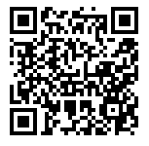
Reflections
Now at the end of the lesson...​
LINK: Complete a quick class reflection.
It takes less than 5 minutes.
Answer honestly: there are no right or wrong answers.
This helps us understand what you learned and how you feel about taking action in your community.
Notes:
Student Reflections
NB: Only you need to scan the QR code or click the link embedded on the slide. The questions are student facing, are done as a group and act as reflective prompts for your class. Optional: screenshot your answers before submitting for your own activity records.

Slide 20

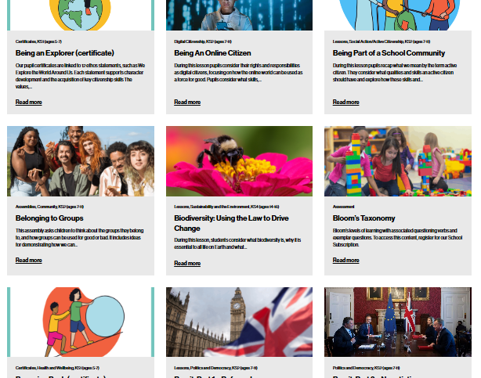

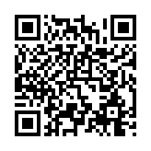
After The Session
Your Thoughts...
Want More Resources?
Tag Us!
We have heard what your students think during the lesson, now tell us how you found it as a teacher.
We'd love to hear how you use Young Citizens resources over at Facebook, LinkedIn and Instagram. You can tag us at:
RE
We have a library of over 100 free resources available for you to download right now. Sign up here:
www.surveymonkey.com/r/JSKFS5H
www.youngcitizens.org/resources
Citizenship
PSHE
@YoungCitizensUK

