Slide 1


The Big
Democracy
Lesson
Key Stage 4 & 5
Lesson Plan & Slides
Notes:
The Big Democracy Lesson: Key Stage 4/5 Lesson Plan & Slides
For more Big Democracy Lesson resources and information, please head to www.youngcitizens.org/bigdemocracylesson
To find out more information about Young Citizens, find out more on our website at www.youngcitizens.org

Slide 2


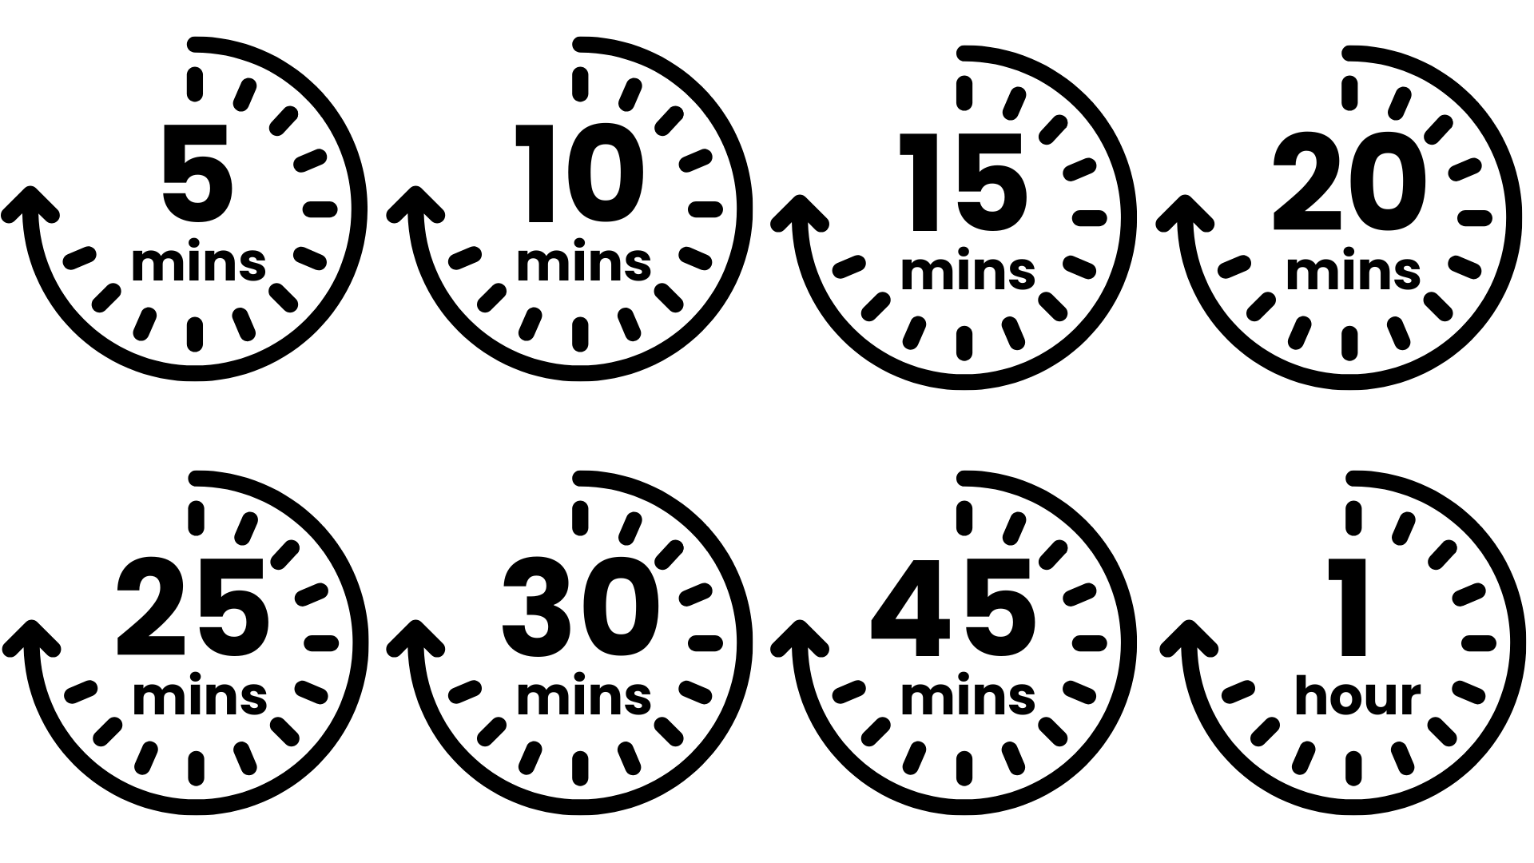




Lesson Preparation
Teacher Checklist
Keyword Definitions
Why Teach
The Big Democracy Lesson?
Allow a minimum of 60 minutes to deliver the lesson.*
Familiarise yourself with the Lesson Overview (Slide 3) and slides.
Read through the Top Tips & Democracy 101 (Slide 4 and 5).
Read the 'Notes' in each slide which have additional information.
Political Party – organised group sharing beliefs, ideas and views.
Member Of Parliament (MP) - elected to represent the interests of people in a particular area (their 'constituency').
Independent MP – not affiliated to any political party.
Polling – measuring public opinion, either by research or by holding a vote.
Manifesto - a public declaration of what a political party wants to achieve.
Disinformation – false or inaccurate information shared with intent to deceive.
Misinformation – false or inaccurate information shared in good faith, without intent to deceive.
Secret ballot – the right to keep your vote private.
Ofsted** Personal Development & Wellbeing
Curriculum**
Citizenship Spiritual, Moral, Social and Cultural development (SMSC)
RSE
English
Skills
Critical thinking
Communication
Oracy
Pedagogical Principles
Support on making learning impartial
Notes:
*If timing is tight, there are suggestions on slides 3 and 13 which allow you to shorten the lesson to 45 minutes.
**Full Ofsted and Curriculum References:
Ofsted Personal Development & Wellbeing, Page 44: Ensuring the curriculum contributes to pupils’ personal and SMSC development, supports them to become responsible, respectful and active citizens, and develops their understanding of fundamental British values.
SMSC, Page 5: 'an understanding of how citizens can influence decision-making through the democratic process'
Citizenship, Page 2: 'deepen pupils' understanding of democracy, government and the rights and responsibilities of citizens. Pupils should develop their skills to be able to use a range of research strategies, weigh up evidence, make persuasive arguments and substantiate their conclusions'
English, Page 6: writing 'adapting their writing...selecting and organising ideas...reflecting audience, purpose and context'

Slide 3
Lesson Overview
Activity 1
Activity 2
Activity 3
How do I decide?
Slide 6
Introduce the lesson, inviting 4 students to share their thoughts using the prompts on the slide, or run this as a quick quiz.
Slide 7
Introduce the learning objectives of the session.
Slide 8
Explain that these are all the political parties currently represented in the UK Parliament. At a General Election, voters choose which party to support. Invite students to share suggestions about how best to make this choice.
Slide 9 – Slide 10
Which issues are most important to you? Students compare polling data on the top issues for young people and adults, discuss what polling shows (and what it doesn’t), and reflect on why priorities might differ.
Slide 11
Students reflect on what influences political decisions.
Your Manifesto
Slide 12
Explain that a manifesto is produced by each political party to tell voters what they aim to do if they are elected.
Slide 13
Working in groups, students produce a manifesto inspired by their views. Encourage them to consider how they will write it to persuade others.
Share the contents of the manifestos.
Tip: Political parties can be a controversial topic! For support on impartiality in the classroom: See Top Tips, Slide 4.
How reliable is the information I see?
Slide 14 - 15
How does mis/disinformation affect our choice?
Debate motion: Social media makes it harder for voters to make informed choices during elections.
Slide 16
Students choose actions to prepare for their future vote.
Slide 17
Scan the QR code/click the link and submit your class reflections (do this as an activity as part of the lesson). Reflect and record what students have learnt because of the lesson.
Notes:
Lesson Length:
This lesson can be shortened to a 45 minute lesson rather than a 60 minute lesson.
Activity 1 remains the same for both versions.
Activity 2 can be shortened by having the creation of the manifestos be 15 rather than 25 minutes (slide 13).
Activity 3 remains the same for both versions.

Slide 4
Top Tips
Preparation
Impartiality
Impartiality checklist
Consider differentiating so EAL and SEND students can access the learning and express their ideas.
Identify existing resources you can repurpose such as class agreements, or existing practices such as respectful listening, the right to pass, the right to have opinions respected.
Identify potential 'hot spots', based on knowledge of your students and their experiences, which may trigger an emotional impact or response. Can you adapt the lesson to consider their needs?
Identify any topics that may come up that cause you to feel uncomfortable – acknowledge these to yourself and consider how you will equip yourself to handle these.
Impartiality doesn't mean avoiding certain subjects – even ones you have strong beliefs about.
Impartiality does mean:
Avoiding promoting partisan political views
Providing a balanced presentation of views
Challenging extremist or discriminatory views
Addressing misinformation, supporting students in distinguishing fact from opinion
Support respectful discussion using:
Avoid sharing who you vote for/your own political views.
Use 'neutral' phrasing to promote discussion and critical thinking: "What stands out to you?” “What patterns do you see?” “What reasons might explain this?” “What questions does this raise?”
When comparing manifestos: focus on structure and language, not agreement with policies.
When discussing polling: ask “Why might priorities differ?” instead of “Which is right?”
When handling controversial views, redirect to evidence-based discussion: “Is that a fact or an opinion?” or “Can you explain why you think that?”
I think that… It looks like… Because …
My view of this is…
I agree/disagree with… Because...
I appreciate this view however...
It is my opinion that... however others may think that...

Slide 5
Democracy 101
Political parties & manifestos
A political party is an organised group of people who share common beliefs, ideas, and views. In a democracy, these are shared ideas about how society can develop for the benefit of everyone. This is naturally subjective, as political parties often have different views on how society should develop. Political parties will agree what they believe are the priorities for the country and what actions they would take if they were to be elected. A manifesto is a public declaration, published before a general election, that clearly states what a political party wants to achieve if elected in key areas like the economy, health, defence, education and the environment. Manifestos support citizens in making informed decisions about who to vote for. They also allow citizens to hold the government to account as they can observe whether political parties are doing and achieving what they said they would in their manifesto.
Democracy and mis/disinformation
The rise of AI and social media have brought many benefits but also make it quicker and easier for wrong or misleading information to spread than ever before – either inadvertently (misinformation) or with intent (disinformation). What we see online can shape how we vote – or even make us doubt the fairness of the whole electoral process.
Today, introducing democracy also means helping young people learn how to find reliable information and make their voting decisions based on facts that are accurate and complete.

Slide 6

The Big Democracy Lesson
Quick quiz:
Which political party is currently in power?
How would you define a political party?
Are all MPs members of a political party?
Why do you think the UK has more than one party?
Notes:
Starter Activity
Spend 2 minutes on this slide.
1. Which political party is currently in power? The party that won the most seats in the last general election forms the government. Currently, this is Labour as they have the majority of seats in the House of Commons.
2. How would you define a political party? A group of people who share similar ideas about how the country should be run.
3. Are all MPs members of a political party? No. Most MPs belong to a political party, but some are independent and do not represent any party.
4. Why do you think the UK has more than one political party?
To represent different views and priorities in society.
To give voters a choice between different ideas and policies.
To encourage debate and accountability in government.

Slide 7


Lesson Objectives
By the end of the lesson, I will be able to...​
Explain what political parties, manifestos, and polling are – and why reliable information matters.
Compare different viewpoints and decide which issues matter most to me.
Understand why my voice matters in a democracy and feel motivated to make informed choices when I vote in the future.
Notes:
Lesson Objectives
Spend 1 minute on this slide.
Read through the objectives and check students' understanding.
Flag that you will be asking them to reflect on how they achieved these at the end of the lesson.

Slide 8
How do I decide?
Most Members of Parliament (MPs) in the House Of Commons belong to a political party.
Below are some of the parties represented and their numbers of seats as of November 2025:
There are many other parties represented including Reform, Sinn Fein and some independent MPs who belong to no party.
At a General Election, voters choose which party to support.
405
Labour
119
Conservative
9
Scottish National Party
72
Liberal Democrats
4
Green Party
4
Plaid Cymru
How do you choose which party to vote for?
Notes:
Activity 1
Spend 2 minutes on this slide
Use this slide to illustrate the breadth of choice we have in a General Election.
Remind students that the government has recently announced their intention to give 16 year olds the vote. This makes the discussion relevant to them and highlights the importance of understanding how to make informed choices.
Support information:
A political party has one 'seat' in the House of Commons for every constituency they win in a General Election.
Breakdown above correct as of November 2025. For more information see https://members.parliament.uk/parties/commons - includes a useful visual breakdown

Slide 9

How do I decide?
Cost of living
Crime
Supporting the NHS
Climate change and the environment
Levels of immigration
Affordable housing
Asylum seekers crossing the channel
Mental health
Jobs and unemployment
Education and childcare
What are the most important issues for you? Choose 3 and explain your choice to your partner.
Notes:
Activity 1
Spend 5 minutes on this slide. Note: These issues represent a selection of those chosen by two groups, 16-18 year olds and over 18's, in More in Common's August 2025 polling for The Sunday Times. Your students may feel that their issues are missing from this list – feel free to ask them and add these in for your classroom. You can see the full data here: https://www.moreincommon.org.uk/media/qitbuhbn/sunday-times-16-17s.pdf Sentence stems to support discussion:
“One issue I think is important is ______ because ______.”
“I chose ______ as my top issue because it affects ______.”
“This matters to me because ______.”
“Compared to other issues, I think ______ is more important because ______.”
“If this issue isn’t addressed, ______ might happen.” Add guiding questions:
Why does this issue matter to you or your community?
How might this issue affect young people/wider society?
What could happen if this issue is ignored?
Model an example: Show how to pick an issue and explain why it matters (e.g., “I chose education because it affects everyone’s future opportunities”) Top Tips
Handling controversial opinions in the classroom: Remind students that everyone is entitled to their opinion, but all views must be shared respectfully. If a controversial point arises, acknowledge it calmly and steer the discussion back to the learning objective by asking for reasons and evidence. Encourage phrases like “I see it differently because…” or “Can you explain why you think that?” to keep the conversation constructive. Ask them to reflect "Is that a fact or an opinion?".

Slide 10
How do I decide?
Polling data: In your opinion, which are the most important issues facing the country today?
16 – 17 year olds:
All Adults (18+):
1. Cost of living – 53%
1. Cost of living – 63%
2. Jobs and unemployment – 27%
2. Supporting the NHS – 35%
3. Levels of immigration and Supporting the NHS – 22%
3. Levels of immigration – 34%
What do you notice about the top priorities for young people and adults? Why might they not be exactly the same?
Notes:
Activity 1
Spend 1-2 minutes on this slide
Explain that: These issues represent a selection of those chosen by two groups, 16-17 year olds and over 18's, in More in Common's August 2025 polling for The Sunday Times. For a more comprehensive activity – you may want to share Slide 35 of The Sunday Times polling presentation deck which includes a full breakdown of all of the issues. You can see the full data here: https://www.moreincommon.org.uk/media/qitbuhbn/sunday-times-16-17s.pdf.
What is Polling? Polling is when researchers ask a sample of people questions to find out what they think about certain topics. It gives us an idea of trends and patterns in opinions, but it’s based on a sample, not every single person. It does not mean that all young people think the same way. It shows what a group of people said at one point in time – opinions can change.
Handling controversial opinions in the classroom: Remind students that everyone is entitled to their opinion, but all views must be shared respectfully. If a controversial point arises, acknowledge it calmly and steer the discussion back to the learning objective by asking for reasons and evidence. Encourage phrases like “I see it differently because…” or “Can you explain why you think that?” to keep the conversation constructive. Ask them to reflect "Is that a fact or an opinion?".

Slide 11
How do I decide?
There are many factors that go in to how people decide to vote...
Your top issues
Which party’s policies match the issues you care about most?
Media influence
How do news and social media shape your view?
Leadership and trust
Do you trust the people leading the party?
Advice and conversations
What do friends, family, or influencers say?
Impact on your life
How would their policies affect you, your family, and your community?
Short-term vs long-term
Are you thinking about immediate benefits or future consequences?
Fairness and values
Which party reflects your sense of fairness and equality?
Party manifestos
What does each political party promise on each issue?
If you were voting tomorrow, what would help you decide which party aligns best with your values?
Notes:
Activity 1
Spend 1-2 minutes on this slide Ask students to reflect how they would go about making their choice. Encourage them to think beyond personal preference and consider what influences voting decisions. Extension:
What are the benefits of relying on these factors?
What are the drawbacks?
(Example: Listening to family might help you feel confident, but could limit your own research.)
“The factor that influences me most is ______ because ______.”
“A benefit of this is ______, but a drawback could be ______.”

Slide 12







Your manifesto
Parliament describes a manifesto as...
A publication issued by a political party before a General Election. It contains the set of policies that the party stands for and would wish to implement if elected to govern.
Parties will publish their full manifestos on their websites as PDFs.
They will use colours associated with their party, a main slogan, and make promises on different topics.
Notes:
Activity 2
Spend 1 minute on this slide
Please note: The covers of manifestos here are shown for illustrative and education purposes and are not endorsements of the parties represented. Activity Notes:
We've used the UK Parliament definition of manifesto here: https://www.parliament.uk/site-information/glossary/manifesto/
Extension discussion prompts: Why do parties publish manifestos? To explain their policies and priorities to voters and outline what they would do if elected. How do design elements (colours, slogans) influence voters? They can help create a clear identity and make the message memorable.
Why might promises differ between parties? Parties often have different priorities, values, and ideas about how to address issues. Explain that students will now create their own manifestos:
They should think about their priorities for young people and issues they believe matter most.
Encourage creativity but also clarity - manifestos should be persuasive and realistic.

Slide 13


Your manifesto
Your turn. Working in your group, produce a mini-manifesto inspired by your core issues.
Choose your top 3 issues as a group (from earlier activities).
Write one clear promise for each issue (e.g., “We will invest in mental health support for schools.”).
Add a short headline or slogan that sums up your vision.
Notes:
Activity 2
For the 45 minute lesson spend 15 minutes on this slide
For the 60 minute lesson spend 25 minutes on this slide
Split the class into small groups.
Each group should write their own manifesto.
Explain that their manifesto should be based on the opinions of group members and written in persuasive language to encourage others to vote for their ideas.

Slide 14







How reliable is the information I see?
Think to yourself:
What is misinformation?
How is it different from disinformation?
Talk to your partner:
Rank the sources below from 'Least Reliable' to 'Most Reliable' - think of a reason as to why.
Where do you get your news from? How would you rank it on the same scale of reliability?
Notes:
Activity 3
Spend 10 minutes on this slide Ask students to reflect on: What is misinformation? Explain that misinformation is false or inaccurate information shared without intent to deceive. How is it different from disinformation? Disinformation is deliberately false information intended to mislead or manipulate. Tip: Use a quick example for each (e.g., someone sharing an incorrect fact they believe is true vs. a fake news article created to influence opinions).
Students pair up and rank the provided sources from Least Reliable to Most Reliable.
Encourage them to justify their rankings:
Consider factors like authorship, bias, fact-checking, and accountability.
Highlight that reliability is not always obvious—social media posts, blogs, and even some news outlets can vary widely.
Extension Activity: Get your students to create a script for an informative video on identifying mis/disinformation online for their peers. How do they know? What can they do to check their sources? Why should people care especially around elections and voting?

Slide 15
How reliable is the information I see?
Debate: Social media makes it harder for voters to make informed choices during elections.
For the motion
Against the motion
Ofcom found that over a 4-week period during the time of the general election, 39% of misinformation seen online related to UK politics.
Why does this matter for elections?
How could mis/disinformation change someone’s vote?
What role do algorithms and echo chambers play?
“I agree because social media…”
“One reason this makes voting harder is…”
“If people believe false information, then…”
Ofcom also found that almost half of UK adults they surveyed feel confident they can judge whether sources of information are truthful.
How can social media help voters access reliable information?
What tools or features make it easier to fact-check?
How does social media increase political engagement?
“I disagree because social media…”
“One way it helps voters is…”
“Social media can support informed choices by…”
Notes:
Activity 3
Spend 10 minutes on this slide
The facts on this slide are from: Ofcom, Understanding misinformation: an exploration of UK adults' behaviour and attitudes Mis and disinformation report Ofcom: Ofcom is the UK’s communications regulator which means that it sets rules for companies that provide these services. It protects consumers from harmful or misleading content. Activity Notes: Divide each table into two groups: Group A: Agree with the statement Group B: Disagree with the statement. Remind them that good debaters should be able to argue both sides of the statement, regardless of their own views!
Preparation (3 minutes): Each group uses the statistic and prompts on the slide to build 2–3 arguments. Encourage use of sentence stems if needed.
Debate (6–8 minutes): Keep this simple. Each side presents their strongest argument as an opening statement. Then the opposing side can respond with a counterpoint.
Optional: Conduct a class vote (2 minutes): What do they actually think? Students vote: Agree / Disagree / Undecided.

Slide 16




Your vote matters: What's next?
As a class, create a list of tools and tactics to combat mis/disinformation.
Take one step to help you decide which party best aligns with your values.
Find out when you can register to vote and how it works: www.gov.uk/register-to-vote
Ask your family/friends how they decide who to vote for.
Notes:
Call to Action
End the lesson by inviting the students to identify actions they could take, based on their ideas.
There are some ideas on the slide – invite students to contribute more.
End with a show of hands – which of these options will students choose to carry out?
If appropriate, agree whether they will do this at home or at school – for example in form time.

Slide 17

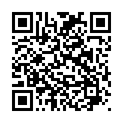
Reflections
Now at the end of the lesson...​
LINK: Complete a quick class reflection.
It takes less than 5 minutes.
Answer honestly: there are no right or wrong answers.
This helps us understand what you learned and how you feel about making decisions around voting in the future.
Notes:
Student Reflections
NB: Only you need to scan the QR code or click the link embedded on the slide. The questions are student facing, are done as a group and act as reflective prompts for your class. Optional: screenshot your answers before submitting for your own activity records.

Slide 18

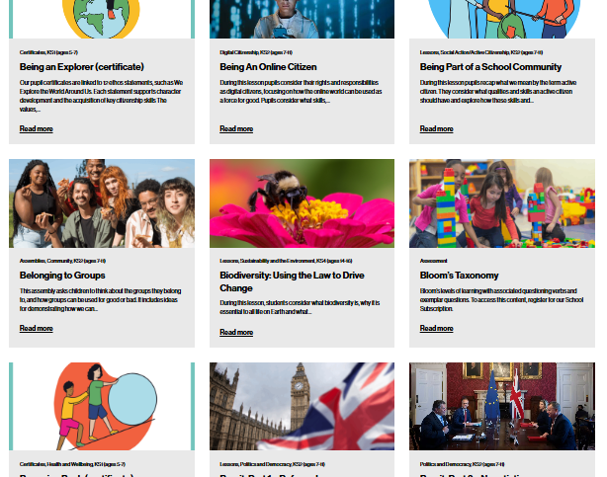

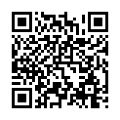
After The Session
Your Thoughts...
Want More Resources?
Tag Us!
We have heard what your students think during the lesson, now tell us how you found it as a teacher.
We'd love to hear how you use Young Citizens resources over at Facebook, LinkedIn and Instagram. You can tag us at:
We have a library of over 100 free resources available for you to download right now. Sign up here:
www.surveymonkey.com/r/JSKFS5H
www.youngcitizens.org/resources
Citizenship
PSHE
@YoungCitizensUK

