Slide 1


The Big
Democracy
Lesson
Secondary
Spark Activity Pack
Notes:
The Big Democracy Lesson: Secondary Spark Activity Pack
For more Big Democracy Lesson resources and information, please head to www.youngcitizens.org/bigdemocracylesson
To find out more information about Young Citizens, find out more on our website at www.youngcitizens.org

Slide 2







Spark Activity 1: Fast Facts
How can I tell the difference between opinions versus facts?
Think to yourself:
What’s the difference between a fact and an opinion?
Can you give one example of each?
UK-Wide elections set to align with Scottish and Welsh voting age rules at 16
Talk to your partner:​
Look at the statements on the right. Which ones are facts and which ones are opinions? How do you know?
Lowering voting age would give young people a stronger voice
Together as a group:
Why is it important to know the difference between facts and opinions - especially when making decisions like voting?
5 reasons why letting 16 year olds vote is a bad idea
Idea for Action:​
Find one example of a fact and one opinion about the same topic. How do they sound different?
16 – 17 year olds to be able to vote in the next general election
Notes:
Spark Activity 1: Fast Facts

Slide 3
Spark Activity 2: Be a Super Searcher
How do I know what’s true online?
Think to yourself:
What makes you trust something you read online? Is it the source, the way it looks, or something else?
When asked why they thought something online was false or misleading, this is what people said...
46% I knew the facts which are different from this view.
Talk to your partner:​
Can you think of a time when someone believed something online that turned out to be false? What impact did it have?
43% The information looked and felt untrustworthy.
Together as a group:
What signs can help you spot if a story or post might be fake or misleading? (e.g. source, evidence, tone, date)
37% I checked the facts with other reliable sources.
Idea for Action:​
Create 3 tips you would give to someone to check if online information is reliable. Look at the stats on this slide to help!
34% The account had shared something untrustworthy before.
Notes:
Spark Activity 2: Be a Super Searcher
The statistics on this slide are from: Ofcom, Understanding misinformation: an exploration of UK adults' behaviour and attitudes Mis and disinformation report.
Ofcom: Ofcom is the UK’s communications regulator which means that it sets rules for companies that provide these services. It protects consumers from harmful or misleading content.

Slide 4
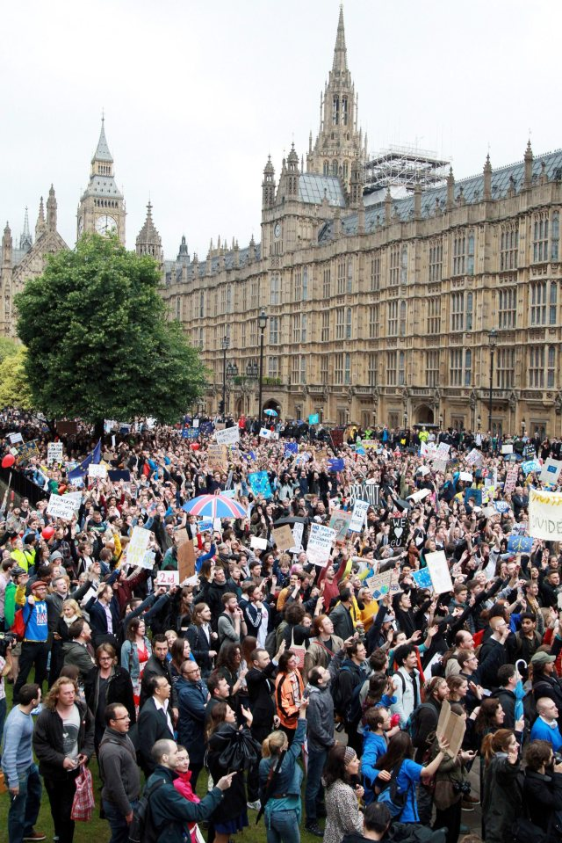
Spark Activity 3: Bubble Trouble
Why should we search for different perspectives?
Think to yourself:
Have you ever noticed that your home page looks different from your friend’s home page? Why is that?
Talk to your partner:
Can you think of a time you’ve heard one event described in very different ways? Did these different perspectives cause different reactions?
Together as a group:
What’s going on in this picture?
How many different perspectives could there be?
Idea for Action:
Search for one news story from two different sources. Spot one difference in how it is presented.
Notes:
Spark Activity 3: Bubble Trouble
Photograph shows protest against Brexit referendum result in Central London
https://www.thesun.co.uk/news/1358773/hundreds-of-people-turn-out-in-london-to-protest-against-brexit-referendum-result/

Slide 5
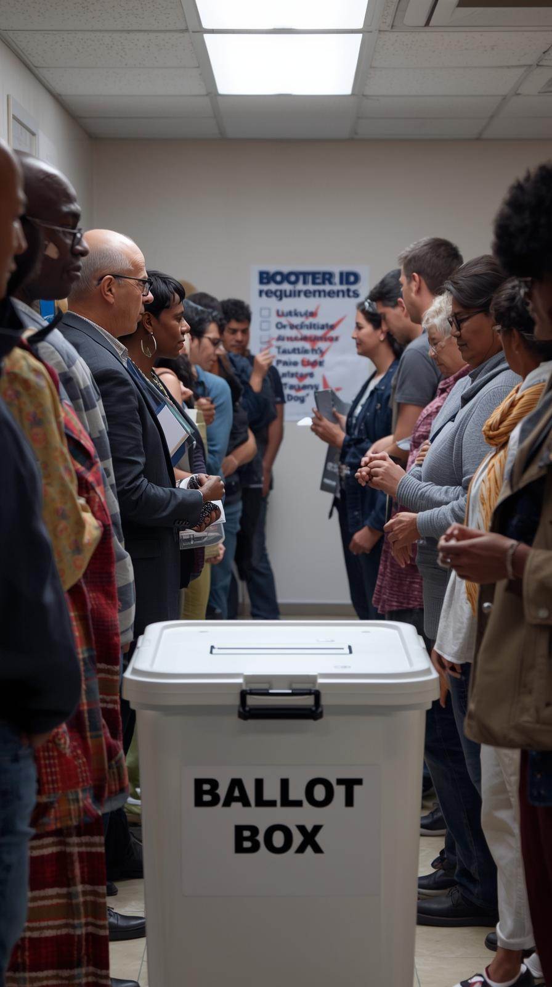
Spark Activity 4: Robot Reporter
What does AI have to do with it?
Think to yourself:
What clues might show something was written or produced by Artificial Intelligence (AI)?
Talk to your partner:​
Why is it important to know whether content is AI-generated when making decisions about voting? What risks could arise if we don’t check?
Together as a group:
Look at the image on this slide. Is it a real photo or is it AI generated? How can you tell?
Idea for Action:
Write one quick rule for yourself: how will you check if content is trustworthy before using it to make a decision?​
Notes:
Spark Activity 4: Robot Reporter
This image was AI generated using the Canva AI generation tool.

Slide 6

Spark Activity 5: You, Me And Them
Who can fight mis/disinformation?
Think to yourself:
Misinformation is false or inaccurate information shared in good faith, without intent to deceive. Disinformation is false or inaccurate information shared with intent to deceive.
What could go wrong if mis/disinformation spreads?
Talk to your partner or group:​
Different groups (such as government, technology companies, media organisations, and individuals) can all play a role in making sure information is reliable.
What actions could each group take to help reduce misinformation and disinformation? Are there any challenges or limitations for each group?
Idea for Action:​
Write one action you could take today to stop the spread of false information.
Notes:
Spark Activity 5: You, Me And Them
Images are free use images from Canva.

Slide 7


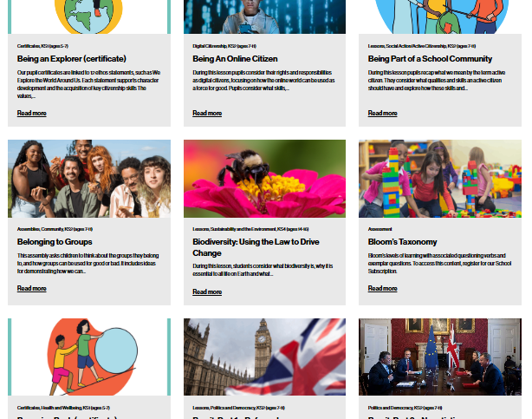

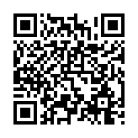
After The Session
Your Thoughts...
Want More Resources?
Tag Us!
Tell us how you found this resource as a teacher.
We'd love to hear how you use Young Citizens resources over at Facebook, LinkedIn and Instagram. You can tag us at:
RE
We have a library of over 100 free resources available for you to download right now. Sign up here:
www.surveymonkey.com/r/JSKFS5H
www.youngcitizens.org/resources
Citizenship
PSHE
@YoungCitizensUK

