Slide 1



The Big
Democracy
Lesson
Produced in partnership with
Key Stage 1
Lesson Plan & Slides
Notes:
The Big Democracy Lesson: Key Stage 1 Lesson Plan & Slides
For more Big Democracy Lesson resources and information, please head to www.youngcitizens.org/bigdemocracylesson
To find out more information about Young Citizens and our mission, you can check our website at www.youngcitizens.org

Slide 2


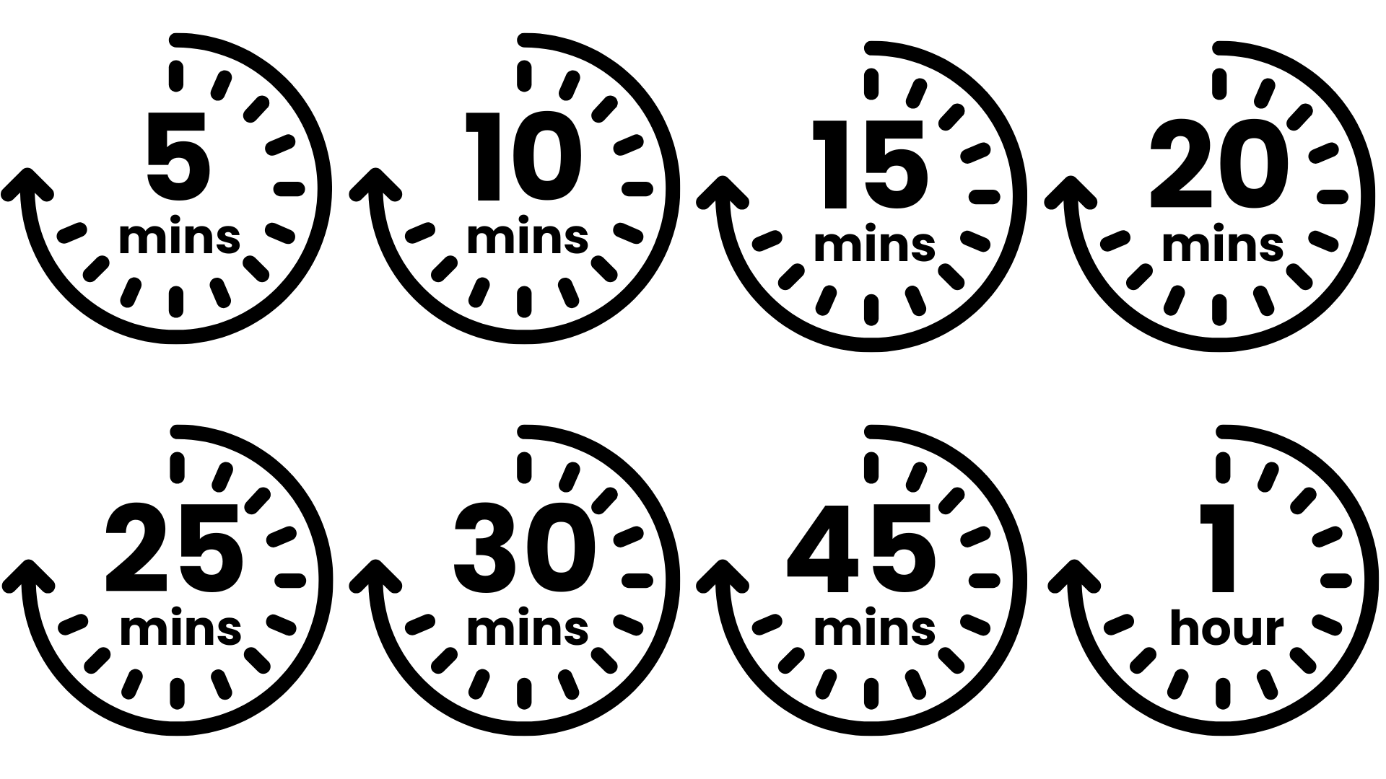




Lesson Preparation
Teacher Checklist
Keyword Definitions
Why Teach
The Big Democracy Lesson?
Allow a minimum of 45
minutes to deliver the
lesson.
Familiarise yourself with Lesson Overview (Slide 3) and slides.
Read the Top Tips & Democracy 101 (Slide 4 and 5).
Read the 'Notes' in each slide which have more information.
Democracy – system of governing where citizens get a say in how decisions are made.
Voting – a way of selecting an outcome that takes the opinions of all participants into account and delivers a majority decision. To be effective, the voting process must be free and fair.
National Government - responsible for the issues that affect everyone across the UK.
Parliament – the UK's main law-making body, where laws are debated, changed and approved, and the government is held to account.
Member Of Parliament (MP) - elected to represent the interests of people in a particular area (their 'constituency').
Ofsted Personal Development & Wellbeing
Curriculum
Citizenship Spiritual, Moral, Social and Cultural development (SMSC)
English
Skills
Critical thinking
Communication
Oracy
Pedagogical Principles
Support on making learning locally relevant and impartial
Notes:
How The Big Democracy Lesson supports Ofsted requirements:
Ofsted Personal Development & Wellbeing, Page 44: Ensuring the curriculum contributes to pupils’ personal and SMSC development, supports them to become responsible, respectful and active citizens, and develops their understanding of fundamental British values.
How The Big Democracy Lesson supports Curriculum requirements:
Citizenship: Citizenship Programme of Study (non-statutory), page 3, 2.f and 2.g, Key Stage 2 pupils should be taught 'to resolve differences by looking at alternatives, making decisions and explaining choices; what democracy is, and about the basic institutions that support it locally and nationally'
Spoken English: Primary National Curriculum – English, page 7: 'listen and respond appropriately to adults and their peers; ask relevant questions to extend their understanding and knowledge; maintain attention and participate actively in collaborative conversations, staying on topic and initiating and responding to comments; use spoken language to develop understanding through speculating, hypothesising, imagining and exploring ideas'
SMSC, Fundamental British Values, Page 5 and 6: 'enable students to acquire a broad general knowledge of and respect for public institutions and services in England; encourage respect for democracy and support for participation in the democratic processes, including respect for the basis on which the law is made and applied in England; an understanding of how citizens can influence decision-making through the democratic process'
How The Big Democracy Lesson supports skill development:
Activities are designed to support development of critical thinking, communication and oracy.
If your school uses the Skills Builder frameworks you may be able to map lesson activities to the following steps: Listening 1, 2; Speaking 1, 2; Problem Solving 1, 5, 6, 7.

Slide 3
Lesson Overview
Activity 1
Activity 2
Activity 3
What is a vote?
Slide 6, 7
Introduce the lesson using the starter prompts on the 'Making a choice' slide.
Slide 8
Introduce the learning objectives of the session.
Slides 9-13
Invite pupil feedback on what a vote is. Introduce and explain the definition using the prompts on the slide and in the teacher notes below each slide.
Follow the Go Givers as they vote on a decision and use the talking prompts to invite pupil feedback on the outcome.
Encourage the children to contribute their ideas about whether the process was fair, using the prompts and notes on the slide.
Who should represent us?
Slide 14
Use this slide only if your school does not
operate a school council, or similar body.
Slides 15 - 16
Follow the Go Givers as they decide how to cast their vote for the school council.
Use the slides to help children think about the kinds of information voting might be based on and what considerations might be helpful.
Consolidate the children's thoughts using the writing prompt on Slide 16.
How do elections work?
Slide 17
Explain that the Go Givers' vote is a
small version of our General Election – the big vote we use to choose our country's leaders. Follow the slide to introduce related vocabulary.
Slide 18
Relate Alba's experience of the election back to the school council voting in Activity 2.
Slides 19 – 21
Discuss what the candidates' priorities are. First, support the children to focus on noticing the differences rather than judging them. Then, use the prompts on Slide 21 to help the children relate the candidates' priorities to their own.
Slides 22 – 24
Follow the prompts to finish the lesson by completing the challenge and consolidating the children's learning. Reflect as a class on your experience using the link on Slide 24.

Slide 4
Top Tips
Local Relevance
Preparation
Impartiality
This resource is designed to create a space where pupils can practice respectful discussion and begin to see the importance of democracy to their everyday lives.
To ensure this topic feels relevant to your pupils, consider:
Swapping in any Go Givers characters you think will feel particularly relatable for your class – all names and characters are included on Slide 9 to help you.
Activity 2 uses the concept of voting for a school council. If your school uses a different term such as Pupil Parliament or Pupil Leaders, consider changing the wording to match. If your school does not operate a school council, use Slide 14 to introduce the concept.
Find your MP - MPs and Lords - UK Parliament - consider using this before or during the lesson, to find out who your local MP is and show the class their picture.
Consider differentiating so EAL and SEND pupils can access the learning and express their ideas.
Think about your pupils’ experiences and possible preconceptions around government and different political parties. How might these shape their understanding of democracy?
Identify any topics that may come up that cause you to feel uncomfortable – acknowledge these to yourself and consider how you will equip yourself to handle these.
Use familiar classroom routines to support discussion, such as your class agreement or strategies like "respectful disagreement", “right to pass” and “respectful listening.” Encourage pupils to share ideas using simple sentence starters, for example:
I think…
I agree because... I don’t agree because…
I like that idea…
My idea is…
Teaching about democracy can lead to conversations about different political views, various groups and communities and what is the “right” or “wrong” way to run the country.
At this age, pupils may share strong opinions based on their experiences or things they’ve heard.
This means that impartiality in the classroom is important - but impartiality doesn't mean avoiding certain subjects – even ones you have strong beliefs about.
Impartiality does mean:
Avoiding promoting partisan political views
Providing a balanced presentation of views
Challenging extremist or discriminatory views
Addressing misinformation
Supporting students in distinguishing fact from opinion

Slide 5
Democracy 101
What is democracy?
Democracy is one way of organising a system of government. In a democracy, political power is granted by the people, usually through elections in which citizens choose representatives to make decisions on their behalf.
In democratic systems, voting gives citizens a role in shaping how the country is governed.
Through elections, people can:
help decide who holds political authority;
influence the laws, rules, and policies that affect their lives;
replace leaders or representatives if they feel change is needed.
What are elections?
Elections are a method many democracies use to choose people who will represent the public. During an election, eligible voters select between candidates or parties, and the results determine who will take on political responsibilities. Different elections in the UK work differently. For more information on how they work, please visit: How elections work | Electoral Commission
For elections to function effectively, they depend on certain principles, such as:
people being able to vote freely, without intimidation;
votes being counted accurately;
elections being held regularly;
voters having a genuine choice between candidates or parties;
access to reliable information so people can make informed decisions.

Slide 6
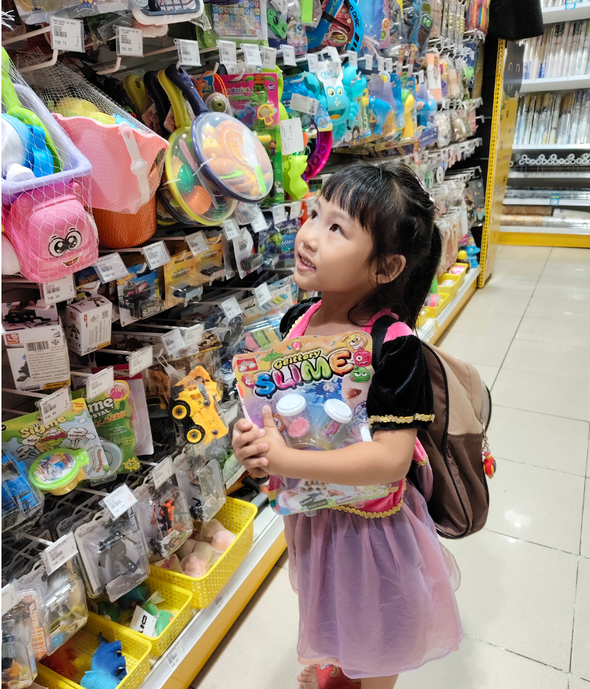
The Big Democracy Lesson
[
Making a choice
What are they choosing between?
Have you ever had to choose between two things you wanted?
Notes:
Making a choice
Spend 1 minute on this slide.
Invite children to share their ideas about what the child in the picture might choose and why. Encourage them to think about times when they had to choose between two things.
After gathering a few responses, ask: How did you decide in the end?
Accept any reasonable answer. This helps children notice that choices often involve thinking about what matters to us – which links to understanding how voters make decisions later.

Slide 7
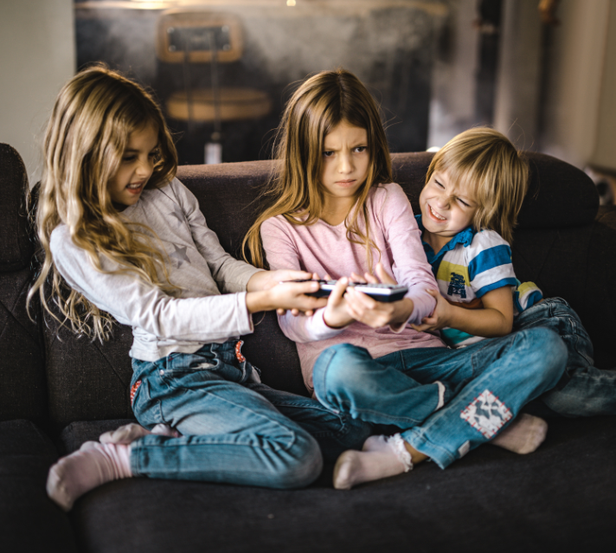

The Big Democracy Lesson
[
Making a choice
Think as a class
What is happening in this picture?
Why is this choice harder than the first one?
How could they decide without fighting?
Notes:
Making a choice
Spend 1 minute on this slide.
This expands the concept from personal choice to shared choices, which requires fairness and listening to others. Work through the prompts on the slide, supporting children to explain what is happening.
Help them articulate that this situation is different because more than one person wants to decide, which can make it harder. Draw out that when a decision affects a group, we need a fair way to choose.
Invite children to suggest similar situations from their own experiences: choosing the story at home or bedtime, deciding which toys to play with, agreeing who tidies up, choosing a playground game.
Discuss how these situations were solved: Did someone get their own way? Did you talk about it and agree?
If children have seen/experienced voting in school (e.g., choosing a story, student council votes), briefly remind them of these examples. This reinforces the idea that voting is one way to make fair decisions when a choice affects more than one person.

Slide 8
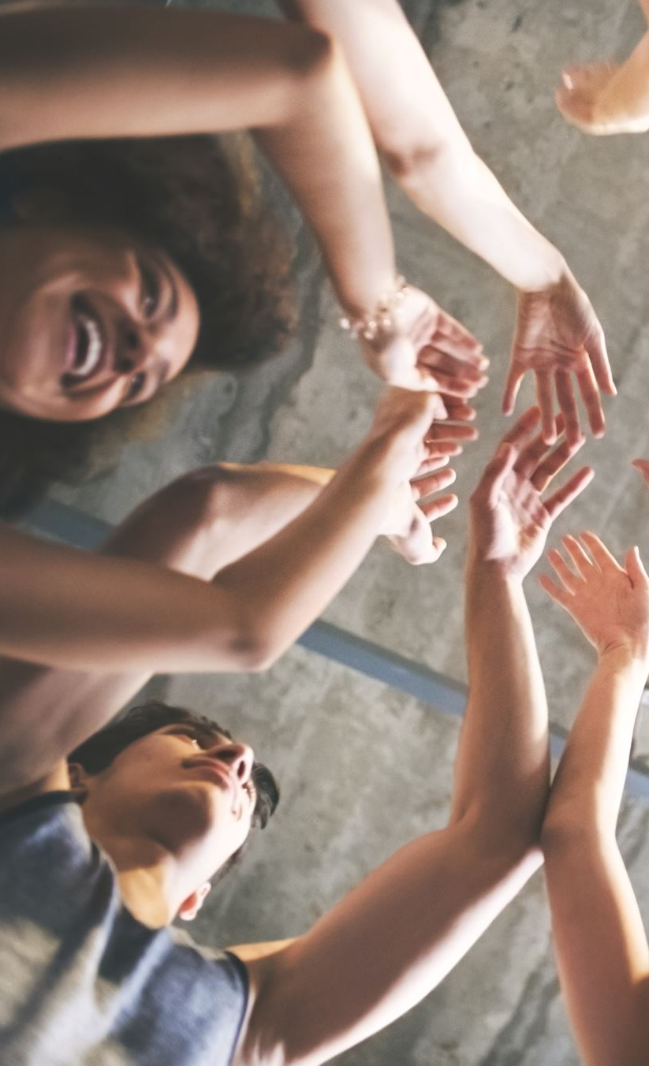

Lesson Objectives
By the end of the lesson, I will be able to...​
Explain what a vote is
Suggest ways to make votes fair
Describe different ways we use voting in society
Notes:
Lesson Objectives
Spend 1 minute on this slide.
Read through the objectives and check students' understanding.
Flag that you will be asking them to reflect on how they achieved these at the end of the lesson.

Slide 9


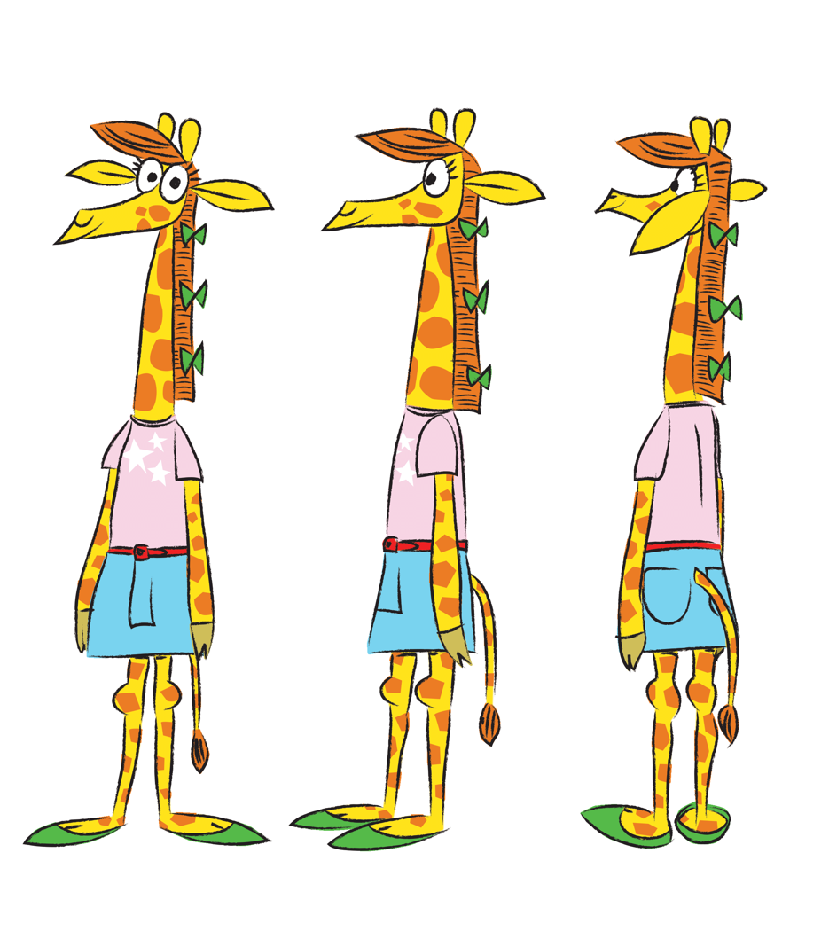
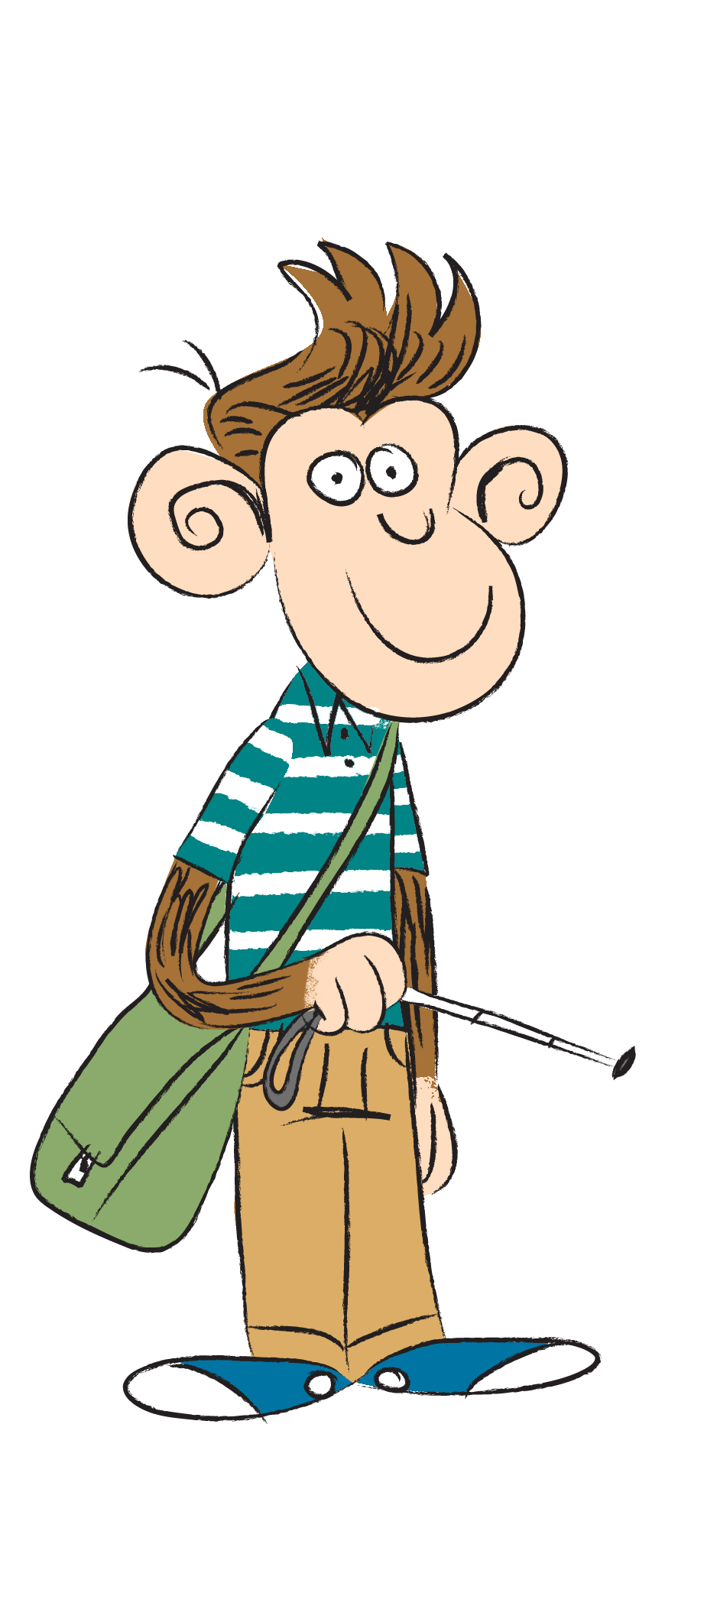
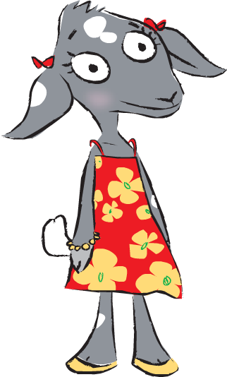
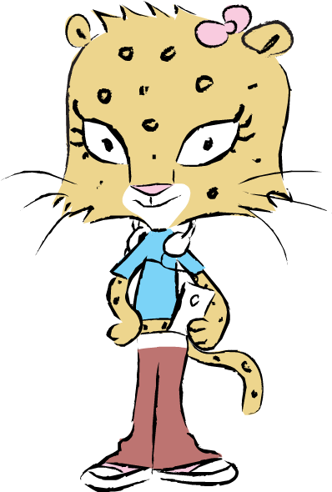
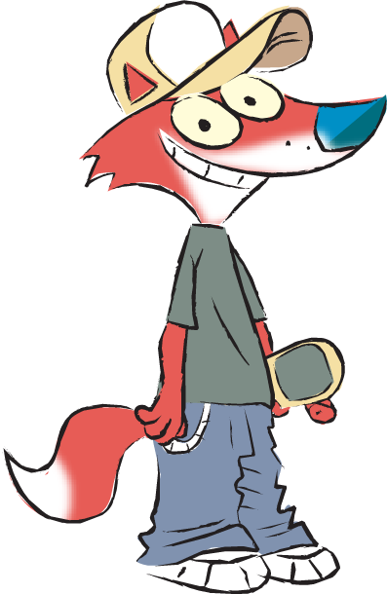
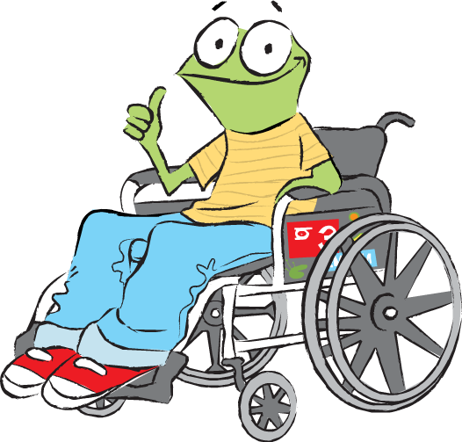
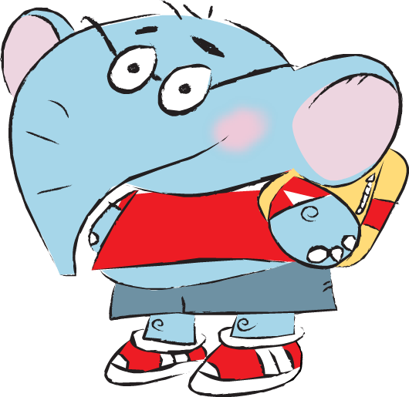
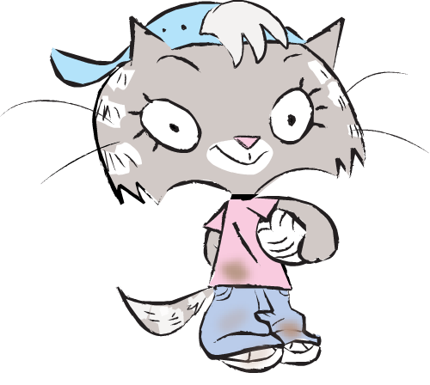
Activity 1:
What is a vote?
The Go‑Givers want to choose a film. They decide to vote so everyone gets a say.
Alba
A vote is a way for everyone to choose something together. Each person picks the option they like best.
What is a vote?
Rio
Ahmeti
Jun
Callum
Pete
Mitali
Anna
Notes:
Activity 1: What is a vote?
Spend 2 minutes on this slide.
Ask children about times they have voted and chosen things using this method. Explain that a vote helps a group choose fairly when people want different things.

Slide 10
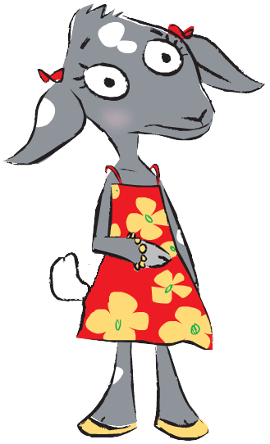



Activity 1:
What is a vote?
Ahmeti is feeling worried.
Talk to your partner
Did the two votes feel the same?
Why do you think that Ahmeti feels this way?
“Sometimes I don’t want the others to know what I have voted for.’’
Let’s try two different ways of voting.
1. Hands up.
2. Heads down, thumbs up.
Notes:
Activity 1: What is a vote?
Spend 3 minutes on this slide.
Run a quick hands‑up vote on a simple question (e.g. favourite fruit, favourite Go‑Giver). Children can see each other’s choices. Run a secret vote using “heads down, thumbs up.” Only the teacher sees the choices.
Ask the class: How did it feel when others could see your vote? How did it feel when your vote was private?
Link to the principle: people should be able to decide without pressure.

Slide 11





Activity 1:
What is a vote?
The Go-Givers decide to use a ‘secret ballot’.
They each write their choice on a piece of paper. This is called a ‘ballot paper’.
They place their ballot paper into a sealed box so no one can see their vote.
Next, the votes are counted using rules that help make the vote fair.
Write down 3 rules that the person counting the votes should follow.
Ballot Paper For Film Night
Vote for one film by putting a cross in the box.
Notes:
Activity 1: What is a vote?
Spend 3 minutes on this slide.
Help guide discussion by focusing on rules that keep the vote fair i.e. Count each vote once. Do not add or remove votes.
Link to the principle: Votes must be counted accurately so the result is fair.

Slide 12


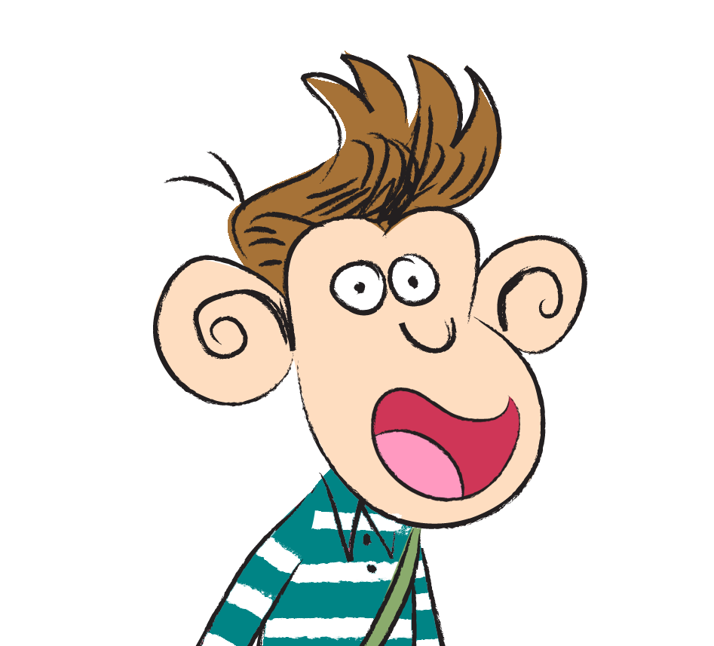
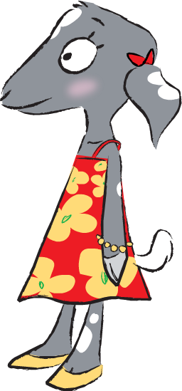
Activity 1:
What is a vote?
All the votes are counted carefully. Frozen won the vote!
Talk to your partner
What would happen if someone got 2 extra votes and everyone else got 1? Is this fair? Why?
I am happy Frozen won!
I voted for Paddington...
Notes:
Activity 1: What is a vote?
Spend 2 minutes on this slide.
Help pupils see why each person voting once matters.
Link to the principle: Every vote is equal!

Slide 13



Activity 1:
What is a vote?
I am not happy that Shaun The Sheep did not win...
Think, Pair, Share
Why might Anna be unhappy?
Should the vote be done again?
Why or why not?
What could you say to Anna to help her feel better?
Notes:
Activity 1: What is a vote?
Spend 2 minutes on this slide.
Support children to understand that feeling disappointed is normal, but because we know the vote was fair – we accept the result. Reinforce the principle: Fair voting doesn’t always mean your favourite choice wins, but everyone had a say.

Slide 14


Activity 2:
Who should represent us?
The Go Givers' school is setting up
a school council.
This is a small group of children who work with the teachers to help make the school better for everybody.
​
Everyone wants to be on the school council but there is only room for six children, so we are going to have an election. We have to vote for the children we think will do the best job!
Notes:
Activity 2: Who should represent us? (Optional Slide)
Spend 2 minutes on this slide.
The Go Givers' school is setting up a school council. This slide gives a basic information of what a school council is. Use this slide to introduce pupils to the concept if your school does not currently operate a school council or similar body. If your school does not currently operate a school council, take this opportunity to ask pupils how they feel about this. Is it something they would like to see happen in school or do they think there are other ways they can make their voices heard? If it's something they would like to see happen, what is the first step they could take?

Slide 15

Activity 2:
Who should represent us?
The Go-Givers are thinking about how they are going to vote in school council elections.
I’m going to vote for Mitali because they are my friend and then they’ll vote for me.
Pick one reason.
What might happen to the whole class if people vote for these reasons?
I’m not going to vote at all because I don’t care who gets onto the school council.
I’m going to vote for Jun because they said they’ll build a swimming pool on the school roof!
Stand up if you think this is a good reason.
Sit down if you think it is unhelpful.
​
Notes:
Activity 2: Who should represent us?
Spend 3 minutes on this slide.
It is school council election day for the Go‑Givers. Explain that we are moving away from “voting to choose something” to “voting to choose someone who will speak for the class”. The people who the Go-Givers are voting for are called candidates.
Work through the different thoughts the Go-Givers are having. Use stand-up/sit-down sorting to help pupils distinguish between helpful vs. unhelpful reasons for choosing.
When discussing consequences, prompt with questions like: Would a swimming pool on the roof really happen? What happens if people vote only for their friends? What happens if lots of people don’t vote at all?
Pupils should understand the core message – the reasons given by the characters on the slide don’t tell us whether the candidate would do a good job for the whole class.

Slide 16
Activity 2:
Who should represent us?
So, what do I need to know about each person before I choose?
As a class, write a list of questions you would want to know about each person before you vote.
Notes:
Activity 2: Who should represent us?
Spend 2 minutes on this slide.
Explain that before we vote, we need to find out useful information about each person who might represent us.
Ask: What would help us choose someone who will speak up for everyone? What questions should we ask to find that out?
Examples pupils may think of: Do they listen to others? Do they have sensible ideas? Do they help everyone, not just their friends? Will they try to keep their promises? Do they make good decisions?

Slide 17
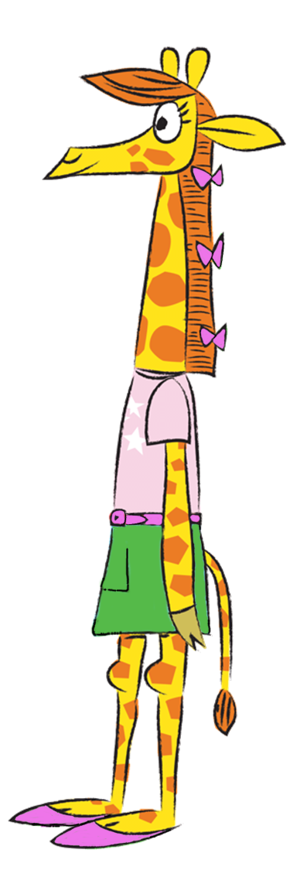

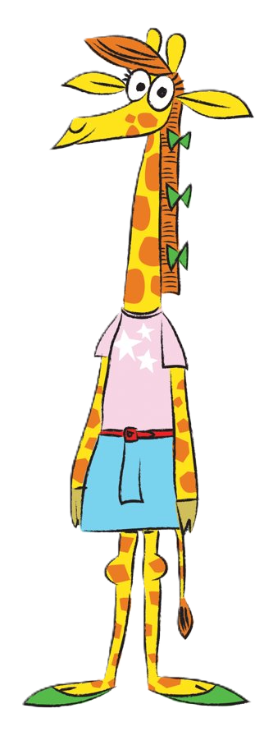
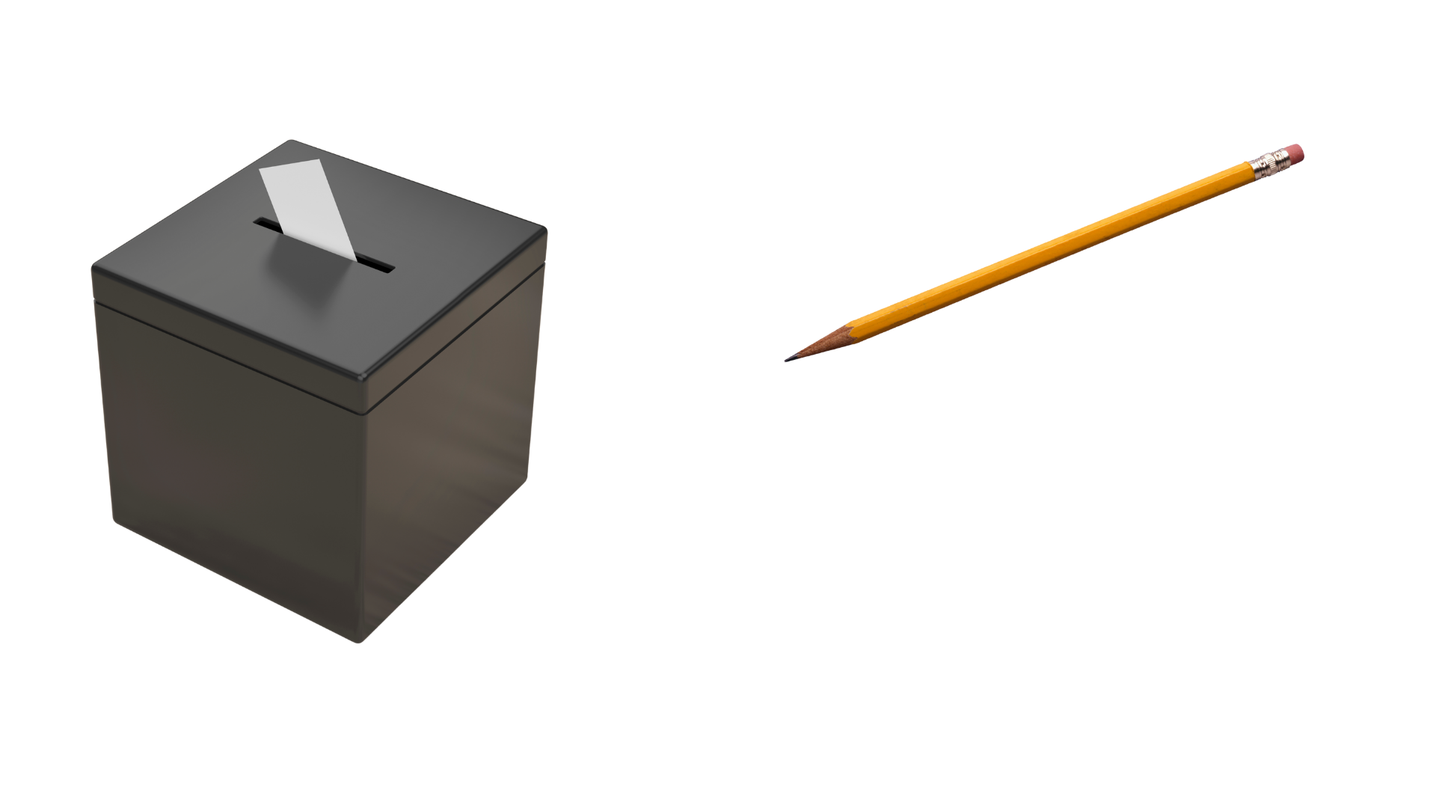
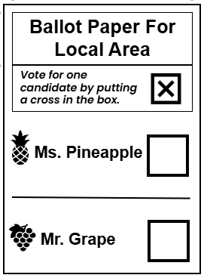
Activity 3:
How do elections work?
Alba wants to see what voting is like in real life.
On the day of the election, they go with their grown‑up to the polling station.
They see lots of people waiting in a queue to cast their vote.
Can you guess what each item is for?
Notes:
Activity 3: How do elections work?
Spend 3 minutes on this slide.
We’ve learned how we vote and what we need to find out about people who might represent us. Now we’re going to see how it works in real life. Explain simply that an election is when grown‑ups vote for who will make decisions for the country or local area. Reinforce definitions for each item on the slide and ask for their purposes.

Slide 18


Activity 3:
How do elections work?
When Alba looks at the ballot paper, they see two names:
Ms. Pineapple
Mr. Grape
Alba wonders:
Ballot Paper For Local Area
Vote for one candidate by putting a cross in the box.
Ms. Pineapple
How do people decide who to vote for?
Mr. Grape
Notes:
Activity 3: How do elections work?
Spend 2 minutes on this slide.
Remind the children that earlier, at the school council elections, we talked about helpful and unhelpful reasons to vote.
Now we’re going to find out helpful information about the candidates in this election to help make a good decision.

Slide 19

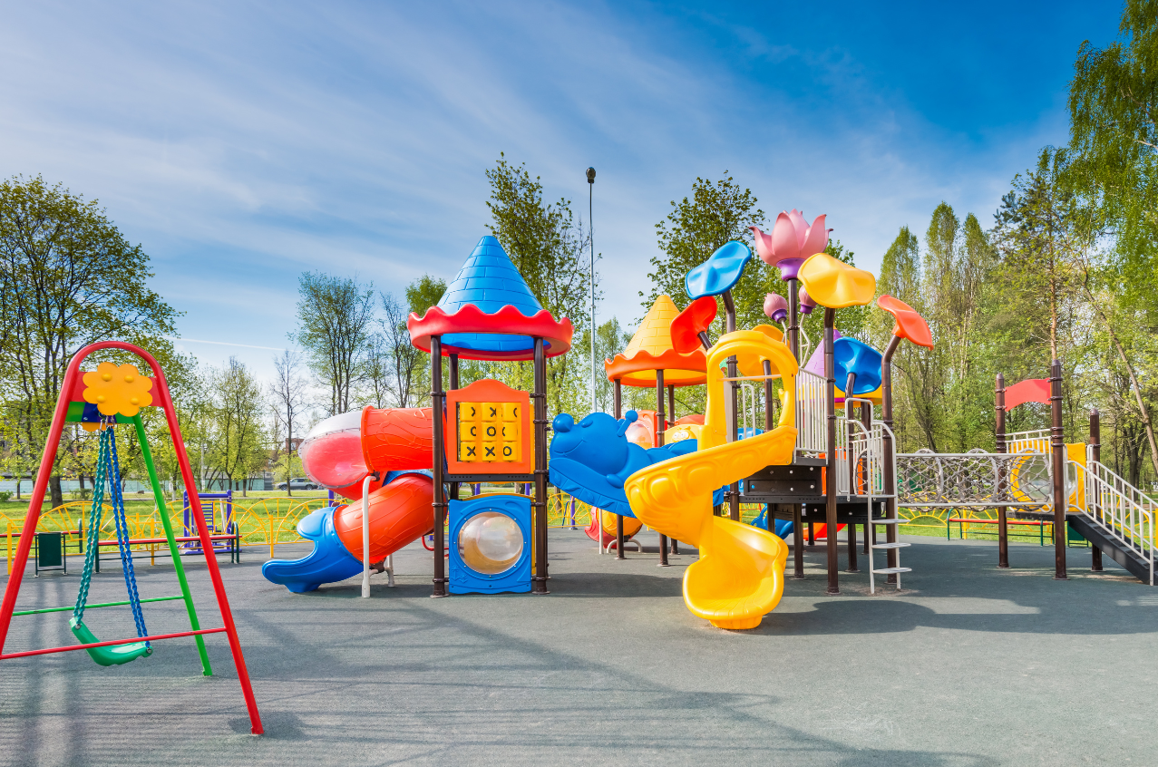
Activity 3:
How do elections work?
Wants to make sure playgrounds are safe
Promises to help keep parks tidy
Thinks it’s important that everyone does their best in school
Ms. Pineapple
Notes:
Activity 3: How do elections work?
Spend 2 minutes on this slide.
Read each point slowly and discuss whether these points are helpful for your community. Who might like these ideas? Why? Focus on noticing the priorities, not judging them.

Slide 20
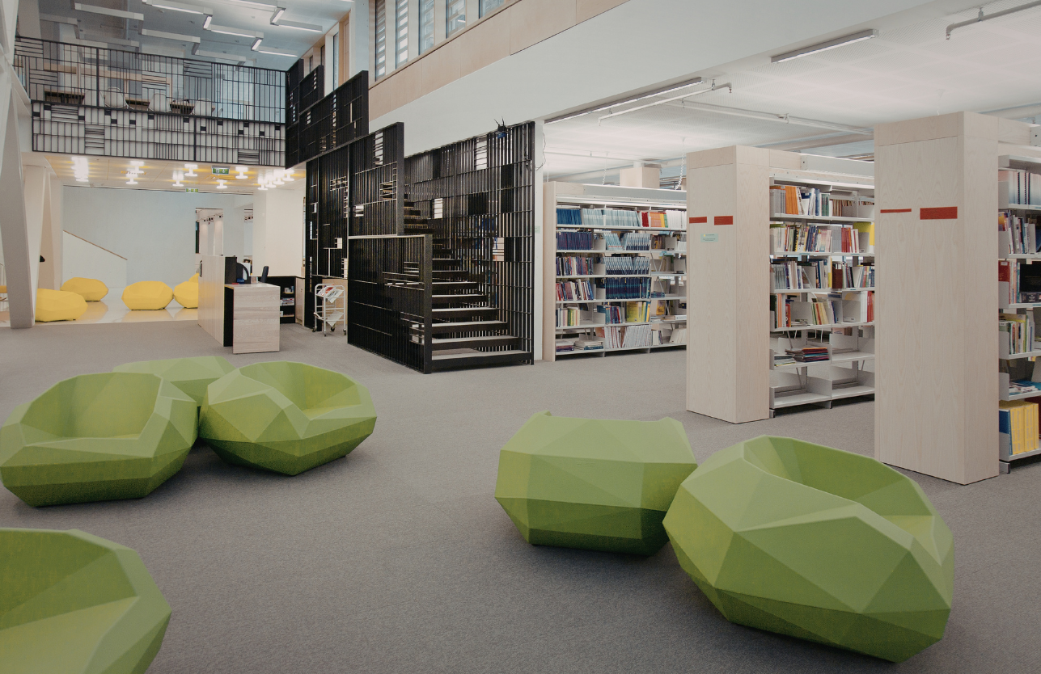
Activity 3:
How do elections work?
Mr. Grape
Wants to improve libraries for everyone
Promises to make roads safer
Thinks it is important that everyone takes turns and listens to each other
Notes:
Activity 3: How do elections work?
Spend 2 minutes on this slide.
Follow the same procedure as for Slide 19. Emphasise to pupils that each candidate cares about different things.

Slide 21
Activity 3:
How do elections work?
Ms. Pineapple
Make playgrounds safe
Parks tidy
Do your best in school
Mr. Grape
Improve libraries
Roads safer
Take turns and listen
Which things do you think are important?
Pick 3 things that you think are the most important and give 3 reasons why.
Just like you, Alba’s adult figured out what was important to them and then made their choice!
Notes:
Activity 3: How do elections work?
Spend 4 minutes on this slide.
Pupils pick three things that matter most to them and explain why. Support the children to use sentence starters such as ‘The 3 most important things for me are...’ ‘This is important to me because...’
Make the point that this is how adults choose too. They use information to choose the person who best matches what matters to them.

Slide 22

The Big Democracy Challenge:
Be A Reporter!
You are a news reporter! Your job is to explain to others what happens in an election and how people choose who to vote for.
Use the words:
vote, ballot paper, candidate, polling station, election
What happens on election days?
How do people choose?
Notes:
The Big Democracy Challenge: Be A Reporter!
Spend 2 minutes on this slide.
This is a challenge activity focused on building oracy skills – encourage pupils to use vocabulary introduced earlier. Encourage expressive voices and gestures. If time allows, invite 2 – 3 groups to present to the class as the live news team. Use the next slide to support pupils planning.

Slide 23
The Big Democracy Challenge:
Be A Reporter!
Hello! This is reporter ___________ speaking.
Today we learned about voting.
I’m here to tell you about what happens on voting day.
First, people go to the...
Then...
When people vote, they choose between...
Today, Ms. Pineapple wanted...
Mr. Grape wanted...
Voters choose by looking at...
That's the end of my report.
Back to the studio!
Use this template letter to write your script.
Don't forget to use the words
vote, ballot paper, candidate, polling station, election
Notes:
The Big Democracy Challenge: Be A Reporter!
Spend 10 minutes on this slide.

Slide 24
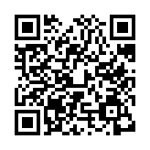
Reflections
Now at the end of the lesson...​
LINK: Complete a quick class reflection.
It takes less than 5 minutes.
Answer honestly: there are no right or wrong answers.
This helps us understand what you learned and how you feel about taking action in your community.
Notes:
Student Reflections
NB: Only you need to scan the QR code or click the link embedded on the slide. The questions are student facing, are done as a group and act as reflective prompts for your class. Optional: screenshot your answers before submitting for your own activity records.

Slide 25
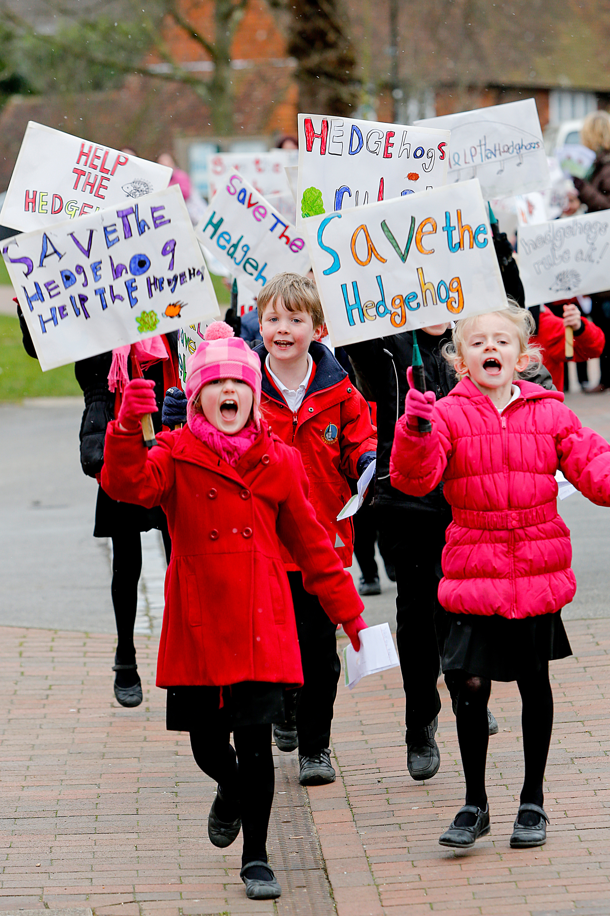
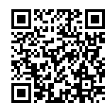
After The Session
Your Thoughts...
Take Citizenship Beyond the Classroom!
We have heard what your students think during the lesson, now tell us how you found it as a teacher:
Give your pupils the chance to lead real change with our Make a Difference Challenge 2026. This immersive programme is designed for primary schools, turning learning into action. Here’s what happens:
Spark Change: Pupils choose an issue they care about. Plan It, Do It: They design and deliver their own social action project.
Shout About It: Celebrate their impact at a regional showcase this July. Secure your place:
www.surveymonkey.com/r/TWPXHQY
Did You Know?
RE
The Electoral Commission also provides resources to support educators:
PSHE
www.electoralcommission.org.uk/resources/resources-educators
Citizenship
www.youngcitizens.org/programmes/make-a-difference-challenge/

