Slide 1



The Big
Democracy
Lesson
Produced in partnership with
Key Stage 2
Lesson Plan & Slides
Notes:
The Big Democracy Lesson: Key Stage 2 Lesson Plan & Slides
For more Big Democracy Lesson resources and information, please head to www.youngcitizens.org/bigdemocracylesson
To find out more information about Young Citizens and our mission, you can check our website at www.youngcitizens.org

Slide 2


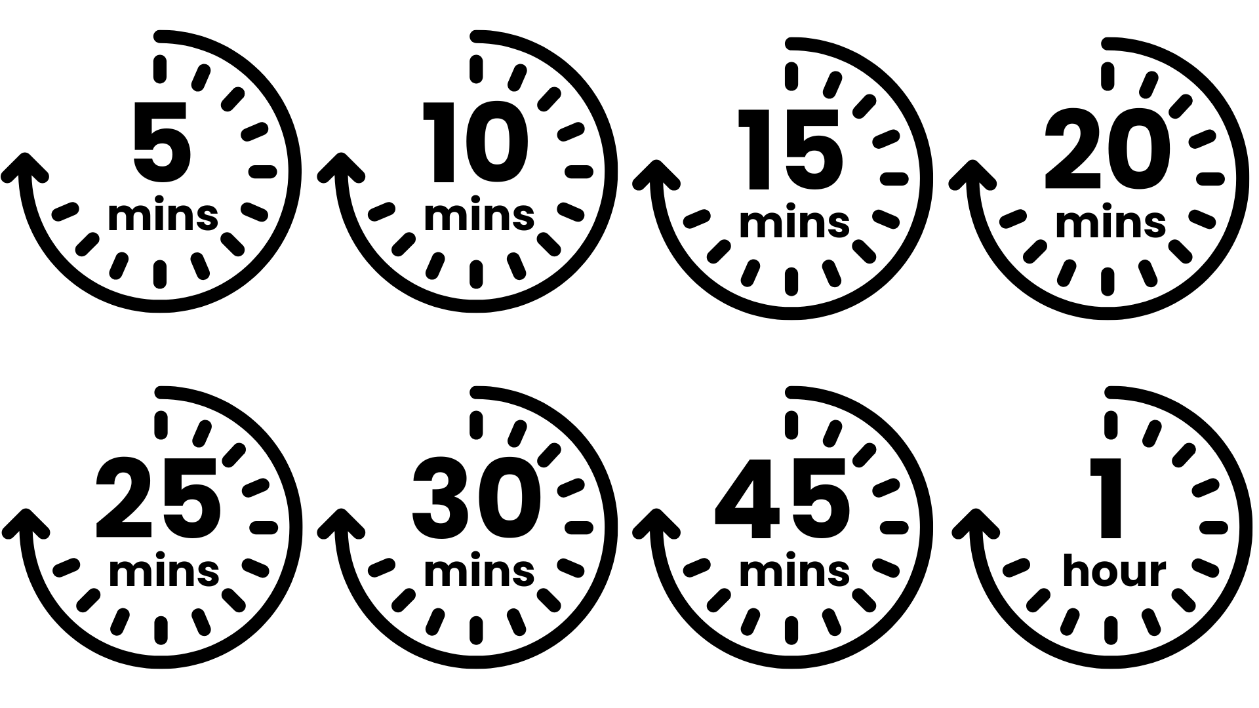




Lesson Preparation
Teacher Checklist
Keyword Definitions
Why Teach
The Big Democracy Lesson?
Democracy – system of governing where citizens get a say in how decisions are made.
Voting – a way of selecting an outcome that takes the opinions of all participants into account and delivers a majority decision. To be effective, the voting process must be free and fair.
National Government - responsible for the issues that affect everyone across the UK.
Parliament – the UK's main law-making body, where laws are debated, changed and approved, and the government is held to account.
Member Of Parliament (MP) - elected to represent the interests of people in a particular area (their 'constituency').
Ofsted Personal Development & Wellbeing
Allow a minimum of 45
minutes to deliver the
lesson.
Familiarise yourself with the Lesson Overview (Slide 3) and slides.
Print copies of the four 'Democratic Roles' worksheets (Slide 4 – 7)for use in Activity 3 'What difference does democracy make to me?' You will need a minimum of one worksheet per small group.
Read the Top Tips & Democracy 101 (Slide 8 and 9).
Curriculum
Citizenship Spiritual, Moral, Social and Cultural development (SMSC)
English
Skills
Critical thinking
Communication
Oracy
Pedagogical Principles
Support on making learning locally relevant and impartial
Notes:
How The Big Democracy Lesson supports Ofsted requirements: Ofsted Personal Development & Wellbeing, Page 44: Ensuring the curriculum contributes to pupils’ personal and SMSC development, supports them to become responsible, respectful and active citizens, and develops their understanding of fundamental British values.
How The Big Democracy Lesson supports Curriculum requirements:
Citizenship: Citizenship Programme of Study (non-statutory), page 3, 2.f and 2.g, Key Stage 2 pupils should be taught 'to resolve differences by looking at alternatives, making decisions and explaining choices; what democracy is, and about the basic institutions that support it locally and nationally'
Spoken English: Primary National Curriculum – English, page 7: 'listen and respond appropriately to adults and their peers; ask relevant questions to extend their understanding and knowledge; maintain attention and participate actively in collaborative conversations, staying on topic and initiating and responding to comments; use spoken language to develop understanding through speculating, hypothesising, imagining and exploring ideas'
SMSC, Fundamental British Values, Page 5 and 6: 'enable students to acquire a broad general knowledge of and respect for public institutions and services in England; encourage respect for democracy and support for participation in the democratic processes, including respect for the basis on which the law is made and applied in England; an understanding of how citizens can influence decision-making through the democratic process'
How The Big Democracy Lesson supports skill development:
Activities are designed to support development of critical thinking, communication and oracy.
If your school uses the Skills Builder frameworks you may be able to map lesson activities to the following steps: Listening 1, 2; Speaking 1, 2, 4, 6, 8; Problem Solving 1, 3, 6, 7.

Slide 3
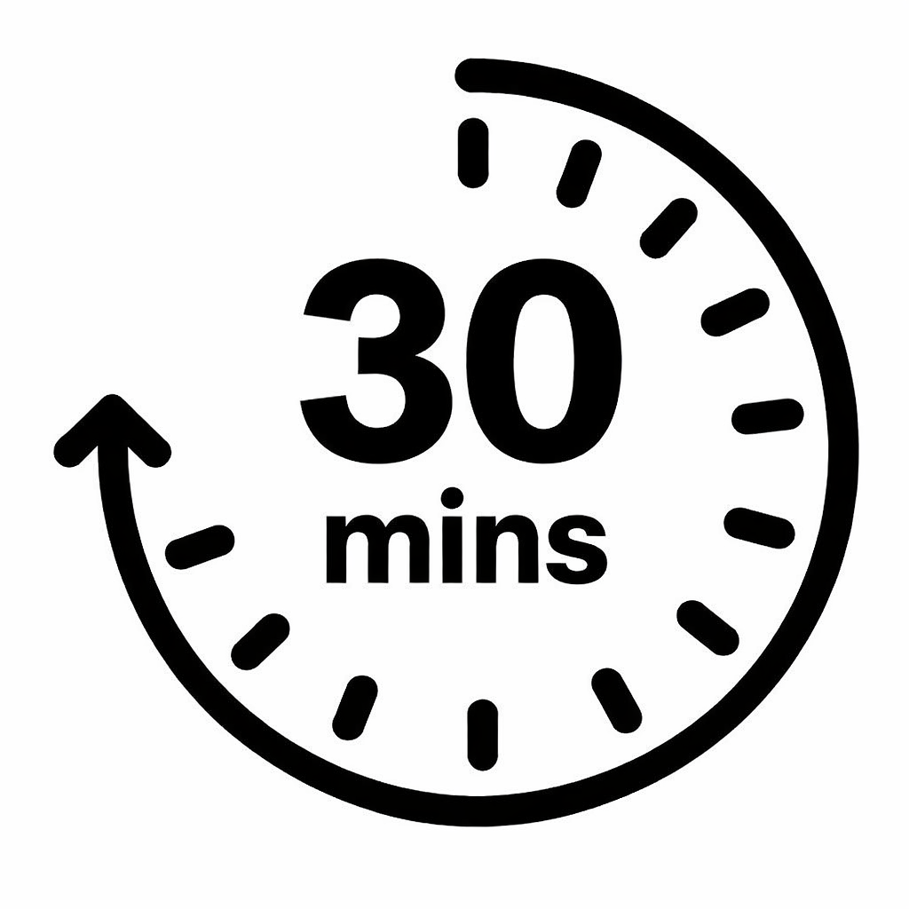
Lesson Overview
Activity 1
Activity 2
Activity 3
How should we decide?
Slides 10-11
Start the lesson by introducing a
decision and talk through three ways of making it. Together as a class, carry out the three different methods for deciding. Encourage pupils to reflect in pairs on each one, using the prompts on screen.
Slide 12
Introduce the learning objectives of the session.
Slide 13
Introduce pupils to the concept
of democracy and explain that we will be looking more closely at how it works throughout the rest of the lesson.
How does democracy work?
Slide 14
Challenge pupils to match the
different roles in a democracy with the description of what they do, then reveal the correct sorting on the screen.
Emphasise that we all have a role to play, regardless of where we live, what we do, and how old we are.
What difference does democracy
make to me?
The Big Democracy Challenge:
Be the MP
Slide 15-16
Using the real-life example of a community issue on the slide, support pupils to work through the different roles in a democracy, spotting how they can help, completing the Democratic Roles Worksheets (Slides 4-7) and feeding back to the class.
Slide 17-19
Explain that pupils will now take part in a challenge to help them understand what MPs do. Use the prompts and notes to introduce pupils to the different aspects of an MP's role, support them to make a speech, debate and vote on a solution to the issue from Activity 2.
Slide 20
Scan the QR code/click the link and submit your class reflections on what they have learnt.

Slide 4


WORKSHEET: DEMOCRATIC ROLES
Role | What they do | What can they do about this problem?
Citizens | People notice problems and speak up when something feels unsafe or unfair. They can share ideas and ask for help. | We could tell... We could ask for... We could work together by...
Notes:
Worksheet Print Out For 'Activity 3: What difference does democracy make to me?' on slide 15.

Slide 5

WORKSHEET: DEMOCRATIC ROLES
Role | What they do | What can they do about this problem?
Member of Parliament (MPs) | MPs listen to people in their area and try to help. They can talk to the council, visit the community to understand what’s happening, or ask questions in Parliament. | Our MP could help by... They can talk to... They can ask about...
Notes:
Worksheet Print Out For 'Activity 3: What difference does democracy make to me?' on slide 15.

Slide 6

WORKSHEET: DEMOCRATIC ROLES
Role | What they do | What can they do about this problem?
Parliament | Parliament talks about ideas for laws and checks whether rules are keeping people safe. They can ask the Government questions. | Parliament can check... They can ask the government...
Notes:
Worksheet Print Out For 'Activity 3: What difference does democracy make to me?' on slide 15.

Slide 7

WORKSHEET: DEMOCRATIC ROLES
Role | What they do | What can they do about this problem?
Government | The Government runs the country. They make safety plans, give money to local councils, and lead road‑safety work. | The Government can make… They can give money for… They can help by…
Notes:
Worksheet Print Out For 'Activity 3: What difference does democracy make to me?' on slide 15.

Slide 8
Top Tips
Local Relevance
Preparation
Impartiality
This resource is designed to create a space where pupils can practice respectful discussion and begin to see the importance of democracy to their everyday lives.
To ensure this topic feels relevant to your pupils, consider:
Swapping the decision made on Slide 10 for one your class needs to make in real life.
Swapping the 'community issue' in Slide 15 for one which will resonate with your pupils.
Using Find your MP - MPs and Lords - UK Parliament before or during the lesson, to find out who your local MP is and access a picture of them to show the class.
Consider differentiating so EAL and SEND pupils can access the learning and express their ideas.
Think about your pupils’ experiences and possible preconceptions around government and different political parties. How might these shape their understanding of democracy?
Identify any topics that may come up that cause you to feel uncomfortable – acknowledge these to yourself and consider how you will equip yourself to handle these.
Use familiar classroom routines to support discussion, such as your class agreement or strategies like "respectful disagreement", “right to pass” and “respectful listening.” Encourage pupils to share ideas using simple sentence starters, for example:
I think…
I agree because... I don’t agree because…
I like that idea…
My idea is…
Teaching about democracy can lead to conversations about different political views, various groups and communities and what is the “right” or “wrong” way to run the country.
At this age, pupils may share strong opinions based on their experiences or things they’ve heard.
This means that impartiality in the classroom is important - but impartiality doesn't mean avoiding certain subjects – even ones you have strong beliefs about.
Impartiality does mean:
Avoiding promoting partisan political views
Providing a balanced presentation of views
Challenging extremist or discriminatory views
Addressing misinformation
Supporting students in distinguishing fact from opinion

Slide 9
Democracy 101
What is democracy?
Democracy is one way of organising a system of government. In a democracy, political power is granted by the people, usually through elections in which citizens choose representatives to make decisions on their behalf.
In democratic systems, voting gives citizens a role in shaping how the country is governed.
Through elections, people can:
help decide who holds political authority;
influence the laws, rules, and policies that affect their lives;
replace leaders or representatives if they feel change is needed.
What are elections?
Elections are a method many democracies use to choose people who will represent the public. During an election, eligible voters select between candidates or parties, and the results determine who will take on political responsibilities. Different elections in the UK work differently. For more information on how they work, please visit: How elections work | Electoral Commission
For elections to function effectively, they depend on certain principles, such as:
people being able to vote freely, without intimidation;
votes being counted accurately;
elections being held regularly;
voters having a genuine choice between candidates or parties;
access to reliable information so people can make informed decisions.

Slide 10



Activity 1:
How should we decide?
We’re going to decide who is going to pick our classroom book this week.
Round 1: Teacher decides
Round 2: Random choice
Round 3: Class vote (hands up)
Notes:
Activity 1: How should we decide?
Spend 5 minutes on this slide.
Introduce the session by explaining that the class will explore how people make decisions together and why it matters. Present one choice that you need to make (e.g., next class book, a fun activity, or what the next classroom display should be). Ideally this should be a decision that you actually do want the pupils to get involved in! Method 1: Teacher decides. Announce your choice without consultation. Ask pupils: How did that feel? Why? Encourage honest responses. Highlight any feelings of frustration or exclusion. Method 2: Choose a slip of paper at random to decide. Ask: Does randomness feel fair? Why or why not? Help pupils notice that although randomness gives every option an equal chance, it still doesn’t let them express their views. Method 3: Pupils raise hands for their preferred option. Emphasise that everyone gets a voice. Count votes clearly so pupils can see the decision being made.

Slide 11

Activity 1:
How should we decide?
Talk to your partner
Which one felt fairest? I thought it was unfair/fair because...
Which one made sure everyone had a say?
Which one worked best?
Notes:
Activity 1: How should we decide?
Spend 2 minutes on this slide.
Guide reflection: Which method felt fairest? Which gave everyone a chance to be heard? Explain that they have just experienced different ways people make decisions, and that in society we use voting as part of a system called democracy: where people have a say in how things are run. Link explicitly: “What we just did helps us understand how decisions are made fairly in a democracy.”

Slide 12


Lesson Objectives
By the end of the lesson, I will be able to...​
Explain what a democracy is
Give examples of different roles in a democracy
Explain my role within a democracy
Notes:
Lesson Objectives
Spend 1 minute on this slide.
Read through the objectives and check students' understanding.
Flag that you will be asking them to reflect on how they achieved these at the end of the lesson.

Slide 13

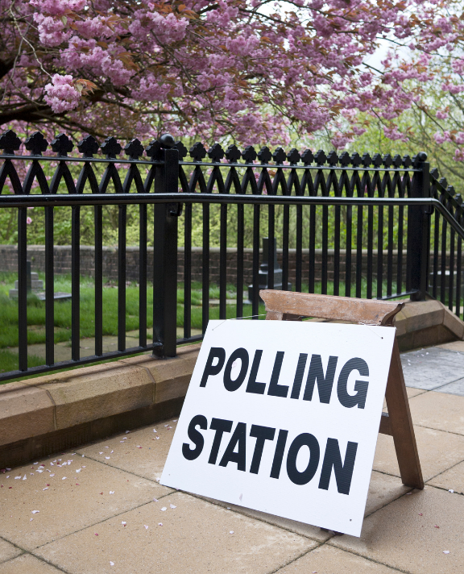



Activity 1:
How should we decide?
Democracy means people have a say in how decisions are made.
Why is this important?
Think, Pair, Share
Notes:
Activity 1: How should we decide?
Spend 2 minutes on this slide.
Introduce the purpose of the activity by explaining that now pupils have experienced different ways of making decisions, it is time to learn more about the system we use where everyone gets to have their say: democracy. Explain that democracy is not just something adults talk about: it is an idea that shapes how schools, communities, local areas, and the whole country can make fair decisions. Remind pupils: 1) When we vote as a class, that is a small example of democracy. 2) When pupils share views with their teacher or school council, that is part of having a say. 3) When adults vote for MPs, that is democracy at a national level.
Pose the question: Why is it important for people to have a say in decisions? Give pupils quiet thinking time. Then ask them to share their ideas with a partner before taking whole-class contributions.
Encourage pupils to justify their views: Why is it fair when everyone gets a say? What might happen if only one person made all the decisions? How does listening to different ideas help us make better choices?

Slide 14

Activity 2:
How does democracy work?
1. Citizens
We run the country day‑to‑day, create ideas for new laws and are led by the Prime Minister.
2. Member of Parliament
B. I have a say in how the country is run because I vote in elections.
C. We debate and check ideas for new laws. We hold the government to account
3. Parliament
D. I represent people in my local area and help them. I ask questions and check the Government’s work. I take part in debates and help make laws.
4. Government
Notes:
Activity 2: How does democracy work?
Spend 5 minutes on this slide.
Explain that a democracy works because different people and groups have different jobs.
Challenge the students to match the roles of People, MPs, Parliament and Government to the descriptions on the slide.
Reveal the correct sorting on screen.
Explain that our democracy works because people participate, MPs represent, Parliament checks and debates, and the Government leads.
Highlight that children also participate by sharing views, helping their community, and taking part in school democracy.
Optional extension: if your class are confident around these concepts already, check they understand that voting takes place for both local and general (national) elections, meaning that eventually they can participate meaningfully in government at both local and national levels.

Slide 15
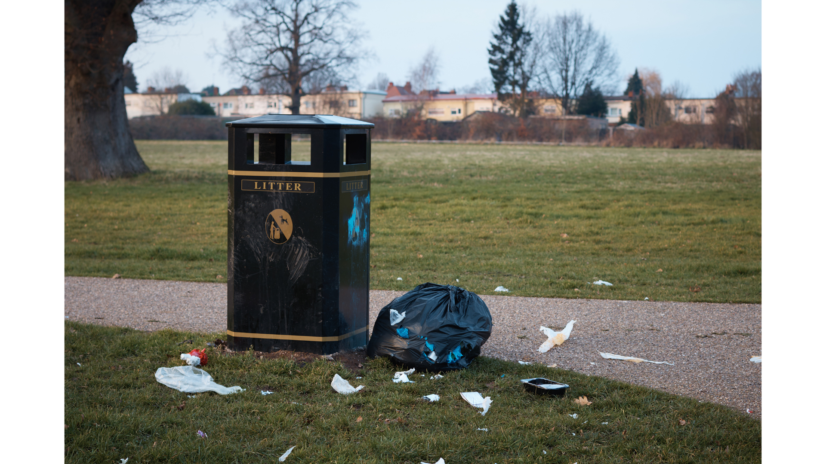
Activity 3: What difference does democracy make to me?
The local park is a mess. There's rubbish everywhere, especially plastic bottles which people use once and throw away. Some people walk their dogs there, but they don't always clean up after them.
Why is this a problem? Who might be able to help?
Notes:
Activity 3: What difference does democracy make to me?
Spend 10 minutes on this slide.
Introduce the problem. You may choose to replace the problem with something that resonates better with your classroom (e.g. litter on beaches, busy roads, improving the facilities in the local hospital). Give each group one of the 'Democratic Roles' worksheets to fill out. Support each group to draw links between ‘What they do?’ and how this may help solve the problems in the park.

Slide 16
Activity 3: What difference does democracy make to me?
What is the solution?
Notes:
Activity 3: What difference does democracy make to me?
Spend 5 minutes on this slide.
Invite each group to share with the rest of the class, using the notes they made on their worksheets to support them. You can use the arrows to write their responses with the interactive whiteboard, or can use pieces of paper/post-it notes to add their main ideas to the board.
Sum up by explaining that democracy works because different roles support each other and children can also take part by sharing views and looking after their community.

Slide 17
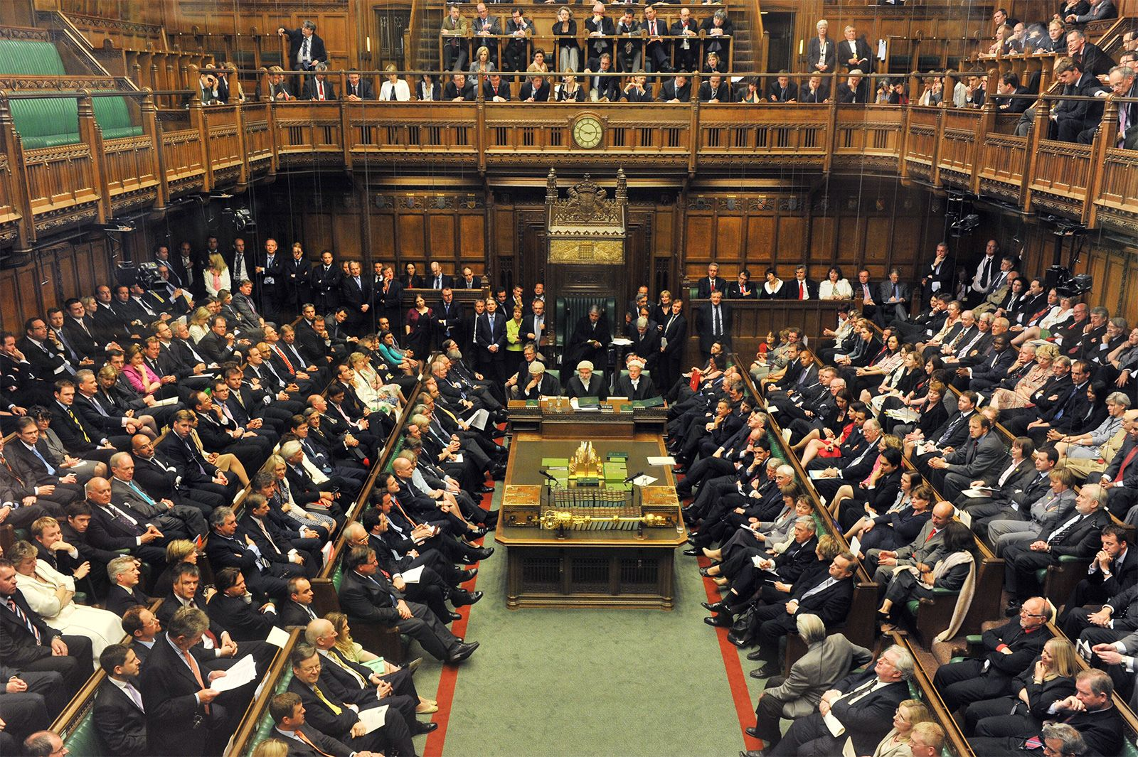
The Big Democracy Challenge:
Be the MP
In Parliament, MPs do not just make laws, they also debate to represent their constituents' views. A debate is when MPs share their ideas, listen to each other, and explain what they think should happen.
Debates are important because they help MPs: • understand different sides of a problem • think carefully before making a decision • check and challenge the Government’s ideas • make sure decisions are fair for everyone
Today, you will imagine you are an MP speaking in Parliament about our community’s problem.
Notes:
Activity 3: The Big Democracy Challenge: Be the MP
Spend 5 minutes on this slide.
Explain that MPs do more than vote and make laws: a big part of their job is debating, which means sharing ideas, listening to others, and thinking carefully before decisions are made. Emphasise that debate helps MPs understand different points of view and check the Government’s ideas to make sure decisions are fair.

Slide 18
The Big Democracy Challenge:
Speech Structure & Sentence Starters
Problem: The local park is a mess. Full of single-use plastic and other litter.
My name is ... and I am speaking for...
The problem is...
This is not good because...
I think we should...
This will help because...
I am asking the Government to...
Your job is to represent your community and explain what you believe should be done to make the park better.
Notes:
The Big Democracy Challenge: Speech Structure & Sentence Starters
Spend 5 minutes on this slide.
Remind pupils of the community problem they encountered on Slides 15 and 16.
Tell pupils they will step into the shoes of an MP and speak “in Parliament” about this issue.
The speeches will last 1 minute – they need to explain the problem, why it matters, and what they think should happen.

Slide 19

The Big Democracy Challenge:
Debate Begins & Voting
Our debate rules: • Wait your turn to speak
• Listen respectfully, so you can agree or disagree with others when you speak • Focus on helping the community • Explain your reasons • Keep it kind and simple
Which idea do you think will help solve the problem?
Let’s vote!
Notes:
The Big Democracy Challenge: Debate Begins & Voting Slide
Spend 5 minutes on this slide.
Set the expectation for respectful listening so the debate feels fun and safe.
After the speeches, move straight to the class vote: explain that pupils are voting for the idea, not the person. You may want to get pupils to put their head down and then put their thumbs up to vote. Count thumbs clearly and announce the winning idea.
Close by reinforcing that this is how Parliament works: people speak, ideas are shared, and a fair vote helps make a final decision.

Slide 20
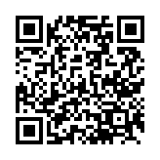
Reflections
Now at the end of the lesson...​
LINK: Complete a quick class reflection.
It takes less than 5 minutes.
Answer honestly: there are no right or wrong answers.
This helps us understand what you learned and how you feel about taking action in your community.
Notes:
Student Reflections
NB: Only you need to scan the QR code or click the link embedded on the slide. The questions are student facing, are done as a group and act as reflective prompts for your class. Optional: screenshot your answers before submitting for your own activity records.

Slide 21
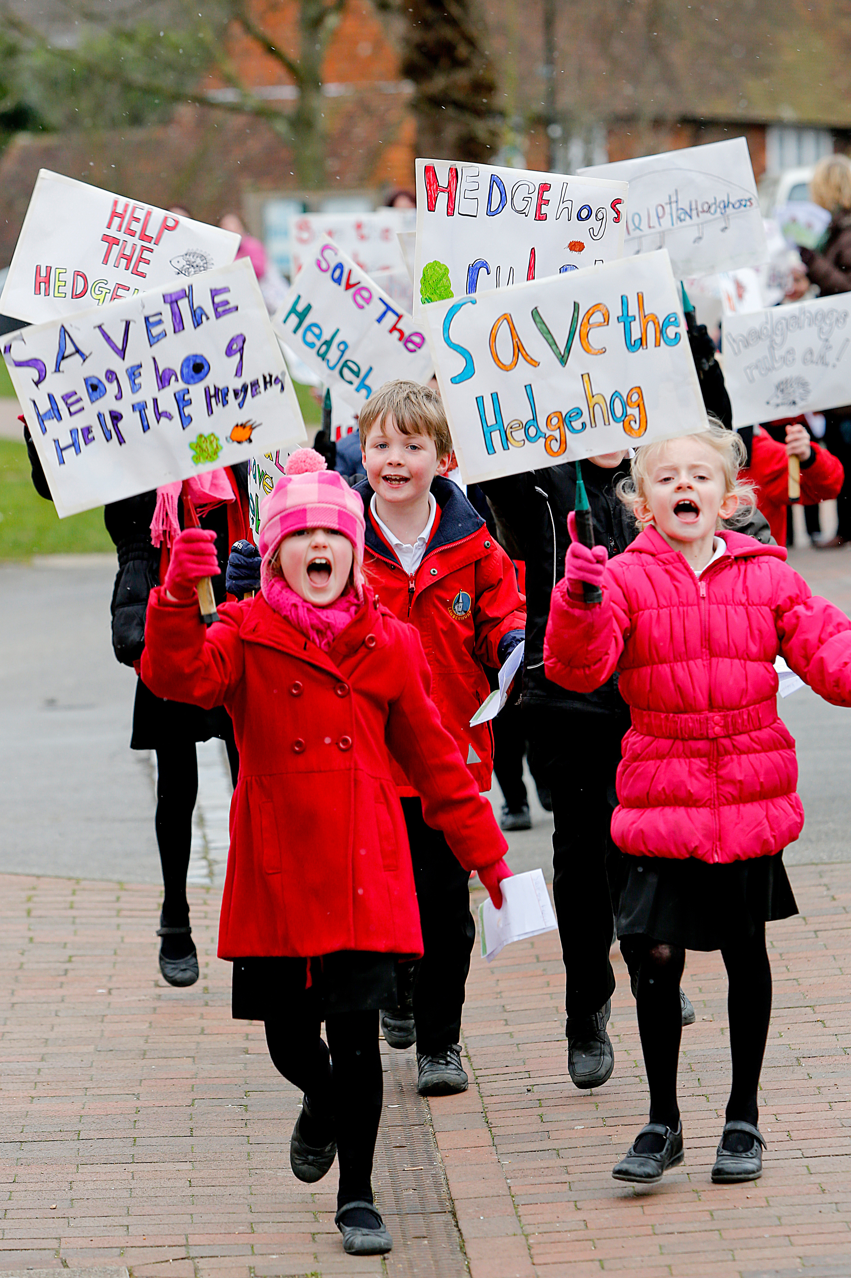
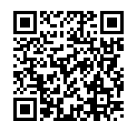
After The Session
Your Thoughts...
Take Citizenship Beyond the Classroom!
We have heard what your students think during the lesson, now tell us how you found it as a teacher:
Give your pupils the chance to lead real change with our Make a Difference Challenge 2026. This immersive programme is designed for primary schools, turning learning into action. Here’s what happens:
Spark Change: Pupils choose an issue they care about. Plan It, Do It: They design and deliver their own social action project.
Shout About It: Celebrate their impact at a regional showcase this July. Secure your place:
www.surveymonkey.com/r/TWPXHQY
Did You Know?
RE
The Electoral Commission also provides resources to support educators:
PSHE
www.electoralcommission.org.uk/resources/resources-educators
Citizenship
www.youngcitizens.org/programmes/make-a-difference-challenge/

