Slide 1



The Big
Democracy
Lesson
Produced in partnership with
Primary
Spark Activity Pack
Notes:
The Big Democracy Lesson: Primary Spark Activity Pack
For more Big Democracy Lesson resources and information, please head to www.youngcitizens.org/bigdemocracylesson
To find out more information about Young Citizens and our mission, you can check our website at www.youngcitizens.org

Slide 2



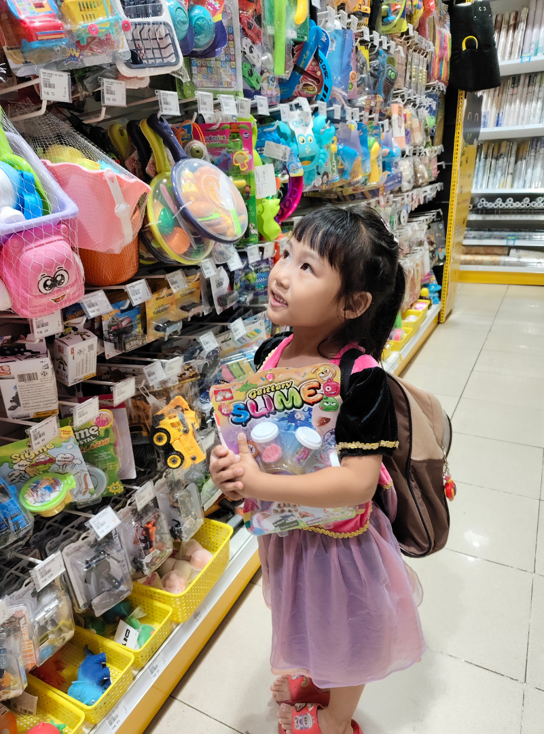



Spark Activity 1: Big Decisions
How shall we choose?
Think to yourself:
What was the last thing you chose by yourself? What things do you choose together with your family or class?
Talk to your partner:​
Is choosing alone or choosing together easier?
What could happen if we don’t all agree?
Together as a group:
List 3 ways we can make a decision as a group. Which of these ways feels the fairest for everyone?
Idea for Action:​
Spot a decision you need to make during the day and try using one fair way from your list to decide together.
Notes:
Spark Activity 1: Big Decisions Key concept: Decisions & fairness
A decision is when you choose between different options.
Some decisions are made by one person; others involve a group.
Fairness: when everyone gets a chance to share or be included.
When more than one person is affected, people often think about fair ways to choose.
Fairness can include listening to others, sharing ideas, or using a method everyone agrees on like voting.

Slide 3
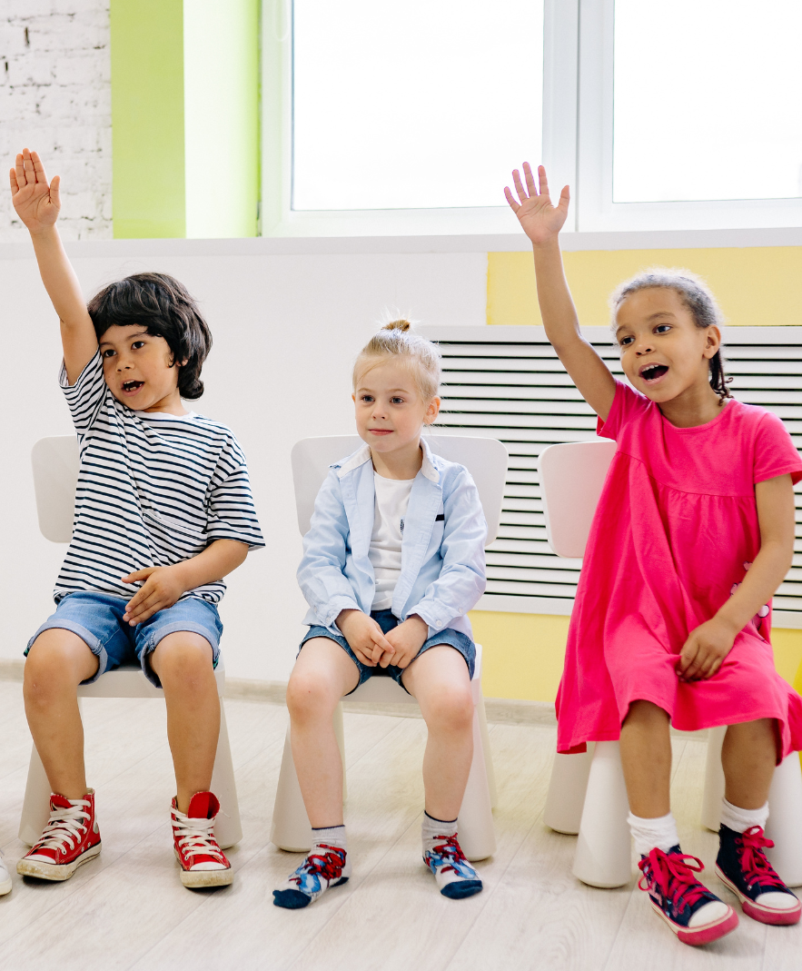
Spark Activity 2: Voting
What makes it fair?
Think to yourself:
Have you ever taken part in a vote?
Did the choice you voted for win?
Talk to your partner:​
What makes a vote fair for everyone?
Together as a group, complete these sentences:
For a vote to be fair, everyone gets a ____. All the votes are _____ . People can keep their votes ____ if they want to.
Idea for Action:​
Use a vote to decide something today and check: did everyone get a turn, were all choices counted, and did everyone feel comfortable choosing?
Notes:
Spark Activity 2: Voting
Key concept: What is a vote?
A vote is a way for a group to choose something together, where each person picks the option they prefer.
Voting is often used when people want different things and need a fair way to decide.
Everyone gets a (e.g., turn / say). All the votes are (e.g., counted). People can keep their vote (e.g., private / secret) if they want to.

Slide 4
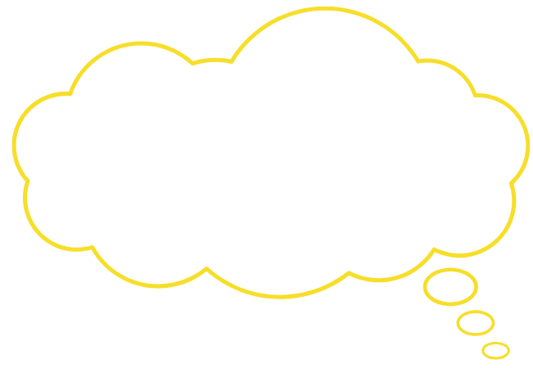
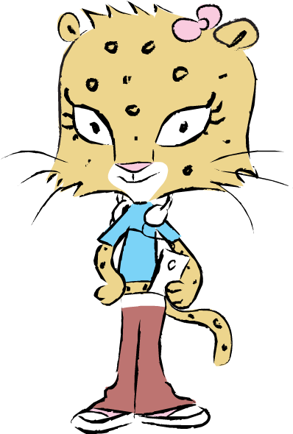
Spark Activity 3: Voting for others
Who gets your vote?
Think to yourself:
If our class needed one person to share our ideas or speak for us, what kind of person would you choose?
I’m going to vote for Mitali because they are my friend and then they’ll vote for me.
Talk to your partner:
Look at the picture. Is this a good reason to choose someone?
Why or why not?
Together as a group:
What makes someone good at speaking up for everyone: not just for themselves or their friends?
Idea for Action:​
Using your list above. Spot a moment during the day when someone shows that quality.
Notes:
Spark Activity 3: Voting for others
Key concept: Representation
When choosing representatives, it helps to think about who will listen to others, act for everyone, and make sensible decisions.
Choosing people based only on friendship or unrealistic promises is not helpful for the whole group.

Slide 5
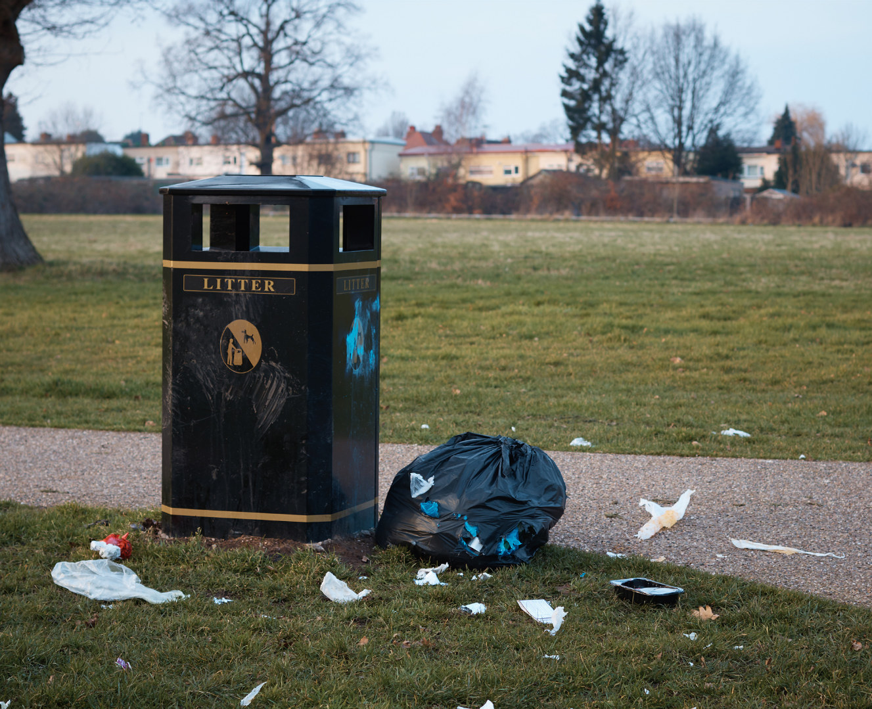
Spark Activity 4: Community
What do I want to change?
Think to yourself:
Is there something in your local area that you would like to make better?
Talk to your partner:
Share your idea. Could you make this change on your own, or would you need someone to help you?
Together as a group:
List all of the people who could help you make this change.
Idea for Action:​
Draw a simple map showing the people who could help make your idea happen. Add small pictures to show who could help with different parts of the change.
What is the solution?
Notes:
Spark Activity 4: Community Key concept: Citizenship & community
A community is the place where you live, learn or play.
Anyone can spot problems or things that could be improved (e.g., litter, safety, equipment).
A citizen is someone who notices problems, speaks up, shares ideas and asks for help when something feels unsafe or unfair.
Change often involves more than one person: sharing ideas is the first step to working together.

Slide 6
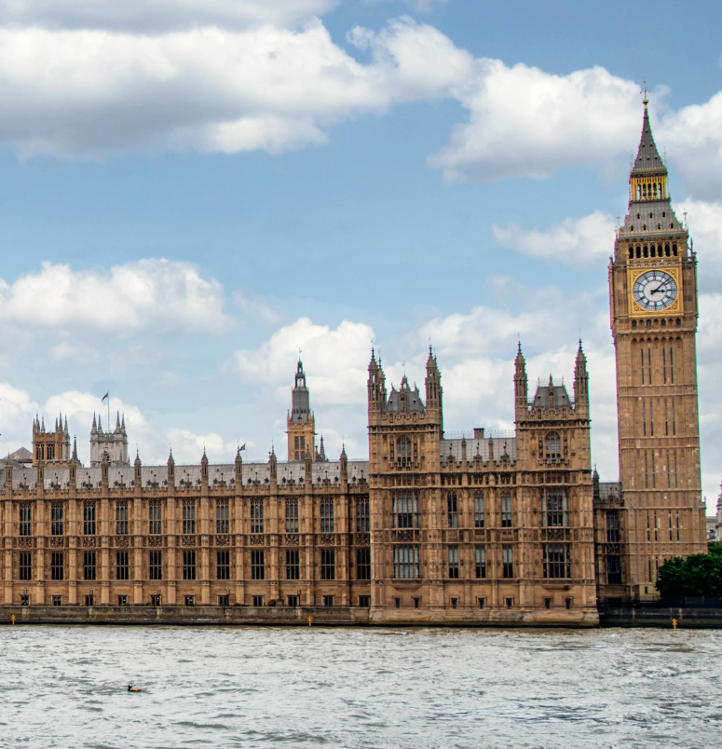
Spark Activity 5: Parliament
How does our country make decisions?
Think to yourself:
What big problems or ideas can affect lots of people across the country?
Talk to your partner:
Where do you think people talk about these big problems? Who might make decisions that affect the whole country?
Together as a group:
If you could tell one grown‑up leader about something that matters to you, what would you want them to talk about?
Idea for Action:​
As a class, find out who your member of parliament is.
Notes:
Spark Activity 5: Parliament Key concepts: Parliament, MPs, national decisions
Parliament is the main place where decisions for the whole country are debated, checked and agreed.
A Member of Parliament (MP) represents people living in a particular area.
MPs listen to local concerns and can ask questions or raise issues in Parliament.
Some issues affect everyone in a country, so decisions about them need to be made at a national level.

Slide 7

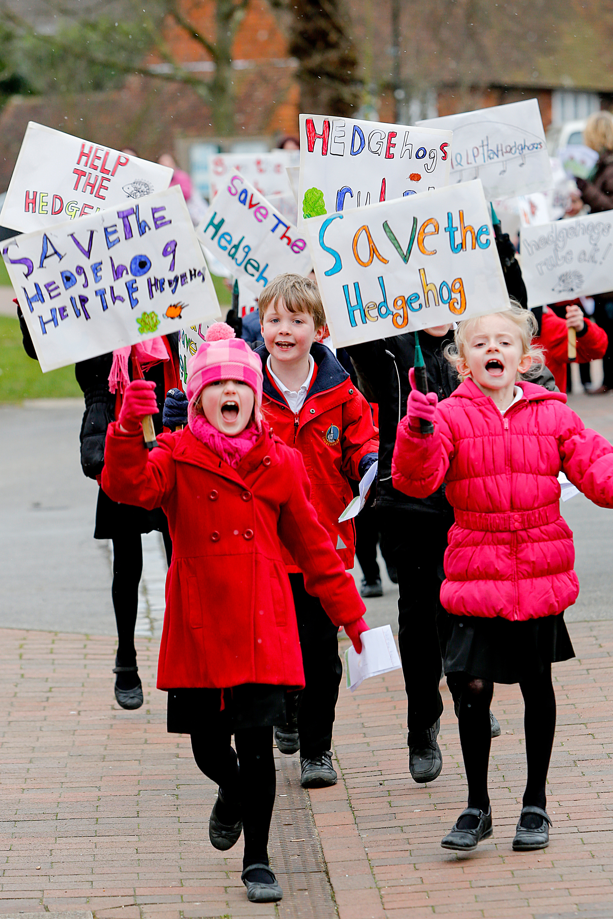
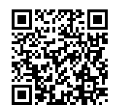
After the session
Your thoughts...
Take Citizenship Beyond the Classroom
Tell us how you found this resource as a teacher.
Give your pupils the chance to lead real change with our Make a Difference Challenge 2026.
Join the Summer of Social Action. This immersive programme is designed for primary schools to turn learning into action. Here’s what happens:
Spark Change: Pupils choose an issue they care about. Plan It, Do It: They design and deliver their own social action project.
Shout About It: Celebrate their impact at a regional showcase this July. Secure your place:
www.surveymonkey.com/r/TWPXHQY
Did You Know?
The Electoral Commission also provides resources to support educators:
www.electoralcommission.or.uk/resources/resources-educators
www.youngcitizens.org/programmes/make-a-difference-challenge/

