Slide 1




The Big
Legal Lesson
Sponsored by
KS1
Notes:
The Big Legal Lesson: Key Stage 1 Lesson Plan & Slides
Thank you for taking part in The Big Legal Lesson 2026. You are joining a network of thousands of teachers across England and Wales who are committed to developing children’s knowledge of the rule of law and their legal rights.
For more The Big Legal Lesson resources and information, please head to www.youngcitizens.org/programmes/the-big-legal-lesson/
To find out more information about Young Citizens and our mission, you can check our website at www.youngcitizens.org

Slide 2

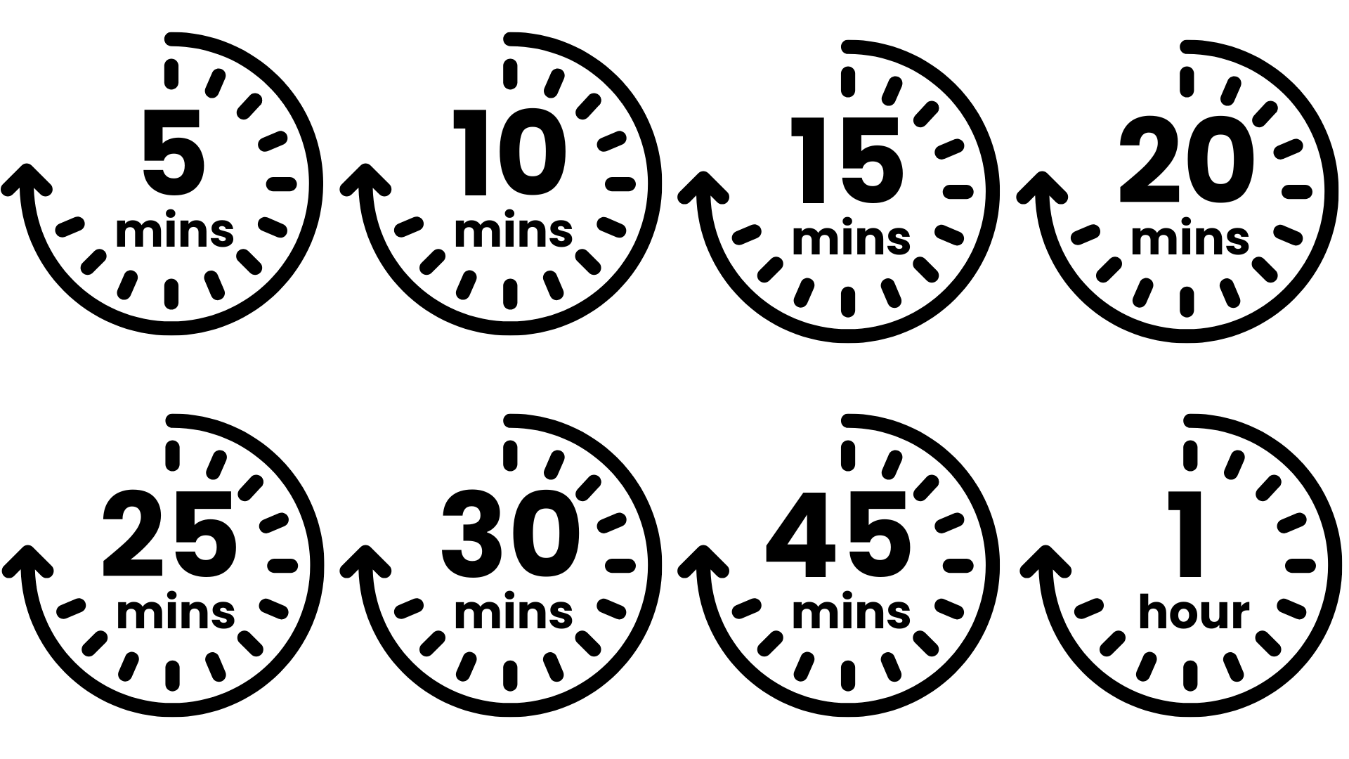




Lesson preparation
Teacher checklist
Keyword definitions
Why teach
The Big Legal Lesson?
Allow a minimum of 45
minutes to deliver the
lesson.
Familiarise yourself with Lesson Overview (Slide 3) and slides.
Read the Top Tips & Rule of Law 101 (Slide 5 and 6).
Read the 'Notes' for teacher guidance and additional prompts.
For 'Rule or Law', we have the option to print Slide 4 to use as a worksheet or look at the activity variations to work as a class.
There are optional extension activities to extend the learning if you have time available.
Rule of Law - a set of principles for a fair and effective society where everyone is accountable to the law.
Parliament - made up of elected MPs in the House of Commons and appointed Lords in the House of Lords. Responsible for creating and amending laws.
The Government - sets the agenda for new laws, drafting them with lawyers and implementing them once passed.
The Judiciary - system of courts and judges, responsible for interpreting and applying existing laws.
Bill - a proposal for a new law, or to change an existing law.
Act - a bill which has been passed by Parliament and given royal approval, making it official law.
Ofsted
Personal Development & Wellbeing
Curriculum
Citizenship
SMSC
English
Skills
Critical thinking
Communication
Oracy
Pedagogical principles
Support on making learning locally relevant and impartiality
Notes:
Full Ofsted and Curriculum References
Ofsted
Schools Inspection Toolkit, Page 47: 'In gathering evidence about the personal development programme, including pupils’ SMSC development, inspectors consider the extent to which: pupils develop their ability to recognise the difference between right and wrong, including...recognising legal boundaries and respecting the civil and criminal law of England'
Curriculum
Citizenship Programme of Study (non-statutory), Key Stage 1, Page 1, 'Preparing to play an active role as citizens: Pupils should be taught a. to take part in discussions with one other person and the whole class; b. to take part in a simple debate about topical issues; c. to recognise choices they can make, and recognise the difference between right and wrong; d. to agree and follow rules for their group and classroom, and understand how rules help them'
Spoken English: Primary National Curriculum – English, page 7: 'listen and respond appropriately to adults and their peers; ask relevant questions to extend their understanding and knowledge; maintain attention and participate actively in collaborative conversations, staying on topic and initiating and responding to comments; use spoken language to develop understanding through speculating, hypothesising, imagining and exploring ideas'
Depending on how you choose to run 'An alien has landed' this can support several of the statutory requirements listed in the Primary National Curriculum for English, under 'Writing – composition' for Year 1, page 14 and for Year 2, page 21.

Slide 3
Lesson overview
Core activity
The Big Challenge 1
The Big Challenge 3
What is 'the law'? with Snippet
Slide 7
Introduce the lesson using the starter prompt on the slide and invite pupils to share thoughts.
Slide 8
Introduce the learning objectives of the session.
Slide 9 - Slide 12
Use the character Snippet the hedgehog to introduce children to the concept of law in a relatable way. Each chapter builds understanding step by step.
Chapter 1 – The Law is for Everyone
Chapter 2 – The Law is Everywhere
Chapter 3 – Who Helps Us with the Law?
Chapter 4 – Who Makes Our Laws?
An Alien has Landed
Slide 13
Pupils imagine an alien has landed and does not know what a law is. Invite pupils to explain what a law is in one sentence or draw a picture to show what a law does.
The Law and Me
Slide 15
Pupils draw a timeline of their day and label where the law helps them. Support with prompts like seatbelts, school attendance, and online safety.
The Big Challenge 2
The Big Challenge 4
Rule or Law? Game
Slide 14
Pupils sort examples into home rules, school rules, and laws. Read each example aloud and invite pupils to respond using the agreed actions or by colouring the worksheet.
My New Law
Slide 16 - Slide 17
Pupils think of a new law they would like to introduce, explain why it is needed, and who it would help. Share ideas with the class and optionally write to an MP using the template.
Notes:
Lesson Length
This resource has been designed to give you flexibility. One main activity is included, which is split into four distinct parts. A number of optional "The Big Challenges" are also included.
You can choose to deliver all the suggested activities or select those that best suit the needs of your pupils and your time-frame.
The supporting PowerPoint can be used in its entirety, or it can be edited, saved, and delivered across several shorter sessions. For example, one activity could be run each day throughout The Big Legal Lesson campaign.

Slide 4
















WORKSHEET: RULE OR LAW
Arrive at school by 8:45am.
Do not enter someone's home without their permission.
Tidy the classroom at the end of the day.
Read through the examples of rules and laws.
Which are the following:
Wear a seatbelt in a car.
Bring your PE kit to school each day.
Bedtime is 7:00pm.
You cannot cook without an adult.
Children must be given an education.
You cannot take something from a shop without paying.
Home Rules
Do not talk when the teacher is talking.
Share your
toys.
You can only have pudding if you eat your dinner.
School Rules
You cannot have a phone until you are 16.
Wear the correct uniform to school.
Do not drop litter.
Laws
Notes:
Worksheet Print Out For The Big Challenge 2: Rule or Law? (Optional)
Display the list of rules on the slide.
Tell pupils that we're going to play a sorting game. When I read a rule, you decide if it’s a Home Rule, a School Rule, or a Law.
Variations of the activity:
1. Worksheet – print
Home Rule: Put your hands on your head.
School Rule: Cross your arms.
Law: Stand up tall.
Read each rule aloud and let pupils respond with the correct action.

Slide 5
Top tips
Local relevance
Preparation
Impartiality
This resource is designed to create a space where students can practice respectful discussion and begin to see the relevance of the law to their everyday lives.
To ensure this topic feels relevant to your students, consider:
Using local references in “The Law and Me” timeline, such as the nearest park, local roads, or community rules pupils encounter daily.
Connecting “My New Law” to real issues pupils care about, like playground safety, recycling in their area, or school lunch choices.
Including familiar faces when discussing who makes laws: mention your local MP or show a photo of Parliament alongside Big Ben.
Consider differentiating so EAL and SEND students can access the learning and express their ideas.
Think about your pupils’ experiences of rules and fairness. How might these shape their understanding of the law? Could any examples feel sensitive or upsetting? Plan ahead to adapt activities if needed.
Use familiar classroom routines to support discussion, such as your class agreement or strategies like “right to pass” and “respectful listening.” Encourage pupils to share ideas using simple sentence starters, for example:
I think…
I agree…
I don’t agree…
I like that idea…
My idea is…
These prompts help pupils practise speaking and listening while exploring what the law means in their everyday lives.
Teaching about the law can lead to conversations about fairness, rules, and what is “right” or “wrong.”
At this age, pupils may share strong opinions based on home experiences or things they’ve heard. Your role is to keep the discussion balanced and respectful.
Impartiality means:
Not saying one view is “better” than another.
Helping pupils understand that people can have different ideas.
Correcting things that are factually wrong (e.g., “You don’t have to wear a seatbelt”).
Avoiding sharing your own political opinions.

Slide 6
Rule of Law 101
What do we mean by 'Rule of Law'?
The rule of law is the idea that everyone plays by the same rules, including those in power. It is what keeps our society fair and functioning well. When the rule of law works, it means decisions are made according to clear and consistent rules, not personal interests. It ensures that our rights are respected and that no one is above the law. Think of it as the “rules of the game” that create a level playing field for all of us.
Why do we need laws?
Laws exist to keep life safe, fair, and organised. They organise society, protect people from harm, make sure everyone is treated equally, and safeguard basic rights. For example, seatbelt laws help keep us safe, education laws ensure every child can go to school, and consumer laws mean shops must sell safe food. The rule of law is not just about preventing chaos or punishing crime: it shapes everyday life.
Who makes and enforces laws?
In the UK, laws are made by Parliament, which includes the House of Commons and the House of Lords. Members of Parliament (MPs) are elected by the public to represent their communities and help create laws. When both Houses agree on a law, the King or Queen gives final approval, known as Royal Assent. Once a law is in place, judges and courts ensure it is applied fairly, and lawyers help people understand what the law says. This system creates checks and balances so that laws are not only made but also enforced in a fair and consistent way.

Slide 7
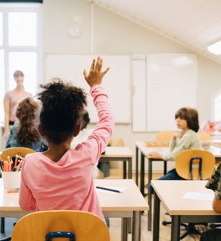

The Big Legal Lesson
[
Think, pair, share
What rules do you follow at school or at home?
Why do we have those rules?
Can you think of a rule that everyone in the country has to follow?
Notes:
Starter Activity
Explain that today we’re going to think about rules and laws.
What rules do you follow at school or at home?
For example, in our classroom we have a rule about putting your hand up before speaking or at home you may have a rule about tidying your room.
Why do we have those rules?
Encourage pupils to explore. Take a few answers and write them on the board.
Can you think of a rule that everyone in the country has to follow?
For example, something that grown-ups and children all have to do.
Possible answers: ‘Wear a seatbelt,’ ‘Don’t steal,’ etc.
Those are called laws. Laws are like rules, but they apply to everyone: not just in school or at home. Laws help keep life fair and safe for all of us. We're going to listen to a story today all about the law.

Slide 8


Lesson objectives
In this lesson, we will meet Snippet the hedgehog!
Together with Snippet, we are going to find out:
What the law is
Why we need laws
Notes:
Lesson Objectives
Read through the objectives and check students' understanding.
Flag that you will be asking them to reflect on how they achieved these at the end of the lesson.

Slide 9
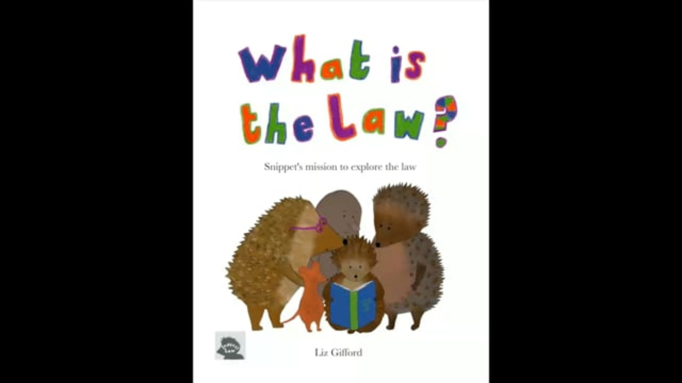
Chapter 1:
The law is for everyone
Snippet is about to find out all about the law.
Snippet says the law is for everyone. ​
​
Who do you think that includes?
www.vimeo.com/youngcitizens/chapter1?
Notes:
Core Activity: Chapter 1 – The Law Is For Everyone
Introduce the class to Snippet and play Chapter 1. In this chapter, Snippet finds out that the law is like a set of rules for everyone in the country to follow.
After the video:
Remind pupils that they have just heard that the law is for everyone.
Challenge pupils to tell you who this might include e.g. does it include:
Their teachers?
The headteacher?
The prime minister?
Celebrities?
Ensure that pupils understand that everyone has to obey the law.

Slide 10
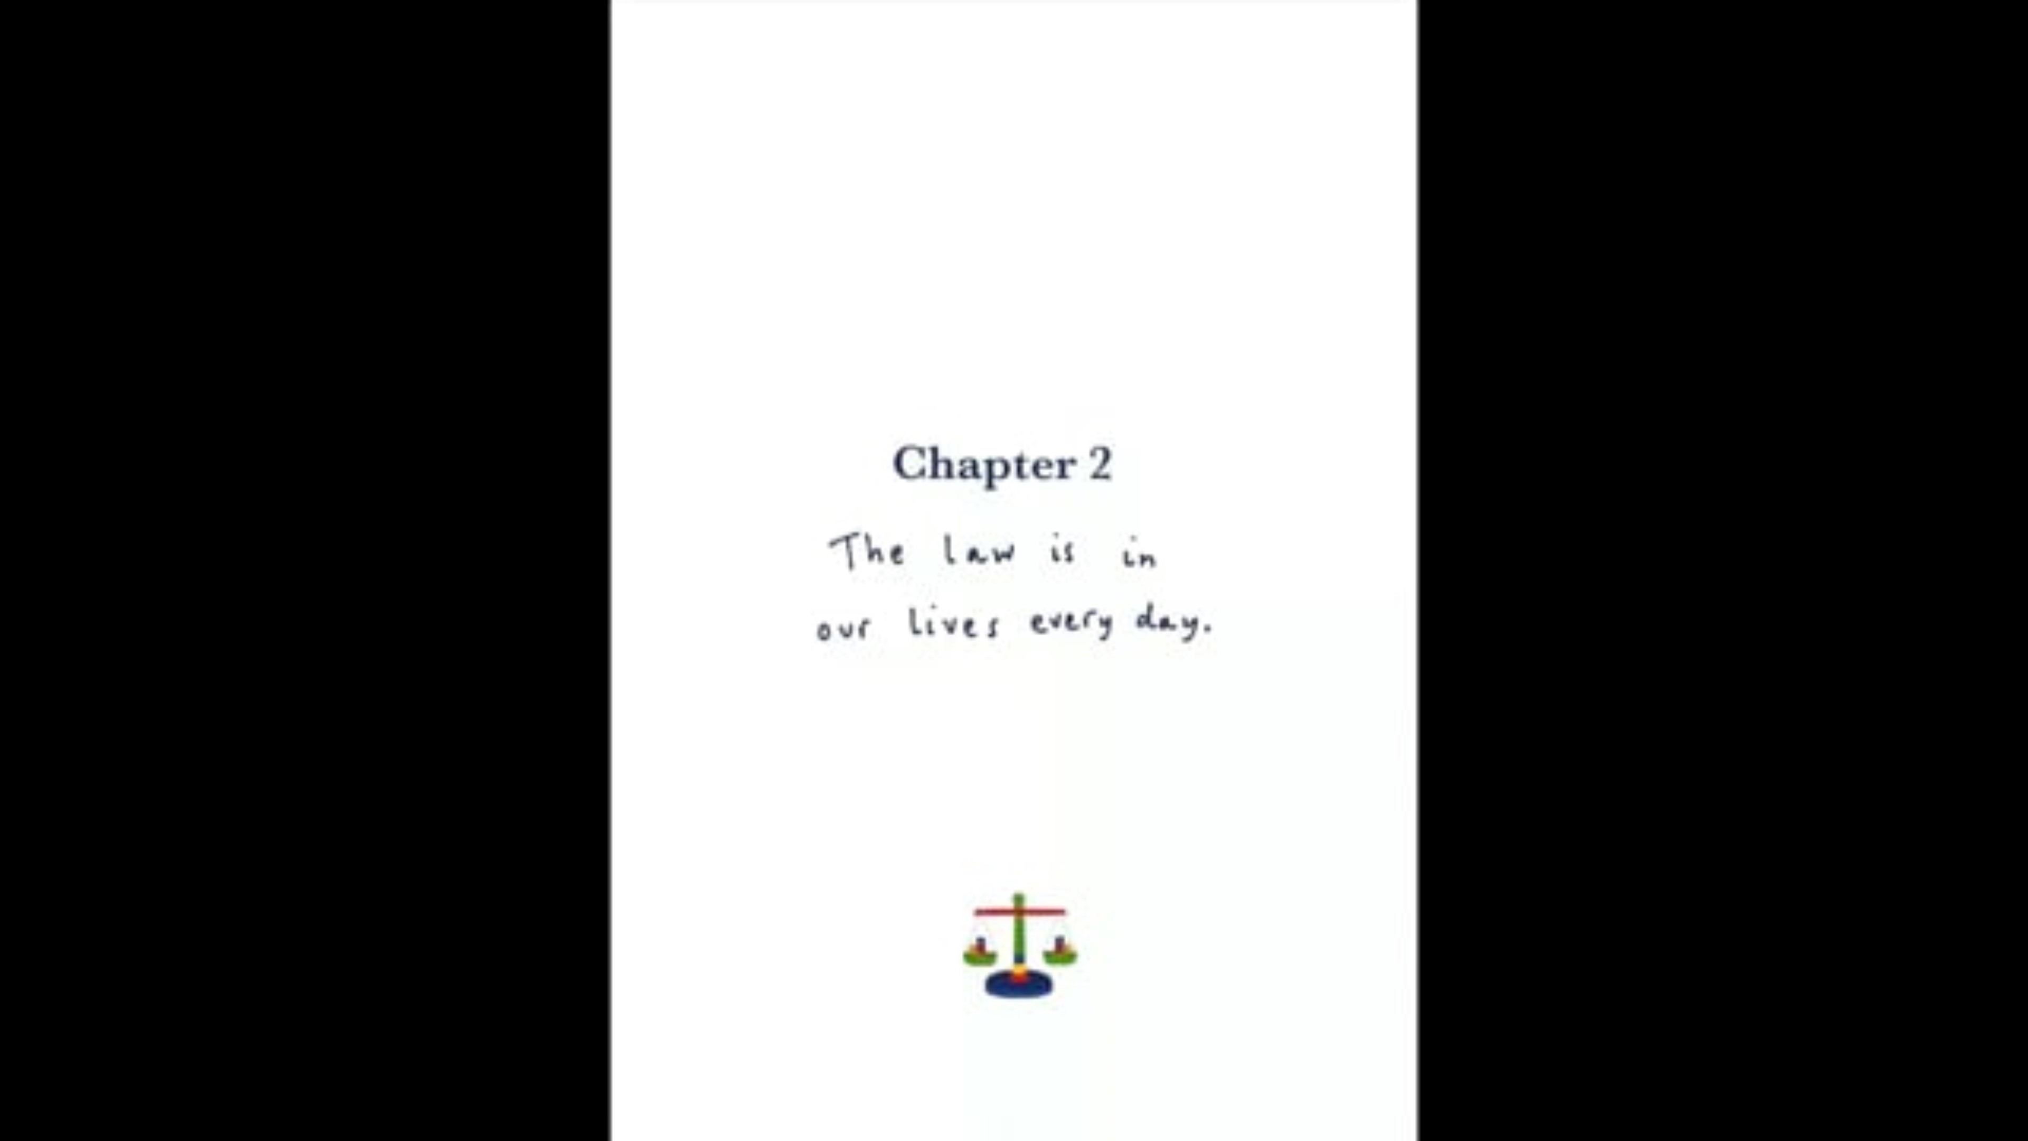

Chapter 2:
The law is everywhere
Imagine you saved up your money and went to the shops to buy a tasty treat. When you got home, it was all mouldy!
How would you feel?
What could you do?
Could the law help you?
www.vimeo.com/youngcitizens/chapter2?
Notes:
Core Activity: Chapter 2 – The Law Is Everywhere
In this chapter, Snippet showed us that the law is all around us - even when we don’t notice it.
After the video:
Reference the scene where Snippet buys a bucket of food from Nutty Buckets.
Ask pupils to imagine this situation on the slide where they bought something that was mouldy. Give pupils time to talk to their partners about the three questions on the slide.
Explain: The law says what should happen if something goes wrong. In this case, the shopkeeper must give you a new chocolate bar or your money back. Even if we don’t realise it, the law is around us all the time, helping to keep things fair.

Slide 11
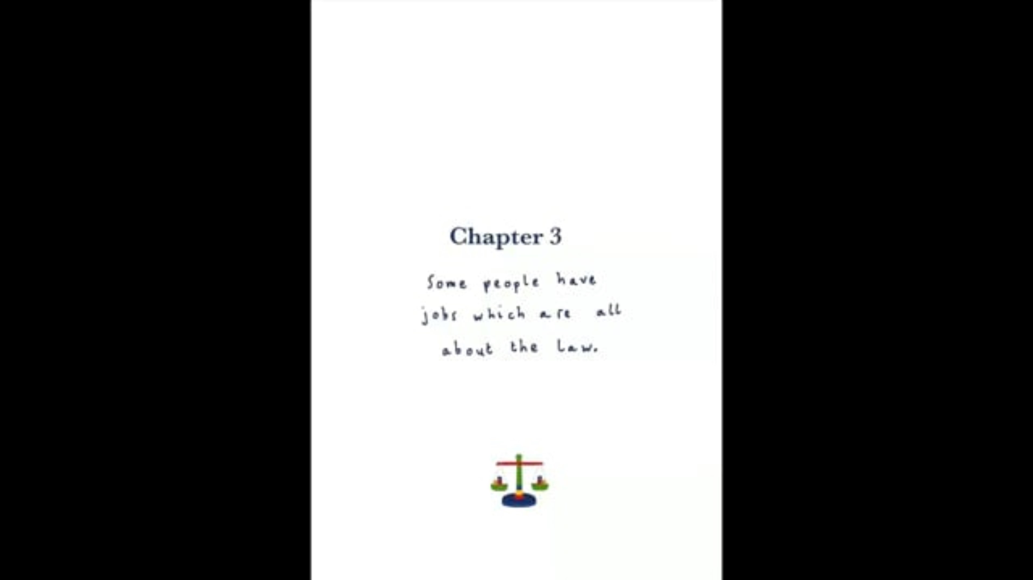
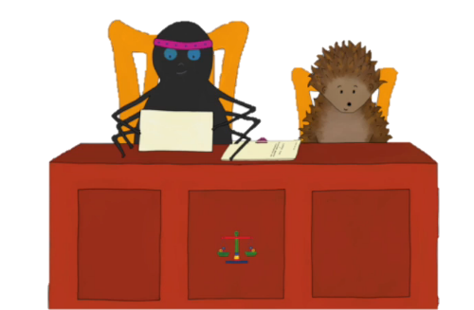
Chapter 3:
Who helps us with the law?
What does Ms. Doodles do as a job?​
Remember your mouldy treat example, who could help you?​
Where does Judge Hoop-lah​ work?
www.vimeo.com/youngcitizens/chapter3?
Notes:
Core Activity: Chapter 3 – Who Helps Us With The Law?
In this chapter, Snippet meets a lawyer and a judge who explain what they do in their jobs.
After the video:
What does Ms. Doodles (the deer) does as a job? Answer: She is a lawyer. She helps people with problems about the law.
2. Remind pupils of the tasty treat example they discussed in the last chapter. Ask pupils to discuss: Who might be able to help you if you didn’t know what to do about your mouldy treat? Answer: Pupils are likely to list a lot of people at this stage (parents, sibling, friends, other trusted adults). Explain to them that Ms. Doodles could have helped them by explaining what the law says they should do.
3. Where does Judge Hoop-lah work? Answer: She works in a court. You might want to tell pupils where your nearest court is. Explain to the pupils that a judge is a person who is in control of a court of law. Part of their job is to make sure that the person taken to court is treated in a fair way. They also decide on what the sentence should be when someone is found guilty of breaking the law.

Slide 12
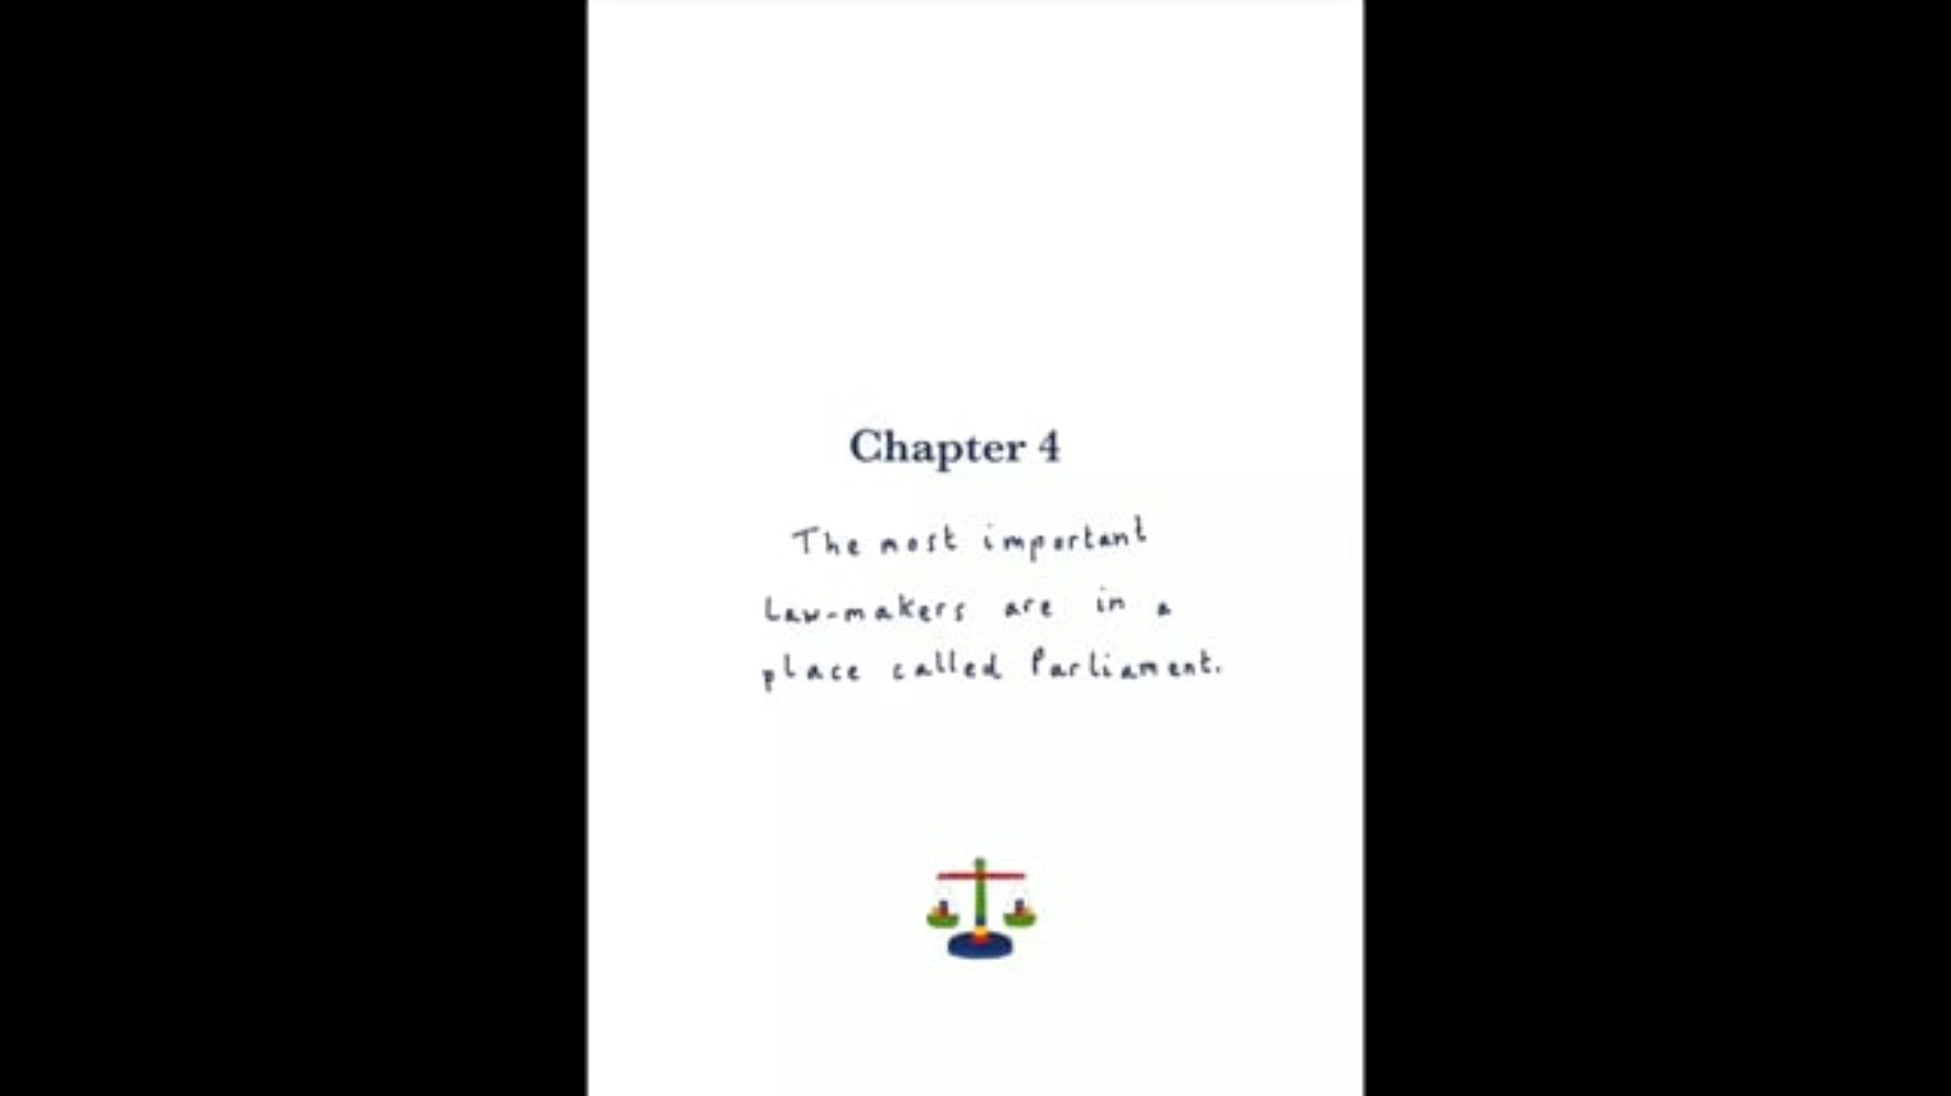
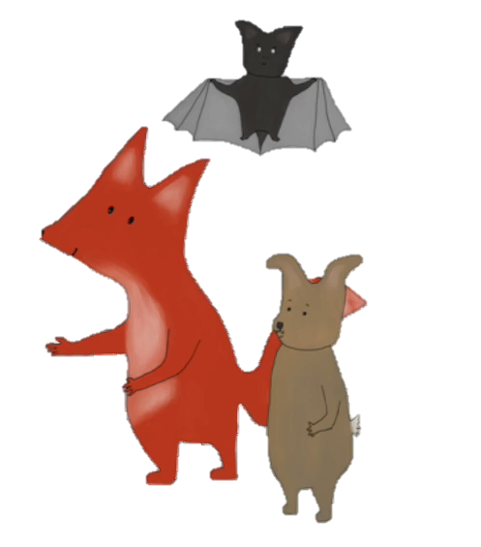
Chapter 4:
Who makes our laws?
Snippet says some people make our laws.
Who do you
think it is?​
​
Where do they work?​
​
Why do we need lots of different laws?​
www.vimeo.com/youngcitizens/chapter4?
Notes:
Core Activity: Chapter 4 – Who Makes Our Laws?
In this chapter, Snippet finds out who makes our laws. The story then ends at a party Snippet has invited everyone to.
After the video:
Laws are made by Members of Parliament (MPs). MPs work in the Houses of Parliament, next to Big Ben in London. This is where all the most important laws for our country are decided.
You can tell pupils:
MPs are people chosen by people, like you and me, to speak for their area.
There are lots of different laws because they cover many parts of life—like keeping people safe, protecting animals, and making sure we are treated fairly.
You might want to share who your local MP is. You can find this here: https://members.parliament.uk/FindYourMP.

Slide 13




The Big Challenge 1:
An Alien has Landed
Now imagine...
An alien has landed in the playground.
It does not know what the law is.
Think
What is a law?
What words will you use?
Can you think of an example?
Create
Write one sentence to
explain what a law is
OR
draw a picture to show what a law does.
Notes:
The Big Challenge 1: An Alien Has Landed
Explain to pupils that an alien has landed in the playground. It is their job to explain to the alien how life in the UK works, what the law is and why it is important. Pupils can choose to display the information in whatever way they think would help the alien the most.

Slide 14
The Big Challenge 2:
Rule or Law?
Arrive at school by 8:45am.
Do not enter someone's home without their permission.
Tidy the classroom at the end of the day.
School Rules
Laws
School Rules
Read through the examples of rules and laws.
Which are the following:
Wear a seatbelt in a car.
Bring your PE kit to school each day.
Bedtime is 7:00pm.
Laws
School Rules
Home Rules
You cannot cook without an adult.
Children must be given an education.
You cannot take something from a shop without paying.
Home Rules
Laws
Laws
Home Rules
Do not talk when the teacher is talking.
You can only have pudding if you eat your dinner.
School Rules
Share your
toys.
Home Rules
Home Rules
School Rules
You cannot have a phone until you are 16.
Wear the correct uniform to school.
Do not drop litter.
Laws
Home Rules
School Rules
Laws
Notes:
The Big Challenge 2: Rule or Law?
Display the list of rules on the slide. Tell pupils that we're going to play a sorting game. When I read a rule, you decide if it’s a Home Rule, a School Rule, or a Law.
Variations of the activity:
1. Worksheet – print Slide 3 and get the students to colour each box red, blue or green depending on whether they think it is a home rule, school rule or law.
2. Use actions in your classroom e.g.
Home Rule: Put your hands on your head.
School Rule: Cross your arms.
Law: Stand up tall.
Read each rule aloud and let pupils respond with the correct action.

Slide 15




The Big Challenge 3:
The Law and Me
Draw a timeline of your day like below or write down what you do in a day.
Then label: When does the law help you?
Breakfast
Travel To School
School Day
Bedtime
I wore a seatbelt because the law helps keep me safe in the car.
I went to school because the law makes sure every child can learn.
Notes:
The Big Challenge 3: The Law and Me
Ask pupils: “What rules do you follow every day?”
Explain: “Laws are rules created by the government to help and protect us.”
Pupils will draw a timeline of their day, from waking up to bedtime. If drawing is hard, pupils can list activities for you to add to the timeline above and add law-related annotations instead.
On the timeline, they identify moments when UK laws play a role, using prompts like:
Eating breakfast: Shops have rules about where they put sugary foods so they don’t make us eat too much sugar.
Watching TV: Adverts must tell the truth. They can’t show things that are not allowed, like smoking.
Going to school: Your grown-ups must make sure you go to school because the law says children need to learn.
In the car: Everyone must wear a seatbelt. If you’re small, you need a special car seat. Drivers must not use their phone and must drive safely.
Petrol: Children are not allowed to buy petrol. Only grown-ups can.
What you learn: Schools have rules about what they teach. They must treat everyone fairly.
Lunch time: Schools must give healthy food and think about what children need. Some children get free meals.
PE: Schools must have space for you to play and do PE outside.
Buying a game/Watching films: Some games/films have age limits. Shops can’t sell games to children if they are too grown-up for them.
Playing online: There are rules to keep you safe online. Apps must protect children from harmful things.

Slide 16

The Big Challenge 4:
My New Law
If you could make a new law, what would it be?
Why do we need this law?
Who would it help?
Notes:
The Big Challenge 4: My New Law
Ask pupils to think of one new law they would like introduced in the UK and explain what difference it would make.
Extension: Encourage pupils to write to their MP about their idea using the framework provided on the next slide. MP contact details: http://www.writetothem.com.
Share pupil ideas: Write them down, take a photo, and share with @YoungCitizensUK using #TheBigLegalLesson.

Slide 17

The Big Challenge 4:
My New Law
Dear ___________,
My name is __________ and I am a pupil at ____________.
At school we have been taking part in The Big Legal Lesson,
learning what the law is and why it is so important.
We have been thinking about new laws we would like to see
in the UK. My idea for a new law is...
I think we need this law because...
It would help because...
Yours sincerely,
Use this template letter to write to your Member of Parliament.
Notes:
The Big Challenge 4: My New Law (Optional Extension)
Remind pupils and see if they can recall what an MP is from Snippet's story.
Laws are made by Members of Parliament (MPs). MPs work in the Houses of Parliament, next to Big Ben in London. This is where all the most important laws for our country are decided.
Extension: Encourage pupils to write to their MP about their idea using the framework provided on the next slide. MP contact details: http://www.writetothem.com.

Slide 18
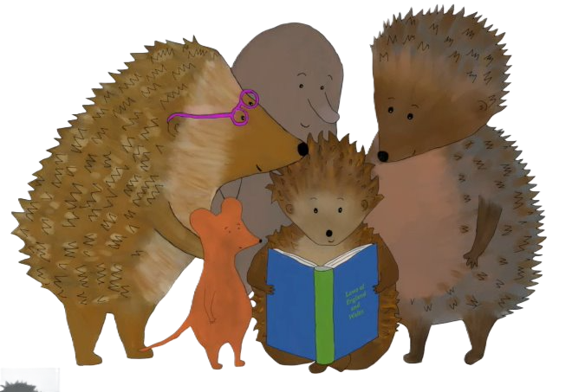
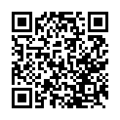
Reflections
Take our class quiz together to reflect on what you've learned:
https://www.surveymonkey.com/r/YLKDRZL
Notes:
Student Reflections
NB: Only you need to scan the QR code or click the pink link embedded on the slide. The questions are student facing, are done as a group and act as reflective prompts for your class.
Optional: Screenshot your answers before submitting for your own activity records.

Slide 19
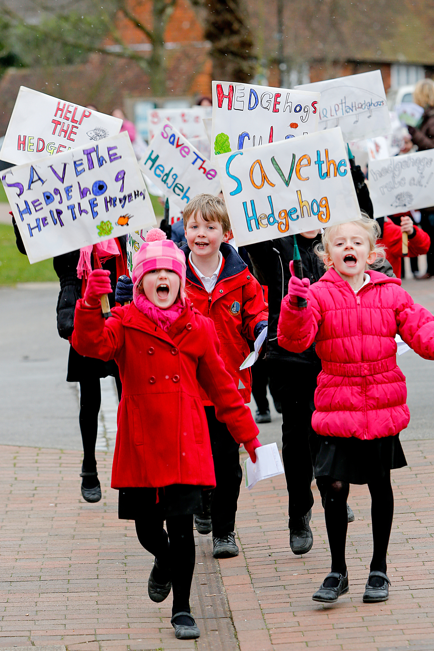
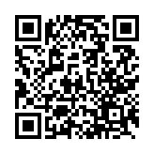
After the session
Your thoughts
Take Citizenship Beyond the Classroom
We have heard what your students think during the lesson, now tell us how you found it as a teacher.
Give your pupils the chance to lead real change with our Make a Difference Challenge 2026.
Join the Summer of Social Action.
This immersive programme is designed for primary schools to turn learning into action.
Here’s what happens:
Spark Change: Pupils choose an issue they care about.
Plan It, Do It: They design and deliver their own social action project.
Shout About It: Celebrate their impact at a regional showcase this July.
Secure your place:
RE
www.surveymonkey.com/r/Z2352VM
Citizenship
PSHE
www.youngcitizens.org/programmes/make-a-difference-challenge/

