Slide 1




The Big
Legal Lesson
Sponsored by
KS2
Notes:
The Big Legal Lesson: Key Stage 2 Lesson Plan & Slides
Thank you for taking part in The Big Legal Lesson 2026. You are joining a network of thousands of teachers across England and Wales who are committed to developing children’s knowledge of the rule of law and their legal rights.
For more The Big Legal Lesson resources and information, please head to www.youngcitizens.org/programmes/the-big-legal-lesson/
To find out more information about Young Citizens and our mission, you can check our website at www.youngcitizens.org

Slide 2

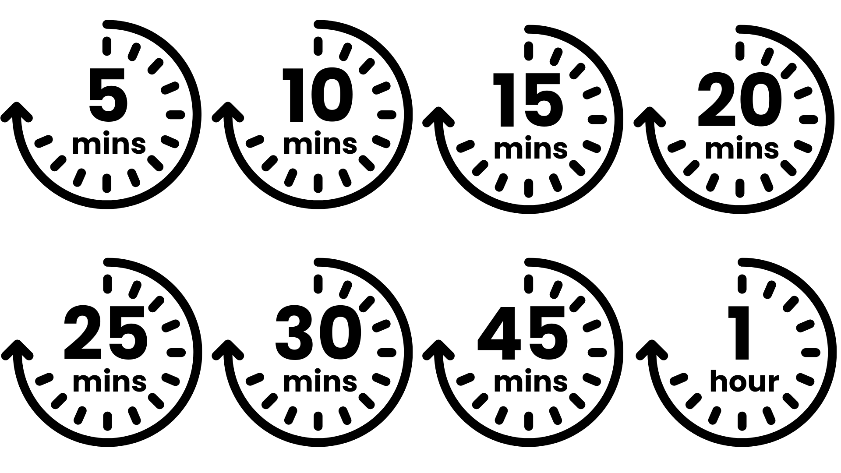




Lesson preparation
Teacher checklist
Keyword definitions
Why teach
The Big Legal Lesson?
Allow a minimum of 45
minutes to deliver the
lesson.
Familiarise yourself with Lesson Overview (Slide 3) and slides.
Read the Top Tips & Rule of Law 101 (Slide 4 and 5).
Read the 'Notes' in each slide which have more information on how to run the activities as well as any additional context you may need.
You can choose to deliver all the suggested activities or select those that best suit the needs of your pupils and your time-frame.
Rule of Law - a set of principles for a fair and effective society where everyone is accountable to the law.
Parliament - made up of elected MPs in the House of Commons and appointed Lords in the House of Lords. Responsible for creating and amending laws.
The Government - sets the agenda for new laws, drafting them with lawyers and implementing them once passed.
The Judiciary - system of courts and judges, responsible for interpreting and applying existing laws.
Bill - a proposal for a new law, or to change an existing law.
Act - a bill which has been passed by Parliament and given royal approval, making it official law.
Ofsted
Personal Development & Wellbeing
Curriculum
Citizenship
SMSC
English
Skills
Critical thinking
Communication
Oracy
Pedagogical principles
Support on making learning locally relevant and impartiality
Notes:
Full Ofsted and Curriculum References
Ofsted
Schools Inspection Toolkit, Page 47: 'In gathering evidence about the personal development programme, including pupils’ SMSC development, inspectors consider the extent to which: pupils develop their ability to recognise the difference between right and wrong, including...recognising legal boundaries and respecting the civil and criminal law of England'
Curriculum
Citizenship Programme of Study (non-statutory), Key Stage 2, Page 3, 'Preparing to play an active role as citizens. Pupils should be taught: a. to research, discuss and debate topical issues, problems and events; b. why and how rules and laws are made and enforced, why different rules are needed in different situations and how to take part in making and changing rules... g. what democracy is, and about the basic institutions that support it locally and nationally'
Spoken English: Primary National Curriculum – English, page 7: 'listen and respond appropriately to adults and their peers; ask relevant questions to extend their understanding and knowledge; maintain attention and participate actively in collaborative conversations, staying on topic and initiating and responding to comments; use spoken language to develop understanding through speculating, hypothesising, imagining and exploring ideas'

Slide 3
Lesson overview
Activity 1
Activity 2
Activity 3
What is 'The Law'?
Slide 6
Introduce the lesson using the starter prompt on the slide and invite pupils to share thoughts.
Slide 7
Introduce the learning objectives of the session.
Slide 8
Ask pupils whether these statements are against the law. If they think it is against the law, they stand up. Reveal answers and accept student feedback.
Slide 9
Consolidate their understanding of what a law is and why we have them.
Charlie's Day
Slide 10
Introduce the character of Charlie.
Slide 11 - Slide 13
Follow Charlie through their day, using the prompts on the slides to help students explore how the law is relevant in each situation. Consolidate learning on Slide 13.
Who makes the Law?
Slide 15 - 16
Pupils are introduced to roles within the legal system through a matching activity.
Slide 17 - 18
They then decide whether each of these people has a role in making or changing the law. Roles in Parliament are consolidated in Slide 18.
The Big Challenge 1
The Big Challenge 2
The Law and Me
Slide 14
Pupils draw a timeline of their day and identify moments where the law helped or impacted them.
My New Law
Slide 19
Pupils think about what power citizens have and think about what new laws they would introduce.
Notes:
Lesson Length
This resource has been designed to give you flexibility. One main activity is included, which is split into three distinct parts. A number of "The Big Challenges" are also included.
You can choose to deliver all the suggested activities or select those that best suit the needs of your pupils and your time-frame.
This PowerPoint can be used in its entirety, or it can be edited, saved, and delivered across several shorter sessions. For example, one activity could be run each day throughout The Big Legal Lesson campaign.

Slide 4
Top Tips
Local relevance
Preparation
Impartiality
This resource is designed to create a space where pupils can practice respectful discussion and begin to see the relevance of the law to their everyday lives.
To ensure this topic feels relevant to your pupils, consider:
Swapping the image in the opening slide for one which will resonate with your pupils
Amending Charlie's name, or any elements of Charlie's day in Activity 2 to make them closer to your pupils' experience
Changing the icons that guide your pupils as they map out a timeline of their own day in Activity 3
Consider differentiating so EAL and SEND pupils can access the learning and express their ideas.
Think about your pupils’ experiences of rules and fairness. How might these shape their understanding of the law? Could any examples feel sensitive or upsetting? Plan ahead to adapt activities if needed.
Use familiar classroom routines to support discussion, such as your class agreement or strategies like “right to pass” and “respectful listening.” Encourage pupils to share ideas using simple sentence starters, for example:
I think…
I agree…
I don’t agree…
I like that idea…
My idea is…
These prompts help pupils practise speaking and listening while exploring what the law means in their everyday lives.
Teaching about the law can lead to conversations about fairness, rules, and what is “right” or “wrong.”
At this age, pupils may share strong opinions based on home experiences or things they’ve heard. Your role is to keep the discussion balanced and respectful.
Impartiality means:
Not saying one view is “better” than another.
Helping pupils understand that people can have different ideas.
Correcting things that are factually wrong (e.g., “You don’t have to wear a seatbelt”).
Avoiding sharing your own political opinions.

Slide 5
Rule of Law 101
What do we mean by 'Rule of Law'?
The rule of law is the idea that everyone plays by the same rules, including those in power. It is what keeps our society fair and functioning well. When the rule of law works, it means decisions are made according to clear and consistent rules, not personal interests. It ensures that our rights are respected and that no one is above the law. Think of it as the “rules of the game” that create a level playing field for all of us.
Why do we need laws?
Laws exist to keep life safe, fair, and organised. They organise society, protect people from harm, make sure everyone is treated equally, and safeguard basic rights. For example, seatbelt laws help keep us safe, education laws ensure every child can go to school, and consumer laws mean shops must sell safe food. The rule of law is not just about preventing chaos or punishing crime: it shapes everyday life.
Who makes and enforces laws?
In the UK, laws are made by Parliament, which includes the House of Commons and the House of Lords. Members of Parliament (MPs) are elected by the public to represent their communities and help create laws. When both Houses agree on a law, the King or Queen gives final approval, known as Royal Assent. Once a law is in place, judges and courts ensure it is applied fairly, and lawyers help people understand what the law says. This system creates checks and balances so that laws are not only made but also enforced in a fair and consistent way.

Slide 6


The Big Legal Lesson
[
Think, pair, share
What rules do you follow at school or at home?
Why do we have those rules?
Can you think of a rule that everyone in the country has to follow?
Image Here
Notes:
Starter Activity
Explain that today we’re going to think about rules and laws.
What rules do you follow at school or at home?
For example, in our classroom we have a rule about putting your hand up before speaking or at home you may have a rule about tidying your room.
Why do we have those rules?
Encourage pupils to explore. Take a few answers and write them on the board.
Can you think of a rule that everyone in the country has to follow?
For example, something that grown-ups and children all have to do.
Possible answers: ‘Wear a seatbelt,’ ‘Don’t steal,’ etc.
Those are called laws. Laws are like rules, but they apply to everyone: not just in school or at home. Laws help keep life fair and safe for all of us.

Slide 7


Lesson objectives
By the end of the lesson, I will be able to:
Explain what laws are.
Describe how laws affect my life.
Identify who makes and changes laws.
Notes:
Lesson Objectives
Read through the objectives and check students' understanding.
Flag that you will be asking them to reflect on how they achieved these at the end of the lesson.

Slide 8








Activity 1:
Is it against the law?
Listen to the statements and stand up if you think it is against the law.
Throwing rubbish from a car window.
Getting a tattoo when you are 16.​
YES
YES
Getting your ears pierced when you are 7.
NO
Not going to school. ​
DEPENDS!
Getting a job when you are 11.​
Not cleaning up your dog’s poo when on a walk. ​
YES
YES
Buying fireworks when you are 17. ​
Crossing the road when the red man is showing. ​
YES
NO
Notes:
Activity 1: Is it against the law?
Explain that you're going to play a game called Is it against the law? You will read out a statement, and they have to decide if it’s against the law or not. Explain that some answers might surprise them and that they’ll learn why after each one.
Read each statement aloud. If they think it is against the law – they have to stand up. If they it isn't against the law – they stay seated. After each response, share the correct answer and the short explanation below.
1. Throwing rubbish out of a car window: YES - against the law. Under environmental law, littering is a crime. The car’s owner could be given a fine if litter is thrown from their vehicle.
2. Getting your ears pierced when you are 7: NO - this is not against the law. There is no age requirement to get your ears pierced in England and Wales. However, most shops would not allow you to do so if you are under 18 unless you have your parent’s permission.
3. Getting a job when you are 11: YES – against the law. There are lots of employment laws which are there to protect children. Generally speaking, the youngest age a child can work part-time is 13. There are a few exceptions. For example, acting and modelling.
4. Buying fireworks when you are 17: YES – against the law. The Fireworks Act is a law that sets out lots of rules about fireworks. For example, anyone under 18 cannot have fireworks in public places. You cannot set fireworks off late at night (after 11pm) except for on some special occasions like New Year’s Eve, Diwali, Chinese New Year and Guy Fawkes night.
5. Getting a tattoo when you are 16: YES – against the law. It is against the law to tattoo a person who is under the age of 18, except when the tattoo is done for medical reasons.
6. Not going to school: It depends! In England, the law says that you have to participate in some sort of education if you are between the ages of 5 and 18. However, that doesn’t always have to be in a school. For example, some families might choose to home school. Legally, you do need to be getting an education. In the rest of the UK, you can leave education at 16.
7. Not cleaning up your pet dog’s poo when out on a walk: YES – against the law. Under environmental law you will commit an offence if you leave dog poo on land to which the public can have access. You may be required to pay a fine.
8. Crossing the road when the red man is showing: NO - this is not against the law. Whilst it isn’t very safe, in the UK this isn’t actually against the law. It is against the law in some places like Germany and certain states in America. However, you could be breaking the law if you intentionally cause danger to other road-users when crossing.
Pick two examples of things that are against the law – ask students to give reasons as to why they think this is the case.

Slide 9




Activity 1:
What is the law?
Laws are rules that everyone has to follow. They...
keep people safe
make life fair
make sure everyone follows the rules
Notes:
Activity 1: What is the law?
After all statements and previous activity, ask: “What do these examples tell us about why laws exist?” Highlight: Laws keep us safe, make life fair, and to make sure everyone follows the rules.
Challenge pupils to tell you who 'everyone' might include e.g. does it include:
■ Their teachers?
■ The headteacher?
■ The prime minister?
■ Celebrities?
Ensure that pupils understand that everyone has to obey the law.

Slide 10

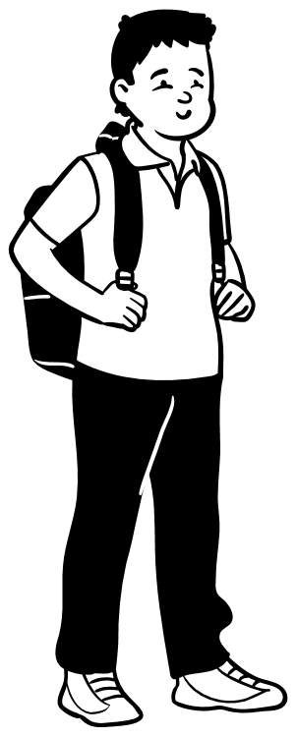
Activity 2:
Charlie's Day
Hi, I’m Charlie. I’m 8 years old and I live with my grandad and dad.
I’ve always thought laws were for grown-ups, not children like me.
Why would they matter to me? I don’t drive a car or work!
Notes:
Activity 2: Charlie's Day
Read Charlie’s introduction aloud to the class. Do they agree with Charlie? Explain that pupils will follow Charlie through a normal day and spot where the law applies. Emphasise the key question: “Can you find the parts of Charlie’s day where the law is involved?”

Slide 11



Activity 2:
Charlie's Day
After each section, talk to your partner:
Do you think there is a law involved?
HINT: Which laws apply to everyone? Which rules only apply to Charlie?
It’s Monday morning. At 8AM Charlie and dad eat breakfast: a bowl of chocolate cereal and milk.
Shops have to follow laws about sugary foods and how they are sold.
Charlie gets driven to school by his grandad. On the way they stop to fill up with petrol. Charlie wants to help but grandad says no.
At school Charlie has Maths, followed by a spelling test. After break Charlie has English.
There are lots of laws about driving. It is against the law to sell petrol to anyone under the age of 16.
Schools have to teach certain subjects and treat everyone fairly.
Notes:
Activity 2: Charlie's Day
Read each section of Charlie's day. Ask pupils to discuss all the ways they think Charlie’s day has been affected by the law. Take in a selection of feedback before revealing the answers.
Eating breakfast: The law stops supermarkets from offering price promotions on certain foods like those that are high in sugar. There are also laws about where these products can be placed in shops.
Going to school: Parents and carers have a legal duty to make sure their children receive an education. In England, the law says you have to stay in some sort of education until you’re 18. In the rest of the UK, it is 16.
In the car: There are lots of laws about driving. For example, both Charlie and his grandad will need to wear a seatbelt. If Charlie is under 135cm he will also need to be in an appropriate car seat. Charlie’s grandad will need to stick to the speed limit and can’t be holding his mobile phone whilst driving or do anything that might take his concentration away from the road. It is against the law to sell petrol to anyone under the age of 16.
At school: Lots of schools have to follow the national curriculum. This sets out what subjects should be taught and what should be covered within those subjects. Schools are under a legal duty not to discriminate against a pupil on the grounds of certain protected characteristics (age, disability, gender reassignment, marriage and civil partnership, pregnancy and maternity, race, religion or belief, sex, and sexual orientation).

Slide 12




Activity 2:
Charlie's Day
Charlie is having a school dinner today; it’s roast dinner on the menu.
On the way home, Dad takes him to the shops. Charlie has got some money to spend and there is a new game out.
Schools have to follow laws about providing healthy food.
Some games have age limits.
When they get home, Charlie’s dad says that they can’t play their new game until they've done their homework.
Charlie has some dinner, plays his new game, and then goes online to play an online game before heading to bed.
This is a rule that applies to Charlie in his house.
Companies have to follow laws to keep children safe online.
Notes:
Activity 2: Charlie's Day
Read each section of Charlie's day. Ask pupils to discuss all the ways they think Charlie’s day has been affected by the law. Take in a selection of feedback before revealing the answers.
Lunch time: The law says that schools have to provide healthy and nutritious food and drink. Schools also need to make sure that pupils’ medical, dietary and cultural needs are taken into account. The law also says that some pupils, who meet certain criteria, should get these meals for free.
Buying a game: Some video games will have an age limit. It is against the law to sell these games to someone under that age. The law also says that the game must be of satisfactory quality. If Charlie got home and the game didn’t work the law says he could get a refund.
Homework: This one is a trick - there are no laws here! The government have set guidelines about how much homework schools should be setting but these have never been made into law.
Playing online games: Social media companies are responsible for users’ safety on their platforms, particularly children. For example, they have to remove illegal consent, protect children from harmful content and enforce age limits and age-checking measures.

Slide 13
Activity 2:
Charlie's Day
I was wrong.
Laws do matter and impact my life.
I've learnt that...
Notes:
Activity 2: Charlie's Day
Prompt your class to fill in this speech bubble – what have they learned about the law through this activity?

Slide 14



The Big Challenge 1:
The Law and Me
Draw a timeline of your day like below or write down what you do in a day.
Label: When does the law help you?
Breakfast
Travel To School
School Day
Bedtime
I wore a seatbelt because the law helps keep me safe in the car.
I went to school because the law makes sure every child can learn.
Notes:
The Big Challenge 1: The Law and Me
Ask pupils: “What rules do you follow every day?”
Explain: “Laws are rules created by the government to help and protect us.”
Pupils will draw a timeline of their day, from waking up to bedtime. If drawing is hard, pupils can list activities for you to add to the timeline above and add law-related annotations instead.
On the timeline, they identify moments when UK laws play a role, using prompts like:
Eating breakfast: Shops have rules about where they put sugary foods so they don’t make us eat too much sugar.
Watching TV: Adverts must tell the truth. They can’t show things that are not allowed, like smoking.
Going to school: Your grown-ups must make sure you go to school because the law says children need to learn.
In the car: Everyone must wear a seatbelt. If you’re small, you need a special car seat. Drivers must not use their phone and must drive safely.
Petrol: Children are not allowed to buy petrol. Only grown-ups can.
What you learn: Schools have rules about what they teach. They must treat everyone fairly.
Lunch time: Schools must give healthy food and think about what children need. Some children get free meals.
PE: Schools must have space for you to play and do PE outside.
Buying a game/Watching films: Some games/films have age limits. Shops can’t sell games to children if they are too grown-up for them.
Playing online: There are rules to keep you safe online. Apps must protect children from harmful things.

Slide 15







Activity 3:
Who makes the law?
There are lots of different people who are involved in the law and they all have a very important role to play.
But who does what? Can you work it out?
A Police Officer
A Member Of Parliament
A Lord or Baroness
The King
A Lawyer
A Judge
The Prime Minister
Notes:
Activity 3: Who makes the law?
Introduce the different people on the slide. How many have they heard of? Do they know what they do?

Slide 16
Activity 3:
Who makes the law?
1. A Police Officer
I lead the government. I am in charge of the political party that won the most seats in the House of Commons at the last general election.
2. Judge
B. I am the monarch and the Head of State.
3. Lawyer
C. I help keep people safe and prevent crimes.
4. The King
D. I am an expert in the law. I give advice and represent people in court.
5. The Prime Minister
E. I sit at the House of Lords and share my expertise.
6. Member Of Parliament
F. I work in court and apply the law to the cases that are brought to me.
7. Lord or Baroness
G. I represent people in my area who voted for me. I work at the House of Commons.
Notes:
Activity 3: Who makes the law?
Pupils should spend some time matching the roles with the definitions. They can either come up to the board and draw a line to the definition or match the number to the letter. Show them the answers when the task is finished.
Answers:
A Police Offer = C. I help keep people safe and prevent crimes.
Judge = F. I work in court and apply the law to the cases that are brought to me.
Lawyer = D. I am an expert in the law. I give advice and represent people in court.
The King = B. I am the monarch and the Head of State.
The Prime Minister = A. I lead the government. I am in charge of the political party that won the most seats in the House of Commons at the last general election.
A Member Of Parliament = G. I represent people in my area who voted for me. I work at the House of Commons.
Lord or Baroness = E. I sit at the House of Lords and share my expertise.

Slide 17



Activity 3:
Who makes the law?
A Police Officer
They make sure people follow the law.
Now you know what everyone does, do you think they can make and change the law?
Yes, they can.
No, they can't.
It's complicated!
A Judge
They use laws to decide cases.
A Lawyer
They advise people on the law.
The King
Not really but all laws have to be given Royal Assent by the King.
The Prime Minister
Yes, but not on their own.
A Member Of Parliament
Yes, but not on their own.
A Lord or Baroness
Their job is to debate and suggest amendments to new laws.
Notes:
Activity 3: Who makes the law?
For each role, get students to decide whether they think they can make and change the law, whether they can't or whether it is complicated.
The Police: No, the police are responsible for maintaining public order and safety. They enforce the law, preventing and investigating criminal activities. They have no direct involvement in making or changing the law.
A Judge: It's complicated, it is not a judge’s role to make the law but rather to uphold it. Sometimes judges have to interpret the law, specially in new or unusual cases. This interpretation can add to 'case law' which then adds to legislation made by parliament.
A Lawyer: No. Lawyers are there to advise on the law; they cannot make or change it.
The King: Sort of, but not really! The final stage of getting any law created or changed is called Royal Assent. In practice, this is a formality and the monarch always grants Royal Assent. The last time a monarch refused was Queen Anne in 1707. The King is not able to introduce new laws.
MPs: Yes (but not on their own). At a general election, citizens vote for an MP to represent them in parliament. A total of 650 MPs are voted in and they all sit in a special chamber called the House of Commons. Part of an MP’s job is to debate and vote on laws in the House of Commons. In order for a new law to pass, 50% or more of MPs have to have voted for it.
The Prime Minister: Yes (but not on their own). The prime minister is the leader of the government, the group of people who have been elected to run the country. The government can propose new laws and suggest changes to laws; however, these have to be voted and agreed on in parliament.
A Lord or Baroness: It's complicated. Otherwise known as peers, these people form the second chamber of parliament – the House of Lords. They are appointed by the monarch on the advice of the prime minister because they are expert in their field (e.g. education, music, science, sport). Their job is to check and challenge the government. As part of this they discuss and debate any proposed changes to the law. The House of Lords cannot prevent bills passing into law, except in very limited circumstances, but they can delay bills and force the House of Commons to reconsider their decisions.

Slide 18
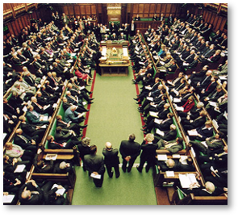
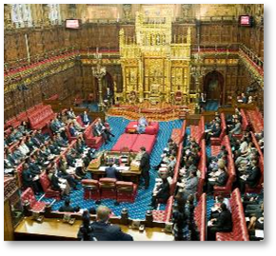
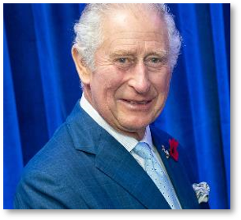
Activity 3:
Who makes the law?
It is the role of parliament to make and change the law.
House of Commons
House of Lords
The Monarchy
650 elected MPs
debate and vote on
changes to the law.
800 appointed Lords and Baronesses check and challenge the government, debate suggested changes to the law.
The King gives Royal Assent to new laws. (The last time they refused was 1708!)
Notes:
Activity 3: Who makes the law? (Optional – Consolidation Slide)

Slide 19



The Big Challenge 2:
My New Law
Think about what power we have as citizens.
Citizens can’t make laws themselves, but you can influence them by:
So... what laws would YOU make?
My new law is...
We need it because...
It would help because...
Another reason to consider this is...
Writing to your MP
Starting a petition
Joining a campaign
Notes:
The Big Challenge 2: My New Law
This activity helps pupils understand that while citizens cannot make laws themselves, they can influence change through democratic actions. It also encourages creative thinking about laws they would introduce.
Keep explanations short and link to real-life examples if possible (e.g., petitions for school meals or playground safety). Briefly share the three ways citizens can influence laws:
Writing to your MP
Starting a petition
Joining a campaign
Set the challenge: Now imagine you could create a new law. What would it be? Why do we need it? Who would it help?
Pupils can use the sentence starters if needed. Pupils work individually or in pairs for 5 minutes to create their law. Encourage them to write one or two sentences using the starters or write a letter to their MP using these sentences. Invite a few pupils to share their ideas with the class.

Slide 20
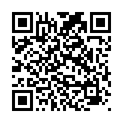
Reflections
Take our class quiz together to reflect on what you've learned:
https://www.surveymonkey.com/r/Z2QPJV9
Notes:
Student Reflections
NB: Only you need to scan the QR code or click the pink link embedded on the slide. The questions are student facing, are done as a group and act as reflective prompts for your class.
Optional: Screenshot your answers before submitting for your own activity records.

Slide 21
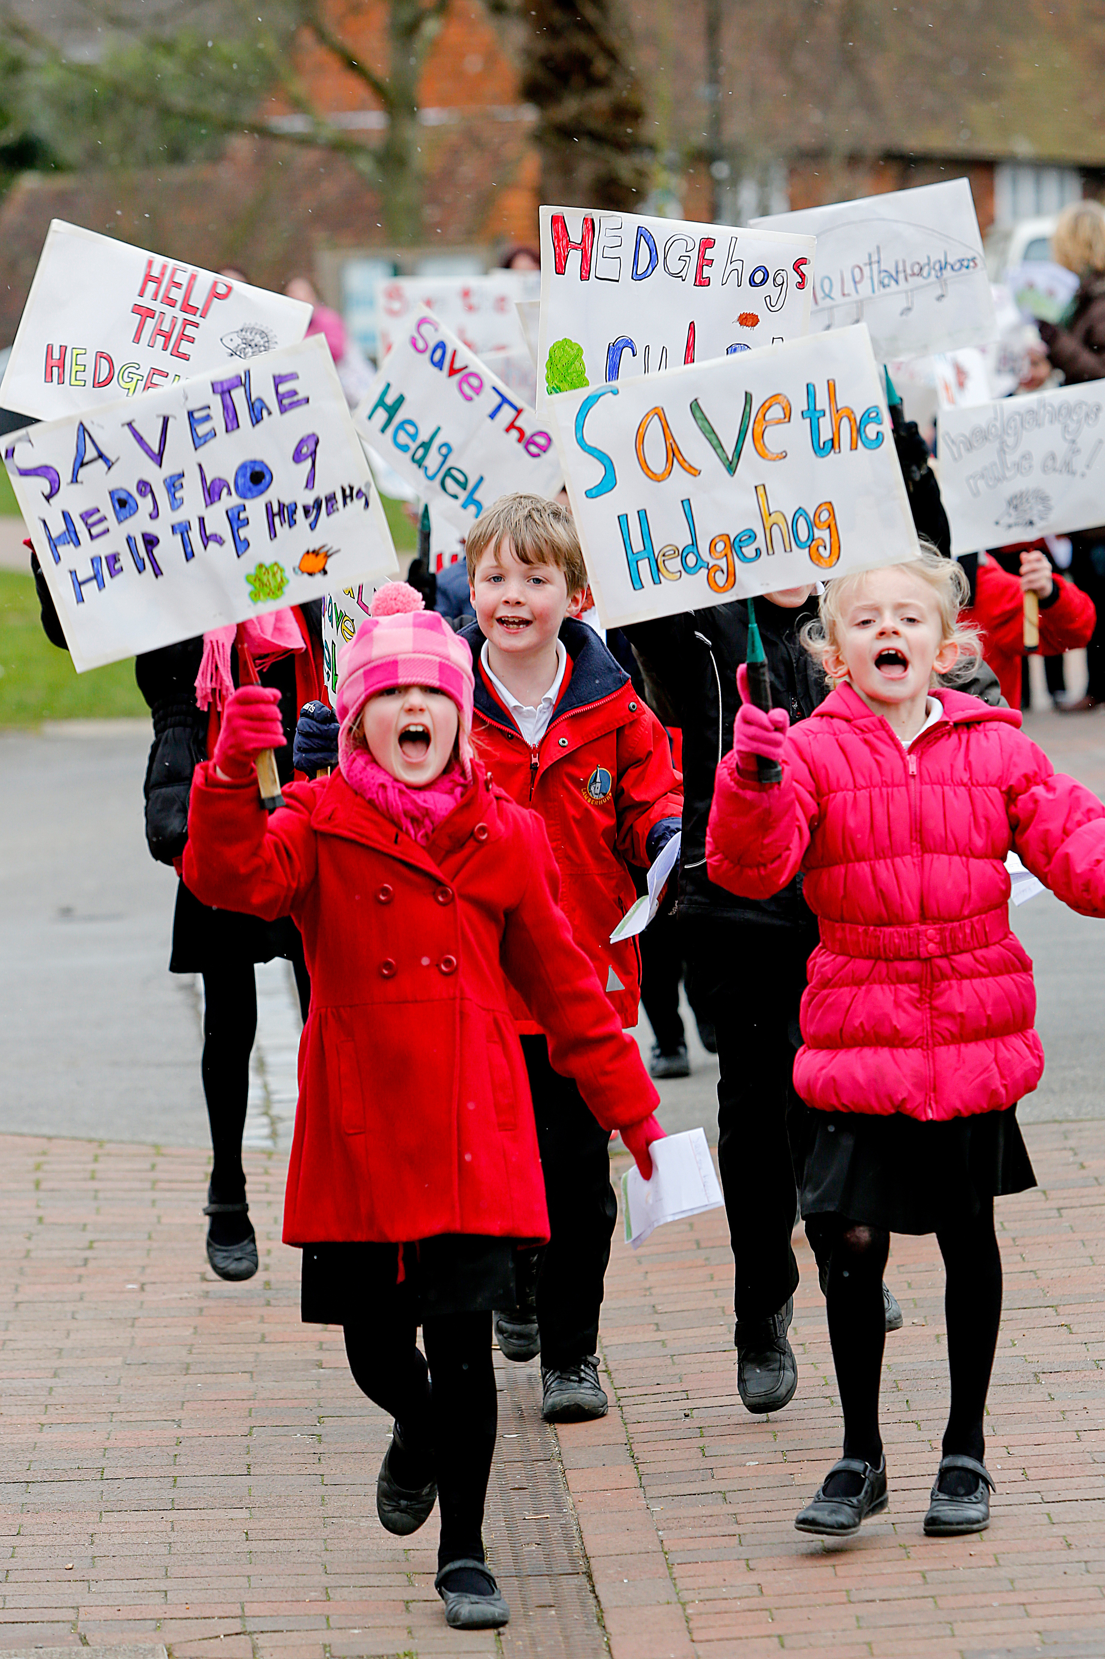
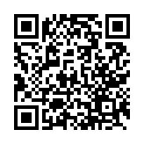
After the session
Your thoughts
Take Citizenship Beyond the Classroom
We have heard what your students think during the lesson, now tell us how you found it as a teacher.
Give your pupils the chance to lead real change with our Make a Difference Challenge 2026.
Join the Summer of Social Action.
This immersive programme is designed for primary schools to turn learning into action.
Here’s what happens:
Spark Change: Pupils choose an issue they care about.
Plan It, Do It: They design and deliver their own social action project.
Shout About It: Celebrate their impact at a regional showcase this July.
Secure your place:
RE
www.surveymonkey.com/r/Z2352VM
Citizenship
PSHE
www.youngcitizens.org/programmes/make-a-difference-challenge/

