Slide 1




The Big
Legal Lesson
Sponsored by
KS3
Notes:
The Big Legal Lesson: Key Stage 3 Lesson Plan & Slides
Thank you for taking part in The Big Legal Lesson 2026. You are joining a network of thousands of teachers across England and Wales who are committed to developing children’s knowledge of the rule of law and their legal rights.
For more The Big Legal Lesson resources and information, please head to www.youngcitizens.org/programmes/the-big-legal-lesson/
To find out more information about Young Citizens and our mission, you can check our website at www.youngcitizens.org

Slide 2

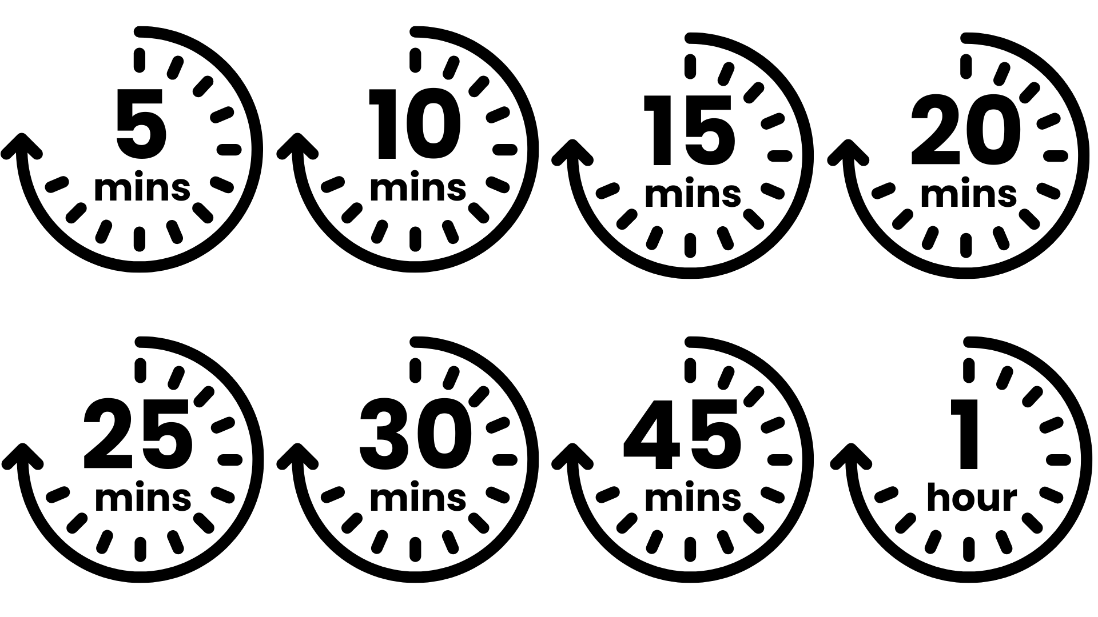




Lesson preparation
Teacher checklist
Keyword definitions
Why teach
The Big Legal Lesson?
Allow a minimum of 45
minutes to deliver the
lesson.
Familiarise yourself with the Lesson Overview (Slide 3) and slides.
Read the Top Tips & Rule of Law 101 (Slide 4 and 5).
Read the 'Notes' in each slide which have more information.
Rule of Law - a set of principles for a fair and effective society where everyone is accountable to the law.
Parliament - made up of elected MPs in the House of Commons and appointed Lords in the House of Lords. Responsible for creating and amending laws.
The Government - sets the agenda for new laws, drafting them with lawyers and implementing them once passed.
The Judiciary - system of courts and judges, responsible for interpreting and applying existing laws.
Bill - a proposal for a new law, or to change an existing law.
Act - a bill which has been passed by Parliament and given royal approval, making it official law.
Ofsted
Personal Development & Wellbeing
Curriculum
Citizenship
SMSC
English
Skills
Critical thinking
Communication
Oracy
Pedagogical principles
Support on making learning locally relevant and impartiality
Notes:
Full Ofsted and Curriculum References
Ofsted
Schools Inspection Toolkit, Page 47: 'In gathering evidence about the personal development programme, including pupils’ SMSC development, inspectors consider the extent to which: pupils develop their ability to recognise the difference between right and wrong, including...recognising legal boundaries and respecting the civil and criminal law of England'
Curriculum
Citizenship Programmes of Study, Key Stage 3 and 4, Page 1, 'The national curriculum for citizenship aims to ensure that all pupils...develop a sound knowledge and understanding of the role of law and the justice system in our society and how laws are shaped and enforced'
English Programmes of Study, Key Stage 3, Page 6, Spoken English, 'speak confidently and effectively, including through...giving short speeches and presentations, expressing their own ideas and keeping to the point'

Slide 3
Lesson overview
Activity 1
Activity 2
Activity 3
What is the 'rule of law'?
Slide 6
Students think about whether these actions are legal or illegal.
Slide 7
Introduce the learning objectives for the session.
Slide 8 - Slide 10
Using the simile of a game or a sport, students unpack what the Rule of Law is and create a definition that they can relate to as to why this principle is important in our society.
Charlie's Day
Slide 11
Introduce the character of Charlie.
Slide 12 - Slide 13
Follow Charlie through their day, using the prompts on the slides to help students explore how the law is relevant in each situation.
Who makes the law?
Slide 14 - 18
Match the definition to the role. Students indicate if these roles can make and change the law.
Slide 19 - 20
Separation of powers principle
The Big Challenge 1
The Big Challenge 2
The Law and Me
Slide 21
Students draw a timeline of their day and identify moments where the law helped or impacted them.
My New Law
Slide 22
Pupils think about what power citizens have and think about what new laws they would introduce.
Notes:
Lesson Length
This lesson can be run as a 45 minute lesson or a 60 minute lesson.
Activity 1 remains the same for both versions.
Activity 2 can be extended by adding the 2 extension activities.
Activity 3 remains the same for both versions

Slide 4
Top Tips
Local relevance
Preparation
Impartiality
This resource is designed to create a space where students can practice respectful discussion and begin to see the relevance of the law to their everyday lives.
To ensure this topic feels relevant to your students, consider:
Swapping the image in the opening slide for one which will resonate with your students
Amending Charlie's name, or any elements of Charlie's day in Activity 2 to make them closer to your students' experience
Changing the icons that guide your students as they map out a timeline of their own day in Activity 3
Consider differentiating so EAL and SEND students can access the learning and express their ideas.
Think about your students' current experience of, or attitudes towards, the rule of law, or law enforcement. How might these affect their experience of the lesson? Might some topics trigger an emotional impact or response? Can you adapt the lesson to consider their needs?
Identify existing resources you can repurpose such as class agreements or existing practices such as respectful listening, the right to pass, the right to have opinions respected, and support respectful discussion using:
I think that… It looks like… because …
My view of this is…
I agree/disagree with…because
I appreciate this view however...
It is my opinion that... however others may think that...
Teaching about the rule of law often leads to discussions around political or societal issues, so learning how to teach about these with impartiality is important to consider ahead of the lesson.
Impartiality doesn't mean avoiding certain subjects, even ones you have strong beliefs about.
Impartiality does mean:
Avoiding promoting partisan political views
Providing a balanced presentation of views
Challenging extremist or discriminatory views
Addressing misinformation, supporting students in distinguishing fact from opinion
Consider ahead of the lesson how you will achieve this, especially if you feel strongly about some of the topics raised.

Slide 5
Rule of Law 101
What do we mean by the 'Rule of Law'?
The Rule of Law is a principle of governance in which all people and institutions, regardless of who they are, and including the state itself, are accountable to the same laws. Under this system, all laws should be:
Publicly declared; so anyone can know what the law is
Equally enforced; the same laws apply to everyone regardless of status, wealth or education
Accessible and impartial; the law is upheld by an impartial justice system which is available to all
Why do we need laws?
Laws exist to keep life safe, fair, and organised. They organise society, protect people from harm, make sure everyone is treated equally, and safeguard basic rights. For example, seatbelt laws help keep us safe, education laws ensure every child can go to school, and consumer laws mean shops must sell safe food. The rule of law is not just about preventing chaos or punishing crime: it shapes everyday life.
Who makes the law?
In the UK, laws are made by Parliament (both the House of Commons and the House of Lords) and formally approved by the Monarch. Most laws start as Bills proposed by the Government or individual MPs and are debated, amended, and voted on in both Houses. The House of Commons, made up of elected MPs, has the final say, while the House of Lords checks and suggests improvements to legislation. Once both Houses agree, the Monarch gives Royal Assent, the Bill becomes law, and the law is interpreted and upheld by the Judiciary (the system of courts and judges). The UK system features a balance of power between these roles and institutions which helps prevent any one group from having too much power over another.

Slide 6









The Big Legal Lesson
[
Read the statements in your pairs and decide
which are against the law (illegal) and which are legal.
Throwing rubbish from a car window.
Getting a tattoo when you are 16.​
Illegal
Illegal
Getting your ears pierced when you are 7.
Legal
Depends!
Not going to school. ​
Getting a job when you are 11.​
Not cleaning up your dog’s poo when on a walk. ​
Illegal
Illegal
Buying fireworks when you are 17. ​
Crossing the road when the red man is showing. ​
Illegal
Legal
Notes:
Starter Activity
Spend 5 minutes on this slide.
Invite students to discuss whether they think these statements are legal or illegal with their partner using the prompt on screen.
After 3 minutes, use the animation to reveal the answers.
Answers
Throwing rubbish from a car window = Illegal. Under environmental law, littering is a crime. The car’s owner could be given a fine if litter is thrown from their vehicle.
Getting your ears pierced when you are 7 = Legal. There is no age requirement to get your ears pierced in England and Wales. However, most shops would not allow you to do so if you are under 18 unless you have your parent’s permission.
Getting a job when you are 11 = Illegal. There are lots of employment laws which are there to protect children. Generally speaking, the youngest age a child can work part-time is 13. There are a few exceptions. For example, acting and modelling.
Buying fireworks when you are 17 = Illegal. The Fireworks Act is a law that sets out lots of rules about fireworks. For example, anyone under 18 cannot have fireworks in public places. You cannot set fireworks off late at night (after 11pm) except for some special occasions like New Year’s Eve, Diwali, Chinese New Year and Guy Fawkes night.
Getting a tattoo when you are 16 = Illegal. It is against the law to tattoo a person who is under the age of 18, even if they give their consent, except when the tattoo is done for medical reasons by a medical practitioner.
Not going to school = It depends! In England, the law says that you have to participate in some sort of education if you are between the ages of 5 and 18. However, that doesn’t always have to be in a school. For example, your family might choose to home school. Legally you do need to be getting an education. In the rest of the UK, you can leave education at 16.
Not cleaning up your pet dog’s poo when out on a walk = Illegal. Under environmental law you will commit an offence if you leave dog poo on land to which the public can have access. You could receive a fixed penalty notice, and may be required to pay a fine.
Crossing the road when the red man is showing = Legal. Whilst it isn’t very safe, in the UK this isn’t actually against the law. It is against the law in some places like Germany and certain states in America. However, you could be breaking the law if you intentionally cause danger to other road-users when crossing.

Slide 7


Lesson objectives
By the end of the lesson, I will be able to...​
Explain what the rule of law is.
Consider the impact of the law on my life.
Identify what actions I can take to make my voice heard.
Notes:
Lesson Objectives
Spend 1 minute on this slide.
Read through the objectives and check students' understanding.
Flag that you will be asking them to reflect on how they achieved these at the end of the lesson.

Slide 8

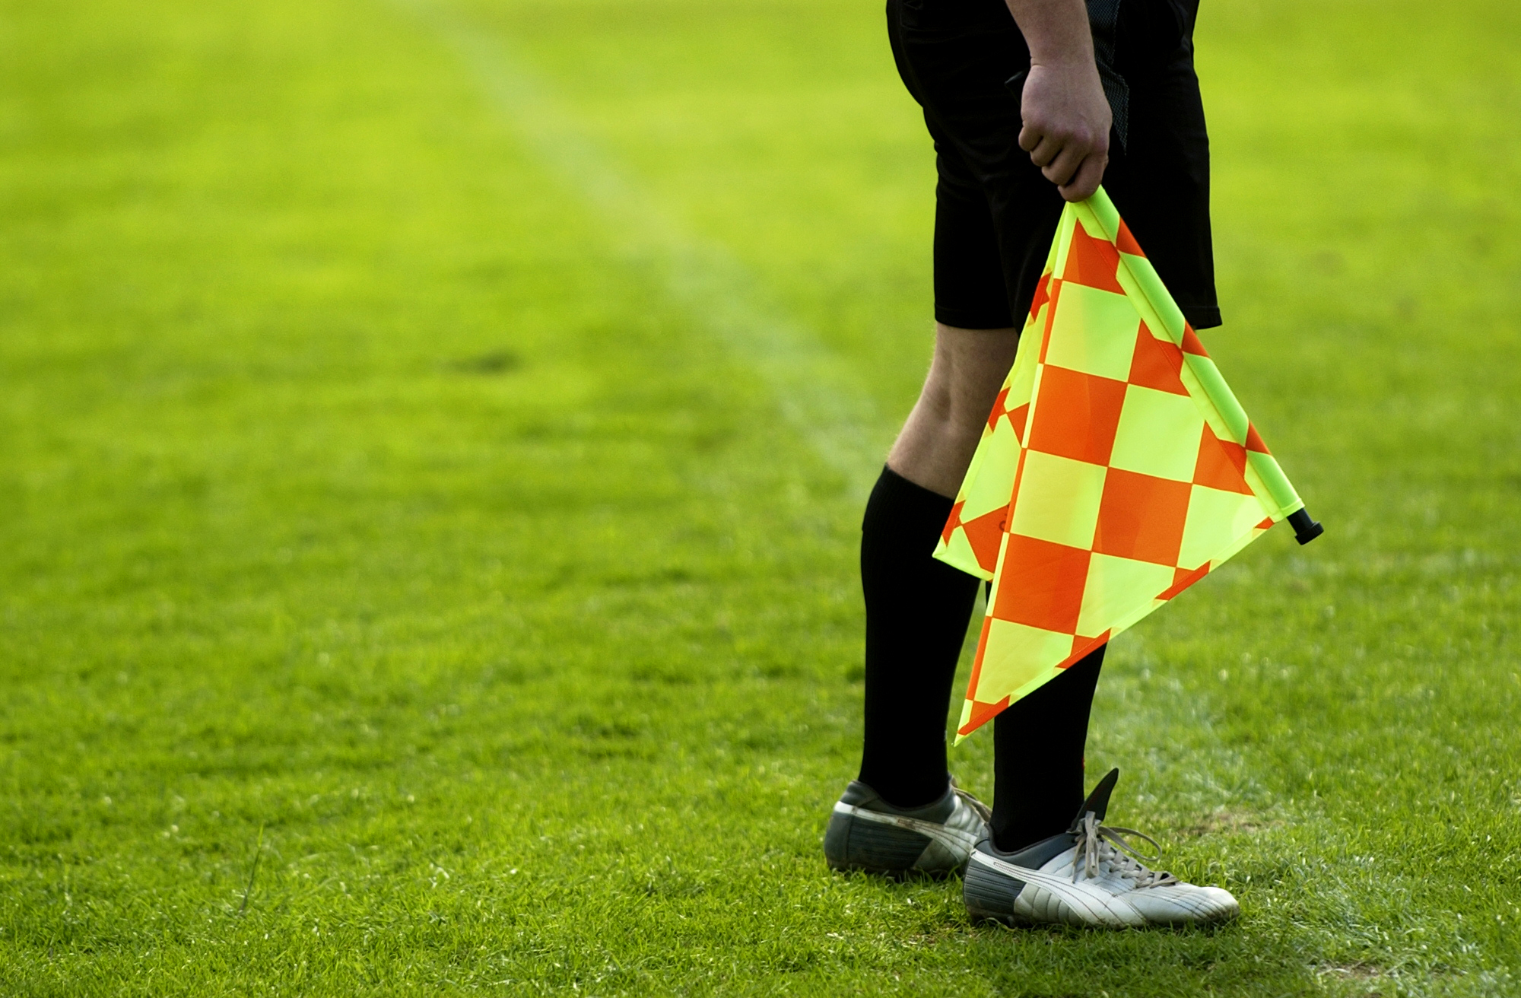
Activity 1:
What is 'the rule of law'?
THINK:
How would a game or sport go wrong if the rules were unclear or only applied to some people?
SHARE:
Would the game feel fair?
What might players start doing?
Who would benefit or lose out?
Notes:
Activity 1: What is 'the rule of law'?
Spend 5 minutes on this slide.
Ask students to feed back, you may get answers such as:
Some people might take advantage when rules aren’t clear.
Arguments break out more easily.
Players don’t know what is allowed or what will happen next.
The game stops feeling fair.
Those with more confidence or strength may dominate.
Explicitly link to framing: This is exactly why societies need the rule of law. Like a rulebook, it keeps things predictable and fair for everyone.

Slide 9







Activity 1:
What is 'the rule of law'?
The Rule of Law means that all people and institutions, including the state itself, are accountable to the same laws.
This means all laws should be...
Publicly declared
Equally enforced
Accessible and impartial
The rule of law aims to...
keep us safe and protect our rights
make life fair
limit the power of those in charge
Notes:
Activity 1: What is 'the rule of law'?
Spend 1-2 minutes on this slide.
Publicly declared = Laws are clear and communicated to all citizens. Everyone knows what the laws are and can easily find out information about the laws. Students should understand that in a fair system, people are not expected to follow hidden or changing rules.
Equally enforced = Laws apply to all citizens including those in positions of power such as the Government and the police. The rule of law only works when the rules apply to all players equally. The game only remains fair when no one is allowed to tilt the pitch or rewrite the rules to their advantage. Students should understand that equal enforcement protects our common good by preventing unfairness and misuse of power.
Accessible and impartial = Justice is delivered in a timely manner by qualified and independent representatives. For justice to work, everyone must be able to have their case heard and understood. This means justice is delivered: fairly, by trained and independent experts, without unnecessary delays, regardless of someone’s background, income or status.
Another central feature of the rule of law is that decisions are made by people who are independent, like referees who cannot be pressured by either team.

Slide 10

Activity 1:
What is 'the rule of law'?
Create your own definition of the rule of law using a simile.
You can build on the idea of a game, a rulebook, referees, a level playing field, or choose your own comparison.
Your metaphor should help someone your age understand:
Why shared rules matter
How they protect fairness for everyone
What happens when those rules aren’t applied equally
The Rule of Law is like...
Notes:
Activity 1: What is 'the rule of law'?
Spend 1-2 minutes on this slide.

Slide 11


Activity 2:
Charlie's Day
Hi, I’m Charlie. I am 13 years old and am in Year 8.
I’ve always thought laws had nothing to do with me unless I broke the law or did something really bad.
Why would they matter to me?I don’t drive a car or work!
Notes:
Activity 2: Charlie's Day
A common misconception of the law is that it only applies when you do something wrong – this activity will show the students that the law impacts all of us, most of the time.
Read Charlie’s introduction aloud to the class. Do they agree with Charlie? Explain that pupils will follow Charlie through a normal day and spot where the law applies. Emphasise the key question: “Can you find the parts of Charlie’s day where the law is involved?”

Slide 12




Activity 2:
Charlie's Day
It’s Monday morning. Charlie gets woken by their alarm and heads downstairs to pour themselves a bowl of chocolate cereal.
At 8am Charlie heads out and walks to the bus stop, then catches the bus to school.
The Food (Promotion and Placement) (England) Regulations 2021
The Road Traffic Act 1988
The school day starts with tutor time and then Charlie heads off for Science followed by Maths.
After Maths, it’s break time followed by PE, then lunch.
The Education Act
The School Premises (England) regulations 2012
Notes:
Activity 2: Charlie's Day AM
Spend 7 minute on this slide.
Have a student read out each paragraph. Talk about what laws could be mentioned here. Then use the animation to reveal one of the main laws we are focused on.
Answers
It’s Monday morning. Charlie gets woken by their alarm and heads downstairs to pour themselves a bowl of chocolate cereal. The Food (Promotion and Placement) (England) Regulations 2021 place restrictions on certain businesses relating to the price promotion and placement of certain foods and drinks that are high in fat, salt or sugar. These restrictions apply to certain foods and drinks both in shops and online.
There are also other laws which say how much tax needs to be paid on soft drinks, for example if they have more than 5g of sugar per 100ml, this makes them more expensive.
At 8:00am Charlie heads out and walks to the bus stop, then catches the bus to school. The bus driver is subject to a number of laws when driving. Most of these are covered by the Road Traffic Act 1988. It also sets out many conditions for drivers; for example, drivers must be insured, their vehicle must not be in a dangerous condition, they must obey traffic signs and speed limits.
Bus drivers who drive school buses are required to have completed an enhanced DBS check. Schools cannot hire drivers who are included in the children’s barred list, for example, because they have previously been convicted of certain offences (e.g. supplying drugs).
The school day starts with tutor time and then Charlie heads off for science followed by maths. The Education Act will affect Charlie’s education. Parents have a legal duty to ensure that their child receives an education. The legal age you can leave school differs across nations but is generally at some point after you turn 16. In England you must stay in some form of education or training until you are 18 (or have reached a level 3 qualification.) Most schools are required to follow the National Curriculum which sets out the key learning for each subject.
Under the Equality Act schools are under a duty not to discriminate against a pupil on the grounds of certain protected characteristics (age, disability, gender reassignment, marriage and civil partnership, pregnancy and maternity, race, religion or belief, sex, and sexual orientation).
After maths, it’s break time followed by PE, then lunch. In 2019, an all-party Parliamentary group on fit and healthy childhood recommended that school children should have a legal right to 75 minutes of break time in the school day. This would allow for the chief medical officer’s recommendations of 60 minutes of physical activity each day. However, there are currently no such laws in place. The School Premises (England) regulations 2012 requires that schools have suitable outdoor space to allow students to play outside and do physical education outside.
Schools have a number of legal duties to provide healthy and nutritious food and drink. Schools should also make reasonable adjustments for pupils with particular requirements, for example to reflect medical, dietary and cultural needs.

Slide 13




Activity 2:
Charlie's Day
In the afternoon Charlie has a 30-minute appointment with the school’s careers adviser. They talk about what options Charlie wants to pick for GCSE.
After school Charlie gets the bus home, grabs their bike and heads off to do their paper round.
The Education (Careers Guidance in Schools) Act 2022
The Children and Young Persons Act 1933
When Charlie gets home, they have some French and English homework to do before they can relax.
After dinner Charlie spends some time chatting with friends online before heading to bed.
There is no law!
The Online Safety Act 2023
Notes:
Activity 2: Charlie's Day PM
Spend 7 minute on this slide.
Have a student to read out each paragraph. Talk about what laws could be mentioned here. Then use the animation to reveal one of the main laws we are focused on.
Answers
In the afternoon Charlie has a 30-minute appointment with the school’s careers adviser. They talk about what options Charlie wants to pick for GCSE. The Education (Careers Guidance in Schools) Act 2022 makes it a legal requirement that all schools and academies provide independent careers guidance for pupils in school in Years 7 to 13.
After school Charlie gets the bus home, grabs their bike and heads off to do their paper round. There are lots of laws involved here. The Children and Young Persons Act 1933 protects children from
(i) working in conditions which may be harmful to their safety, health or development;
(ii) being ill-treated within the workplace;
(iii) working long hours.
Legally, young people can only start full-time work after the end of the academic year in which they’ve reached the minimum school leaving age - they can then work up to a maximum of 40 hours a week. The youngest age you can work part-time is 13, except children involved in areas like acting and modelling.
When Charlie gets home, they have some French and English homework to do before they can relax. This one is a trick - there are no laws here, only guidelines! Previously, the Government gave guidelines on how much homework schools should set, but it is down to each school personally and was never made into law. Ofsted, who are the Government body that inspects and regulates services in England providing education, stopped directly inspecting homework towards their grading criteria in 2019.
After dinner Charlie spends some time chatting with friends online before heading to bed. The Online Safety Act 2023 now makes social media companies more responsible for users’ safety on their platforms.
For example they have to:
(i) Remove illegal content and prevent users from being exposed to such material;
(ii) Protect children from harmful content;
(iii) Enforce age limits and age-checking measures.
Under data protection law, online services are not allowed to collect or store children’s personal information if they are under the age of 13, they can only do this legally if the child’s parent gives their consent.
Under the Human Rights Act, Charlie has the right to privacy. This means Charlie’s personal data is protected as part of their private life and cannot be collected, used or disclosed without justification. Under Data Protection and GDPR laws personal data that social media companies have collected in relation to Charlie must be processed fairly and lawfully.

Slide 14
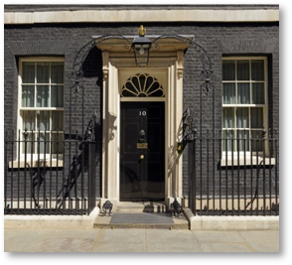
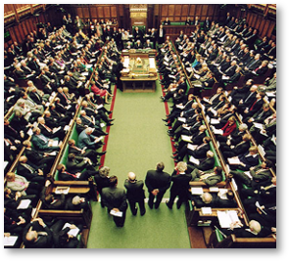
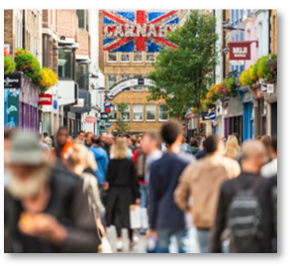
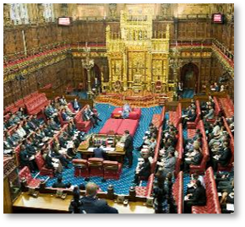
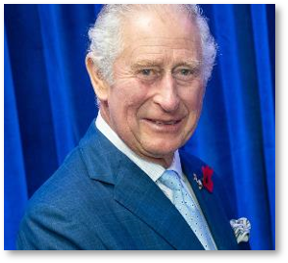
Activity 3:
Who makes the law?
With a partner list all the people or institutions you think are involved in making and changing the law in the UK.
The Prime Minister?
MPs in
the House of Commons?
The General Public?
The House
of Lords?
The King?
In your groups, match the role to the correct description on the next page.
Notes:
Activity 3: Who Makes The Law?
Spend 5 minutes on this slide.
With their partner, get the class to list all the people they think are involved in making and changing the law. After a few minutes, list the ones on this slide.
Split the class into small groups, and get them to match the role card with its definition. Next, display slide 16 and ask students to consider which of these roles has the power to make or change the law.
Note: Certain powers have been devolved from the UK Parliament to the Scottish Parliament, National Assembly for Wales and the Northern Ireland Assembly. Each of these have their own executive and legislative powers in certain areas such as health care and education. For the purposes of this activity, we are only examining how laws are made in the UK Parliament.

Slide 15
Activity 3:
Who makes the law?
1. A Police Officer
2. A Judge
3. A Lawyer
4. The King
5. Member of Parliament
6. A Citizen
7. The Prime Minister
8. The Media
9. A Peer
A. Their role is to maintain law and order within our communities. This includes protecting the public and preventing crime.
B. The leader of the Government. They are the person who is in charge of the political party that won the most seats in the House of Commons at the last general election.
C. A member of the House of Lords. The House of Lords has around over 800 members most of whom were appointed by the monarch on the advice of the prime minister because they are expert in their field (e.g. education, music).
D. A range of communication outlets through which news and information can be spread.
E. The Head of State. They must grant ‘Royal Assent’ for all new law.
F. A public officer appointed to preside over cases in a court of law.
G. Me, you, us! The people that live in a country.
H. A person who has been elected to represent the people from a particular geographical area (a constituency) in the House of Commons.
I. This person is an expert in law. They can give advice on legal matters. Some of them can also represent people in court.
Notes:
Activity 3: Who Makes The Law?
Spend 5 minutes on this slide.
In their small groups, get them to match the role card with its definition. Show them the answers in the next two slides when the task is finished.
Answers:
A Police = A. Their role is to maintain law and order within our communities. This includes protecting the public and preventing crime.
A Judge = F. A public officer appointed to preside over cases in a court of law.
A Lawyer = I. This person is an expert in law. They can give advice on legal matters. Some of them can also represent people in court.
The King = E. The Head of State. They must grant ‘Royal Assent’ for all new law.
Member of Parliament = H. A person who has been elected to represent the people from a particular geographical area (a constituency) in the House of Commons.
A Citizen = G. Me, you, us! The people that live in a country.
The Prime Minister = B. The leader of the Government. They are the person who is in charge of the political party that won the most seats in the House of Commons at the last general election.
The Media = D. A range of communication outlets through which news and information can be spread.
A Peer = C. A member of the House of Lords. The House of Lords has around over 800 members most of whom were appointed by the monarch on the advice of the prime minister because they are expert in their field (e.g. education, music).

Slide 16
Activity 3:
Who makes the law?
1. A Police Officer
A. Their role is to maintain law and order within our communities. This includes protecting the public and preventing crime.
2. A Judge
F. A public officer appointed to preside over cases in a court of law.
3. A Lawyer
I. This person is an expert in law. They can give advice on legal matters. Some of them can also represent people in court.
4. The King
E. The Head of State. They must grant ‘Royal Assent’ for all new law.
5. Member of Parliament
H. A person who has been elected to represent the people from a particular geographical area (a constituency) in the House of Commons.
6. A Citizen
Notes:
Activity 3: Who Makes The Law?
Spend 5 minutes on this slide.
In their small groups, get them to match the role card with its definition. Show them the answers when the task is finished.

Slide 17
Activity 3:
Who makes the law?
G. Me, you, us! The people that live in a country.
6. A Citizen
B. The leader of the Government. They are the person who is in charge of the political party that won the most seats in the House of Commons at the last general election.
7. The Prime Minister
D. A range of communication outlets through which news and information can be spread.
8. The Media
C. A member of the House of Lords. The House of Lords has around over 800 members most of whom were appointed by the monarch on the advice of the prime minister because they are expert in their field (e.g. education, music).
9. A Peer
Notes:
Activity 3: Who Makes The Law?
Spend 5 minutes on this slide.
In their small groups, get them to match the role card with its definition. Show them the answers when the task is finished.

Slide 18



Activity 3:
Who makes the law?
A Police Officer
They make sure people follow the law.
Now you know what everyone does, do you think they can make and change the law?
Yes, they can.
No, they can't.
It's complicated!
A Judge
They use laws to decide cases.
A Lawyer
They advise people on the law.
The King
Not really but all laws have to be given Royal Assent by the King.
The Prime Minister
Yes, but not on their own.
A Member Of Parliament
Yes, but not on their own.
A Lord or Baroness
Their job is to debate and suggest amendments to new laws.
Notes:
Activity 3: Who makes the law? (Optional Extension)
For each role, get students to decide whether they think they can make and change the law, whether they can't or whether it is complicated.
The Police: No, the police are responsible for maintaining public order and safety. They enforce the law, preventing and investigating criminal activities. They have no direct involvement in making or changing the law.
A Judge: It's complicated, it is not a judge’s role to make the law but rather to uphold it. Sometimes judges have to interpret the law, specially in new or unusual cases. This interpretation can add to 'case law' which then adds to legislation made by parliament.
A Lawyer: No. Lawyers are there to advise on the law; they cannot make or change it.
The King: Sort of, but not really! The final stage of getting any law created or changed is called Royal Assent. In practice, this is a formality and the monarch always grants Royal Assent. The last time a monarch refused was Queen Anne in 1707. The King is not able to introduce new laws.
MPs: Yes (but not on their own). At a general election, citizens vote for an MP to represent them in parliament. A total of 650 MPs are voted in and they all sit in a special chamber called the House of Commons. Part of an MP’s job is to debate and vote on laws in the House of Commons. In order for a new law to pass, 50% or more of MPs have to have voted for it.
The Prime Minister: Yes (but not on their own). The prime minister is the leader of the government, the group of people who have been elected to run the country. The government can propose new laws and suggest changes to laws; however, these have to be voted and agreed on in parliament.
A Lord or Baroness: It's complicated. Otherwise known as peers, these people form the second chamber of parliament – the House of Lords. They are appointed by the monarch on the advice of the prime minister because they are expert in their field (e.g. education, music, science, sport). Their job is to check and challenge the government. As part of this they discuss and debate any proposed changes to the law. The House of Lords cannot prevent bills passing into law, except in very limited circumstances, but they can delay bills and force the House of Commons to reconsider their decisions. As of February 2026, there are currently 739 life peers, 84 hereditary peers and 23 bishops in the House of Lords.

Slide 19
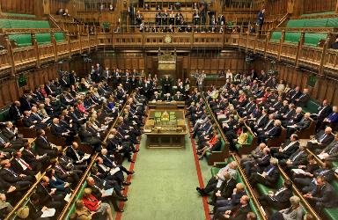


Activity 3:
Who makes the law?
Think to yourself, what are some of the problems that could arise if there was no balance of power?
In the UK, we try to solve this problem by having 3 separate powers...
Parliament
The Government
Justice System
The Legislature:
makes and changes laws
The Executive:
puts laws into practice and makes policy
The Judiciary: Interprets and upholds the law
Notes:
Activity 3: Who Makes the Law?
Spend 1-2 minutes on this slide.
Separation of powers is the principle that the three branches of state should be distinct in order to protect citizens. A strict separation of powers would mean no branch could exercise power over another and no one should be a member of more than one branch.
The UK follows a less strict interpretation of this. In the UK the executive (the Government) is made up of MPs who also form the legislative, and the executive is accountable to the legislative. The Government and the prime minister are not directly elected; instead the leader of the party who secures the most MPs becomes prime minister and they in turn decide on who will get ministerial positions within the Government. For example, they decide who will become chancellor, home secretary etc.
In contrast a country such as the US follows a stricter interpretation. They have an executive (the president) who is directly elected and is entirely separate to the legislative (Congress).

Slide 20
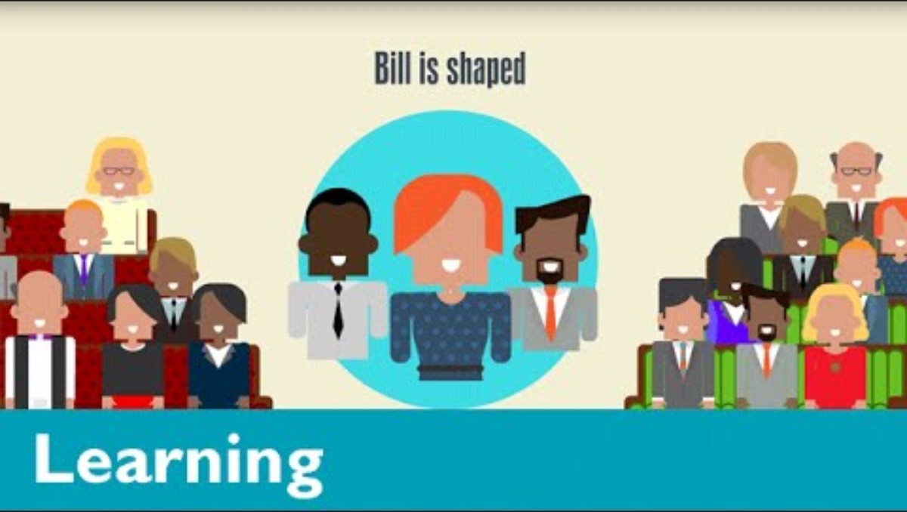

Activity 3:
Who makes the law?
Together as a group:
Why do you think the power to change the law sits with more than one group of people?
Whilst you and me don’t have direct power to change the law, we can still influence it. What actions could you take to influence the law?
www.youtube.com/watch?v=iM4CKYCrW7Y
Notes:
Activity 2: Who Makes The Law? (Optional Extension)
Spend 2 minutes on this slide.

Slide 21



The Big Challenge 1:
The Law and Me
Write/Draw a timeline of your day, describing all the ways you will interact with the law.
Think about all the different areas that the law can affect.
Interests?
Travel?
Education?
Socialising?
Notes:
Activity 3: What’s the law got to do with me?
Spend 5 minutes on this slide.
With Charlie's Day in mind, now have the students create their own time-line of their day and how the law affects them.

Slide 22



The Big Challenge 2:
My New Law
Think about what power we have as citizens.
Citizens can’t make laws themselves, but you can influence them by:
So... what laws would YOU make?
My new law is...
We need it because...
It would help...
Another reason to consider this is...
Writing to your MP
Starting a petition
Joining a campaign
What are the arguments for and against your suggested changes?
Which individuals would be affected if the law was changed?
How would society be affected if the law was changed, including any consequences of not following the law?
Notes:
The Big Challenge 2: My New Law
Spend 10 minutes on this slide.
This activity helps pupils understand that while citizens cannot make laws themselves, they can influence change through democratic actions. It also encourages creative thinking about laws they would introduce.
Keep explanations short and link to real-life examples if possible (e.g., petitions for school meals or playground safety). Briefly share the three ways citizens can influence laws:
Writing to your MP
Starting a petition
Joining a campaign
Set the challenge: Now imagine you could create a new law. What would it be? Why do we need it? Who would it help?
Pupils can use the sentence starters if needed. Pupils work individually or in pairs for 5 minutes to create their law. Encourage them to write one or two sentences using the starters or write a letter to their MP using these sentences. Invite a few pupils to share their ideas with the class.

Slide 23


Reflections
Now at the end of the lesson...
Complete a quick class reflection.
It takes less than 5 minutes.
Answer honestly: there are no right or wrong answers.
This helps us understand what you learned and how you feel about the rule of law.
Notes:
Student Reflections
NB: Only you need to scan the QR code or click the green link embedded on the slide. The questions are student facing, are done as a group and act as reflective prompts for your class.
Optional: Screenshot your answers before submitting for your own activity records.

Slide 24

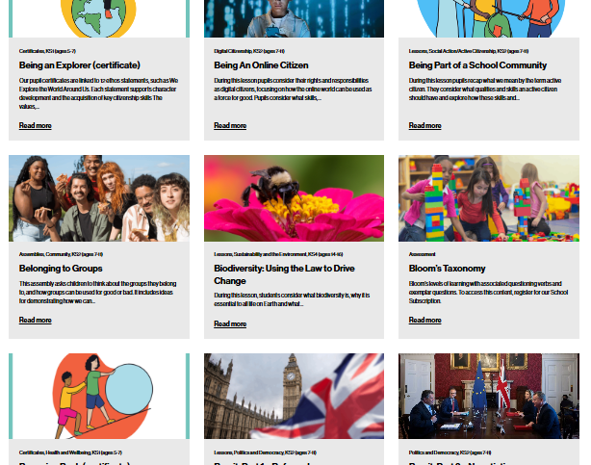


After the session
Your thoughts...
Want more resources?
Tag us!
We have heard what your students think during the lesson, now tell us how you found it as a teacher.
We'd love to hear how you use Young Citizens resources over at Facebook, LinkedIn and Instagram. You can tag us at:
RE
We have a library of over 100 free resources available for you to download right now. Sign up here:
www.surveymonkey.com/r/ZCX3RRS
www.youngcitizens.org/resources
@YoungCitizensUK
#TheBigLegalLesson
Citizenship
PSHE

