Slide 1




The Big
Legal Lesson
Sponsored by
KS4 & 5
Notes:
The Big Legal Lesson: Key Stage 4 & 5 Lesson Plan & Slides
Thank you for taking part in The Big Legal Lesson 2026. You are joining a network of thousands of teachers across England and Wales who are committed to developing children’s knowledge of the rule of law and their legal rights. For more The Big Legal Lesson resources and information, please head to www.youngcitizens.org/programmes/the-big-legal-lesson/
To find out more information about Young Citizens and our mission, you can check our website at www.youngcitizens.org

Slide 2

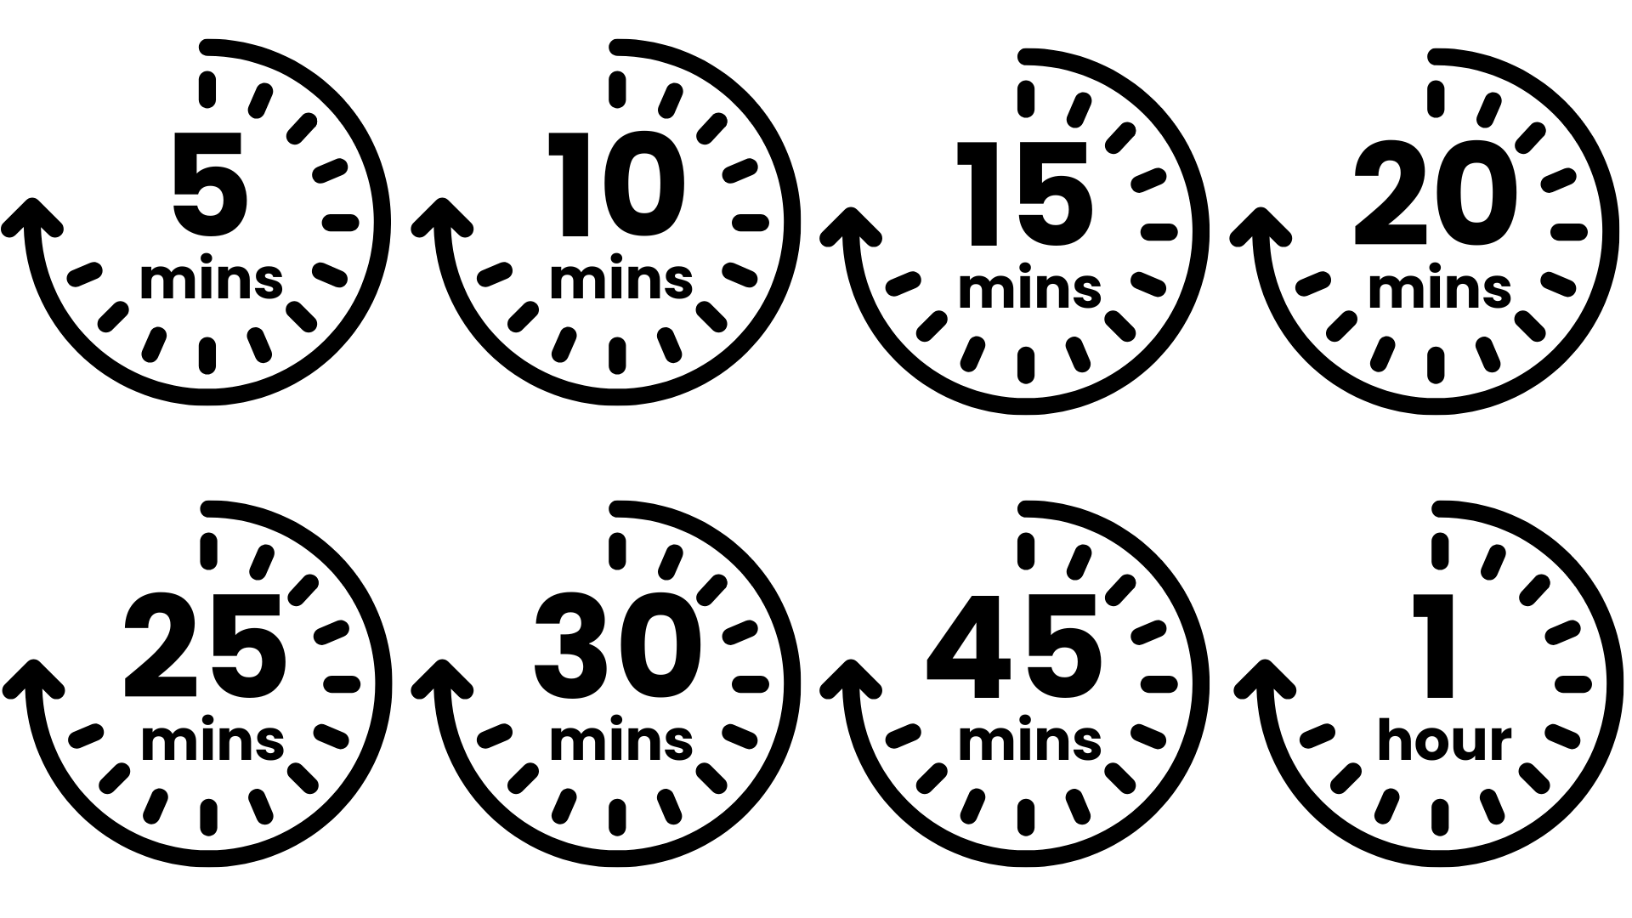




Lesson preparation
Teacher checklist
Keyword definitions
Why teach
The Big Legal Lesson?
Allow a minimum of 45
minutes to deliver the
lesson.
Familiarise yourself with Lesson Overview (Slide 3) and slides.
Read the Top Tips & Rule of Law 101 (Slide 4 and 5).
Read the 'Notes' in each slide which have more information.
For Charlie's Day, we have two variations differentiated by age. Please use the version most relevant for your students.
Rule of Law - a set of principles for a fair and effective society where everyone is accountable to the law.
Parliament - made up of elected MPs in the House of Commons and appointed Lords in the House of Lords. Responsible for creating and amending laws.
The Government - sets the agenda for new laws, drafting them with lawyers and implementing them once passed.
The Judiciary - system of courts and judges, responsible for interpreting and applying existing laws.
Bill - a proposal for a new law, or to change an existing law.
Act - a bill which has been passed by Parliament and given royal approval, making it official law.
Ofsted Personal Development & Wellbeing
Curriculum
Citizenship SMSC
English
Skills
Critical thinking
Communication
Oracy
Pedagogical principles
Support on making learning locally relevant and impartiality
Notes:
Full Ofsted and Curriculum References
Ofsted Schools Inspection Toolkit, Page 47: 'In gathering evidence about the personal development programme, including pupils’ SMSC development, inspectors consider the extent to which: pupils develop their ability to recognise the difference between right and wrong, including...recognising legal boundaries and respecting the civil and criminal law of England'
Curriculum
Citizenship Programmes of Study, Key Stage 3 and 4, Page 1, 'The national curriculum for citizenship aims to ensure that all pupils...develop a sound knowledge and understanding of the role of law and the justice system in our society and how laws are shaped and enforced'
English Programmes of Study, Key Stage 4, Page 7, 'working effectively in groups of different sizes and taking on required roles, including leading and managing discussions, involving others productively, reviewing and summarising, and contributing to meeting goals/deadlines; listening to and building on the contributions of others, asking questions to clarify and inform, and challenging courteously when necessary; planning for different purposes and audiences, including selecting and organising information and ideas effectively and persuasively for formal spoken presentations and debates'

Slide 3
Lesson overview
Activity 1
Activity 2
Activity 3
What is 'the rule of law'?
Slide 6
Introduce the lesson using the starter prompt on the slide and invite pupils to share thoughts.
Slide 7
Introduce the learning objectives of the session.
Slide 8 – Slide 10
Students consider what the features of the rule of law principle is and how it strengthens society and communities.
They are challenged to justify how the rule of law benefits them and their lives.
Charlie's Day
Slides 11 – 13 (Ages 14 – 16)
Students identify where the laws apply in Charlie's day and what purpose they serve.
OR
Slide 14 – 16 (Ages 16+)
Students are challenged to identify or discuss any potential tensions apparent in the laws they spot.
Who makes the law? (Optional)
Slide 17 – 21 Who makes the law? Context explaining how laws are made in the UK and the different roles involved.
The Changing Law
Slide 22 - 25
Students are introduced to 3 areas where the law has changed recently (The Right to Strike, The Right to Protest, The Right to Vote). In each scenario, they have to consider why the law has changed, who it affects and whether they agree with the changes).
Make your voice heard
Slide 26
Students prepare a proposal outlining a change they would introduce, they consider who they need to influence and how they may get their voice heard.
Notes:
Lesson Length
This lesson can be run as a 45 minute lesson or a 60 minute lesson.
Activity 1 remains the same for both versions.
Activity 2 can be extended by adding the 2 extension activities.
Activity 3 remains the same for both versions

Slide 4
Top tips
Local relevance
Preparation
Impartiality
This resource is designed to create a space where students can practice respectful discussion and begin to see the relevance of the law to their everyday lives.
To ensure this topic feels relevant to your students, consider:
Swapping the image in the opening slide for one which will resonate with your students
Amending Charlie's name, or any elements of Charlie's day in Activity 2 to make them closer to your students' experience
Changing the icons that guide your students as they map out a timeline of their own day in Activity 3
Consider differentiating so EAL and SEND students can access the learning and express their ideas.
Think about your students' current experience of, or attitudes towards, the rule of law, or law enforcement. How might these affect their experience of the lesson? Might some topics trigger an emotional impact or response? Can you adapt the lesson to consider their needs?
Identify existing resources you can repurpose such as class agreements or existing practices such as respectful listening, the right to pass, the right to have opinions respected, and support respectful discussion using:
I think that… It looks like… because …
My view of this is…
I agree/disagree with…because
I appreciate this view however...
It is my opinion that... however others may think that...
Teaching about the rule of law often leads to discussions around political or societal issues, so learning how to teach about these with impartiality is important to consider ahead of the lesson.
Impartiality doesn't mean avoiding certain subjects, even ones you have strong beliefs about.
Impartiality does mean:
Avoiding promoting partisan political views
Providing a balanced presentation of views
Challenging extremist or discriminatory views
Addressing misinformation, supporting students in distinguishing fact from opinion
Consider ahead of the lesson how you will achieve this, especially if you feel strongly about some of the topics raised.

Slide 5
Rule of Law 101
What do we mean by the 'Rule of Law'?
The Rule of Law is a principle of governance in which all people and institutions, regardless of who they are, and including the state itself, are accountable to the same laws. Under this system, all laws should be:
Publicly declared; so anyone can know what the law is
Equally enforced; the same laws apply to everyone regardless of status, wealth or education
Accessible and impartial; the law is upheld by an impartial justice system which is available to all
Why do we need laws?
Laws exist to keep life safe, fair, and organised. They organise society, protect people from harm, make sure everyone is treated equally, and safeguard basic rights. For example, seatbelt laws help keep us safe, education laws ensure every child can go to school, and consumer laws mean shops must sell safe food. The rule of law is not just about preventing chaos or punishing crime: it shapes everyday life.
Who makes the law?
In the UK, laws are made by Parliament (both the House of Commons and the House of Lords) and formally approved by the Monarch. Most laws start as Bills proposed by the Government or individual MPs and are debated, amended, and voted on in both Houses. The House of Commons, made up of elected MPs, has the final say, while the House of Lords checks and suggests improvements to legislation. Once both Houses agree, the Monarch gives Royal Assent, the Bill becomes law, and the law is interpreted and upheld by the Judiciary (the system of courts and judges). The UK system features a balance of power between these roles and institutions which helps prevent any one group from having too much power over another.

Slide 6
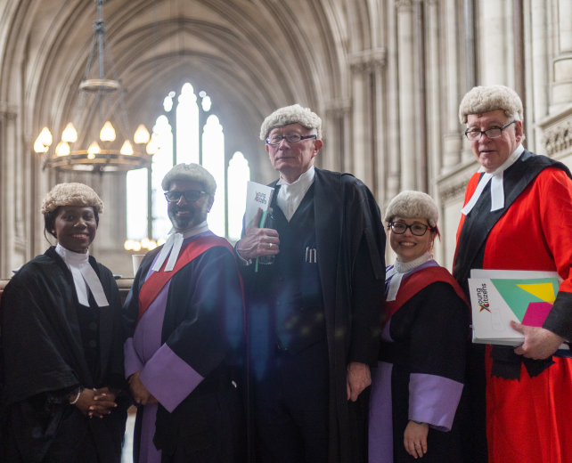
The Big Legal Lesson
[
What is one thing you know about the law?
What is one question you have about how laws work?
Who do you think has the most influence over decisions that affect your life: Parliament, Government, Courts, or Citizens?
Notes:
Starter Activity
Spend 2 minutes on this slide.
Explain that there are no right or wrong answers; this is a baseline to launch the session. If students completed the KS3 lesson, this activates prior understanding; if not, it provides an inclusive starting point. Take 2–3 verbal contributions to surface misconceptions you will address later.

Slide 7
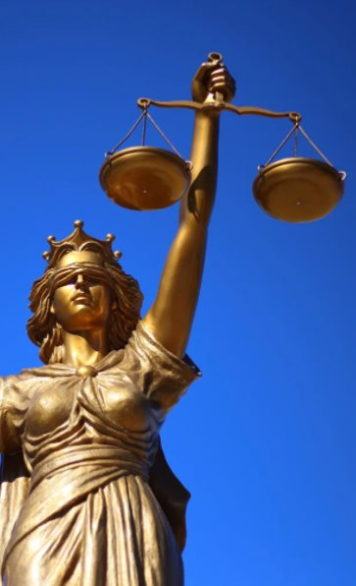

Lesson objectives
By the end of the lesson, I will be able to...​
Explain what the rule of law is and why it matters.
Identify how the law affects your daily life.
Identify what actions you could take to make your voice heard by those in positions of power.
Notes:
Lesson Objectives
Spend 1 minute on this slide.
Read through the objectives and check students' understanding.
Flag that you will be asking them to reflect on how they achieved these at the end of the lesson.

Slide 8



Activity 1:
What is 'the rule of law'?
The rule of law means that all people and institutions, including the state itself, are accountable to the same laws.
This means all laws should be...
Publicly declared
Equally enforced
Accessible and impartial
Discuss: Why do these principles matter to all of us?
Notes:
Activity 1: What is 'the rule of law'?
Spend 1-2 minutes on this slide.
Key messages: The rule of law helps ensure our society works fairly and consistently for all of us. Keep the tone focused on the rule of law as a public service that benefits all of us, not a niche legal concept. Avoid crime‑only examples in your explanations: emphasise how clear, fair rules support communities, workplaces and everyday life.
Laws are publicly declared. So everyone knows the rules we are all expected to follow, and those rules are clear and accessible.
Laws are equally enforced. Those in power must follow the rules just like everyone else - no exceptions, no special treatment.
Laws are accessible and impartial. People can challenge unfair decisions through an independent justice system that serves the public and is fair for everyone.

Slide 9
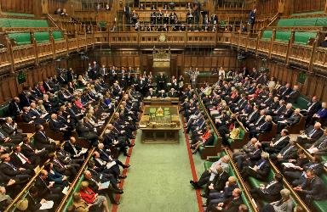

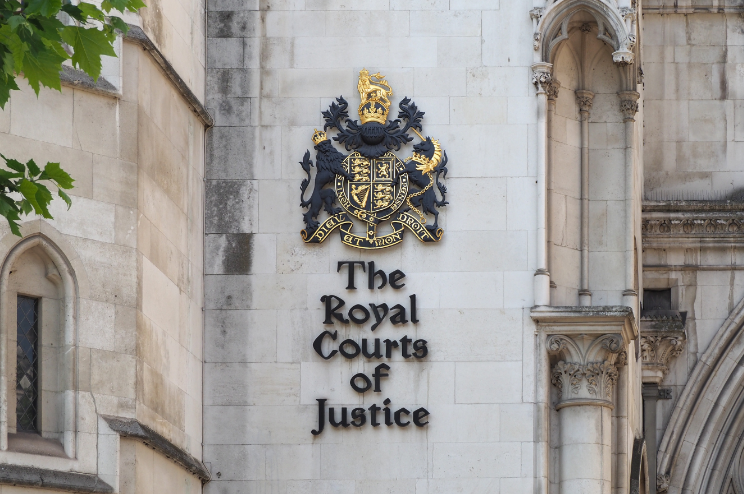
Activity 1:
What is 'the rule of law'?
Parliament
The Government
Justice System
The Legislature:
makes and changes laws
The Executive:
puts laws into practice and makes policy
The Judiciary: upholds the law
In pairs: Why is it important that these powers are separate?
What could go wrong if they were not?
Notes:
Activity 1: What is 'the rule of law'?
Spend 1-2 minutes on this slide.
Separation of powers is the principle that the three branches of state should be distinct in order to protect citizens. A strict separation of powers would mean no branch could exercise power over another and no one should be a member of more than one branch.
The UK follows a less strict interpretation of this. In the UK the executive (the government) is made up of MPs who also form the legislative, the executive is accountable to the legislative. The government and the prime minister are not directly elected; instead the leader of the party who secures the most MPs becomes prime minister and they in turn decide on who will get ministerial positions within the government. For example, they decide who will become chancellor, home secretary etc.

Slide 10





The Big Challenge 1:
Make your case
Choose one of the benefits of a strong Rule of Law:
The rule of law aims to...
keep us safe and protect our rights
ensure people can rely on fair treatment
limit the power of those in charge
Imagine you are trying to convince your friend that the rule of law benefits all of us. Write a short paragraph: 1. Why does this aim matter for our common good?
2. Where do you see this aim playing a role in everyday life?
3. What could happen if this aim wasn't protected?
Notes:
The Big Challenge 1: Make your Case
Spend 1-2 minutes on this slide. Students write a short, structured argument (5–7 sentences) explaining why one benefit of the Rule of Law matters most in their own life or community. You can choose to adapt this to an oracy task where students present their arguments to each other after preparing it.

Slide 11


Activity 2:
Charlie's Day
Hi, I’m Charlie. I am 16 years old and am in Year 11. I’ve always thought laws had nothing to do with me unless I broke the law or did something really bad. Why would they matter to me? I don’t drive a car or work!
Notes:
Activity 2: Charlie's Day
A common misconception of the law is that it only applies when you do something wrong – this activity will show the students that the law impacts all of us, most of the time.
Read Charlie’s introduction aloud to the class. Do they agree with Charlie? Explain that pupils will follow Charlie through a normal day and spot where the law applies. For each section of Charlie's Day – you can extend the learning by prompting students to identify: Who is the law trying to protect? What purpose does it serve?

Slide 12




Activity 2:
Charlie's Day: AM
It’s Monday morning. Charlie gets woken by their alarm, heads downstairs, pours a bowl of chocolate cereal and finishes off their homework.
At 8am Charlie heads out and walks to the bus stop, then catches the bus to school.
The Food (Promotion and Placement) (England) Regulations 2021
The Road Traffic Act 1988
The school day starts with tutor time and then Charlie heads off for Maths followed by PE.
After PE it’s break time followed by science, then lunch.
The Education Act 1996
The School Premises (England) regulations 2012
Notes:
Activity 2: Charlie's Day AM [14-16 year olds] Spend 7 minute on this slide.
Have a student to read out each paragraph. Talk about what laws could apply. Challenge them to think about who the law is trying to protect or what purpose it serves.
Additional Notes
BREAKFAST: The Food (Promotion and Placement) (England) Regulations 2021 places restrictions on certain businesses relating to the price promotion and placement of certain foods and drinks that are high in fat, salt or sugar. These restrictions apply to certain foods and drinks both in shops and online. There are also other laws which say how much tax needs to be paid on soft drinks, for example; if they have more than 5g of sugar per 100ml, this makes them more expensive. The sugar tax is changing to 4.5g per 100ml from 1 January 2028. What protection/purpose does this serve? It helps ensure people aren't unfairly influenced by marketing tactics that might encourage unhealthy choices.
HOMEWORK: In years gone by the government have set guidelines about how much homework schools should be setting but these have never been made into law. In 2012, the government scrapped these guidelines saying that headteachers should set their own policies.
BUS TO SCHOOL: The bus driver is subject to a number of laws when driving. Most of these are covered by the Road Traffic Act 1988. It also sets out many conditions for drivers; for example, drivers must be insured, their vehicle must not be in a dangerous condition, they must obey traffic signs and speed limits. Bus drivers who drive school buses are required to have completed an enhanced Disclosure and Barring Service (DBS) check. Schools cannot hire drivers who are included in the children’s barred list, for example, because they have previously been convicted of certain offences (e.g. supplying drugs). What protection/purpose does this serve? It aims to keep everyone safe on the roads by ensuring drivers meet minimum safety standards. It further serves to safeguard children.
SUBJECTS IN SCHOOL: The Education Act 1996 is the main legislation governing education in the UK and will affect Charlie’s education. Parents have a legal duty to ensure that their child receives an education. The legal age you can leave school differs across nations but is generally at some point after you turn 16. In England you must stay in some form of education or training until you are 18 (or have reached a level 3 qualification.) Most schools are required to follow the National Curriculum which sets out the key learning for each subject. Under the Equality Act schools are under a duty not to discriminate against a pupil on the grounds of certain protected characteristics (age, disability, gender reassignment, marriage and civil partnership, pregnancy and maternity, race, religion or belief, sex, and sexual orientation). What protection/purpose does this serve? Ensures all young people have access to consistent learning and prevents unfair treatment in school.
PE AND LUNCH: The School Premises (England) regulations 2012 requires that schools have suitable outdoor space to allow students to play outside and do physical education. A regulation was passed in 2012 which states that a school must have a suitable outdoor space to play outside. In 2019, an all-party parliamentary group on fit and healthy childhood recommended that school children should have a legal right to 75 minutes of break time in the school day. Schools have a number of legal duties to provide healthy and nutritious food and drink. Schools should also make reasonable adjustments for pupils with particular requirements, for example to reflect medical, dietary and cultural needs. What protection/purpose does this serve? Ensures that students have access to food that supports health and learning and ensures school environments are safe and suitable.

Slide 13




Activity 2:
Charlie's Day: PM
After school Charlie attends an event organised by the careers office.
Charlie can’t stay long at the careers event as they have to get to their part-time job.
The Education (Careers Guidance in Schools) Act 2022
The Children and Young Persons Act 1933
Charlie works in a local café for a couple of hours after school on a Monday and all day on a Saturday.
Charlie’s step-dad collects them afterwork. Once Charlie gets home, they spend some time browsing social media. They then grab a quick dinner before heading to bed.
Food Safety Act 1990
The Online Safety Act 2023
Notes:
Activity 2: Charlie's Day PM [14-16 year olds]
Spend 7 minute on this slide.
Have a student to read out each paragraph. Talk about what laws could apply. Challenge them to think about who the law is trying to protect or what purpose it serves.
Additional Notes
CAREERS: The Education (Careers Guidance in Schools) Act 2022 makes it a legal requirement that all schools and academies provide independent careers guidance for pupils in school in Years 7 to 13. Purpose/protection: Ensures all young people receive guidance that helps them make informed decisions about their future.
PART TIME JOB: The Children and Young Persons Act 1933 protects children from (i) working in conditions which may be harmful to their safety, health or development; (ii) being ill-treated within the workplace; (iii) working long hours. Legally, young people can only start full-time work after the end of the academic year in which they’ve reached the minimum school leaving age - they can then work up to a maximum of 40 hours a week. The youngest age you can work part-time is 13, except children involved in areas like acting and modelling. Charlie will have certain rights under employment law. They are entitled to their salary as stated in their employment contract, and they may have rights to daily and weekly rest breaks. Under law, the employer would also need to ensure the health, safety and welfare at work of its employees. Purpose/protection: The law aims to prevent young people from working in unsafe or harmful conditions, being exploited or mistreated and working excessive hours that could affect their health or education.
CAFÉ: The café itself will also be subject to a number of laws around food safety such as those set out in the Food Safety Act 1990 (which is the foundational legislation for food safety). There are also laws under the Hazardous Health regulations which applies to the cleaning of tables and washing dishes. Purpose/protection: Cafes and restaurants store, prepare and serve food safely to reduce the risk of illness.
SOCIAL MEDIA: The Online Safety Act 2023 has now received Royal Assent. It makes social media companies more responsible for users’ safety, for example, they will have to: (i) Remove illegal content and prevent users from being exposed to such material; (ii) Protect children from harmful content; (iii) Enforce age limits and age-checking measures. Under the Human Rights Act, Charlie has the right to privacy. This means Charlie’s personal data is protected as part of their private life and cannot be collected, used or disclosed without justification. Under GDPR laws personal data that social media companies have collected in relation to Charlie must be processed fairly and lawfully. There are many other laws that protect people from harmful communications online. For example, under the Communications Act 2003 people are prohibited from writing ‘menacing electronic communication’. Sending grossly offensive comments is an offence under both the Communications Act and the Malicious Communications Act. If people write something that is untrue or unjustified, which is damaging to a person’s reputation they may be guilty of libel under the Defamation Act. Purpose/protection: Makes online spaces safer by reducing harmful or abusive content and ensuring platforms act responsibly and are accountable for their decisions. Protects people from threatening or offensive online messages or false statements that could damage their reputation.

Slide 14
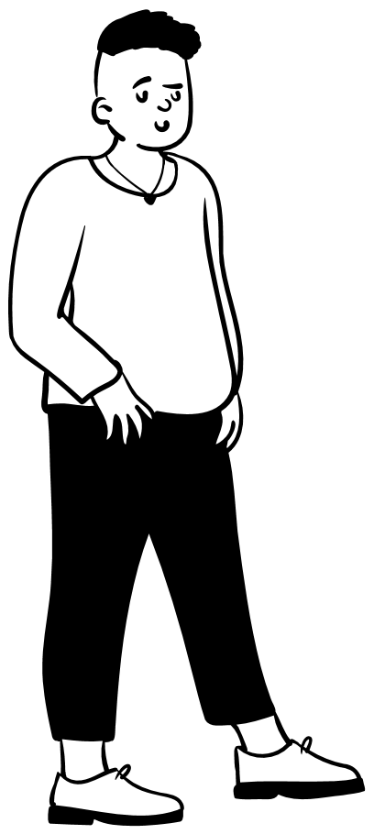
Activity 2:
Charlie's Day
Hi, I’m Charlie. I am 18 years old and in my final year of college. I used to think the law only mattered if you broke it or did something wrong. But most of the time, the law is shaping everyday things I don't even notice – before things go wrong. As we go through my day, try and pinpoint:
What laws apply?
Who do they protect or what purpose do they serve?
Decide whether the laws go far enough or whether they create tensions (e.g. fairness vs practicality, safety vs freedom).
Notes:
Activity 2: Charlie's Day [16+ year olds]
A common misconception of the law is that it only applies when you do something wrong – this activity will show the students that the law impacts all of us, most of the time. For 16+ students, raise the level of challenge by shifting their attention from spotting laws to evaluating how the law operates. This includes analysing how power is used, who benefits most, where fairness may break down, and how effectively the law creates a level playing field. Encourage older learners to consider grey areas: situations where the law may work well for some but not others, or where stronger accountability might be needed. Their task is not just to identify laws, but to question, critique and weigh up their impact. Have a student read out each paragraph. Discuss which laws could apply and then use the animation to reveal one of the main laws we are focusing on.
At this point, you can choose how to explore the “tensions” element of the activity:
Option 1: Briefly touch on the tensions for each scenario as a whole class, using the prompts provided to guide a short discussion.
Option 2: Assign a different law or scenario to each group and ask them to think about (or debate) the tensions specific to their area (for example, balancing safety and independence in driving, or balancing access and security in voting). Groups can then share back their reflections.

Slide 15



Activity 2:
Charlie's Day: AM
Charlie wakes up at 7.00am, has a shower and eats some breakfast.
At 7:45am, Charlie heads out. They have recently passed their driving test and have agreed to drive a couple of friends to college.
The Food (Promotion and Placement) (England) Regulations 2021
The Road Traffic Act 1988
Once Charlie gets to college, they head straight to registration before going off to their lessons.
After lunch Charlie has a meeting with the school’s careers adviser to discuss what their plans are for the following year. Charlie is thinking about going to university but is a bit undecided.
The Education Act 1996
The School Premises (England) regulations 2012
Notes:
Activity 2: Charlie's Day AM [16+ year olds]
Spend 7 minute on this slide.
Have a student to read out each paragraph. Talk about what laws could be mentioned here. Then use the animation to reveal one of the main laws we are focused on.
Additional Notes
BREAKFAST: The Food (Promotion and Placement) (England) Regulations 2021 places restrictions on certain businesses relating to the price promotion and placement of certain foods and drinks that are high in fat, salt or sugar. These restrictions apply to certain foods and drinks both in shops and online. There are also other laws which say how much tax needs to be paid on soft drinks; for example if they have more than 5g of sugar per 100ml, this makes them more expensive. The sugar tax is changing to 4.5g per 100ml from 1 January 2028. PURPOSE/PROTECT: Aim to reduce unhealthy marketing tactics, Intended to create clearer, fairer information for consumers, Protect young people from being targeted by aggressive promotions. TENSIONS TO EXPLORE: What are the benefits of limiting how unhealthy foods are promoted and what might be some unintended consequences? How should the law balance public health goals with individual choice? Do regulations on food marketing affect everyone equally or might different groups experience them differently?
DRIVING: Charlie is subject to a number of laws when driving. Most of these are covered by the Road Traffic Act 1988. For example, this act sets the minimum age requirements to get a driving licence. It also sets out many conditions for drivers; for example, drivers must be insured, their vehicle must not be in a dangerous condition, they must obey traffic signs and speed limits. Charlie will also have to make sure that the vehicle is taxed as set out in the Vehicle Excise and Registration Act, this also means they must tell the DVLA if there is any change to their insurance or if they sell the car. Under the law, Charlie is also responsible for making sure any passengers under 14 are wearing a seatbelt. As a new driver, Charlie will be affected by the Road Traffic (New Drivers) Act. Under this act all new drivers enter a two year probationary period after they pass their test. During this time if they reach six or more penalty points, they will immediately have their licence revoked. The government is currently considering preventing drivers aged under 25 from carrying passengers under 25 for the first six months or year after they pass their test. PURPOSE/PROTECT: Designed to keep public safe by regulating who can drive and how, new driver restrictions aim to reduce accidents, protect passengers.
TENSIONS TO EXPLORE: How should the law balance road safety with young people's independence? Are additional rules for new drivers a fair way to reduce risk or do they create more challenges?
COLLEGE: The Education Act 1996 is the main legislation governing education in the UK and will affect Charlie’s education. For example, in England you are legally required to stay in school until the last Friday in June if you’ll be 16 by the end of the summer holidays. You then must do one of the following until you are 18: (i) Stay in full-time education; (ii) Start an apprenticeship or traineeship; (iii) Spend 20 hours a week volunteering or working whilst in part-time education or training. Amongst other things, the Education Act also gives schools a number of legal powers to tackle behaviour and under-performance. For example, schools can search pupils (without consent) for any dangerous or banned items and headteachers can exclude pupils. Under the Equality Act schools are under a duty not to discriminate against a pupil (or someone who has applied to their school) on the grounds of certain protected characteristics. The protected characteristics are: age, disability, gender reassignment, marriage and civil partnership, pregnancy and maternity, race, religion or belief, sex, and sexual orientation. PURPOSE/PROECT: Access to education, prevent unfair treatment, maintain safety for all pupils and teachers TENSIONS TO EXPLORE: Do behaviour-related policies feel fair in all situations or can they create dilemmas? How should schools balance keeping everyone safe with protecting student privacy and autonomy?
CAREERS/UNIVERSITY: The Education (Careers Guidance in Schools) Act 2022 makes it a legal requirement that all schools and academies provide independent careers guidance for pupils in school in Years 7 to 13. The Higher Education (Fee Limits and Fee Limit Condition) (England) Regulations 2018 sets out the maximum amount that universities can charge for tuition. PURPOSE/PROTECT: Students receive neutral, reliable information about future routes; prevents universities charging excessive tuition fees. TENSIONS TO EXPLORE: Is the law enough to ensure effective careers guidance across all schools? What factors should be considered when deciding how much universities should charge for tuition? How might different fees create advantages or disadvantages for different groups of students?

Slide 16

Activity 2:
Charlie's Day: PM
After school, Charlie heads off to their part time job.
Charlie works in a local café for a couple of hours after school on a Monday and all day on a Saturday.
Employment Laws
Food Safety Act 1990
Just before Charlie heads home for the night, their boss asks if they have remembered that it is local council elections today. Charlie should just have time to get to the polling station before it shuts at 10pm.
Once Charlie gets home, they have some dinner and spend some time flicking through social media before heading to bed.
The Representation of the People Act 1983
The Online Safety Act 2023
Notes:
Activity 2: Charlie's Day PM [16+ year olds]
Spend 7 minute on this slide.
Have a student to read out each paragraph. Talk about what laws could be mentioned here. Then use the animation to reveal one of the main laws we are focused on.
Additional Notes
PART TIME JOB: Charlie will have certain rights under employment law. For example, they would be entitled to their salary as stated in their employment contract, and they may have rights to daily and weekly rest breaks. Under law, the employer would also need to ensure the health, safety and welfare at work of its employees. As Charlie is above the school leaving age they are legally entitled to minimum wage. When working, holiday entitlement is also legally entitled including bank holidays and is pro-rated for part-time workers, otherwise for full-time it is 5.6 weeks’ paid holiday a year (known as statutory leave entitlement or annual leave). Whilst at work Charlie will also be protected from discrimination by the Equality Act. PURPOSE/PROTECT: Ensure young workers are treated fairly at work, prevent unsafe or exploitative working conditions, support a balance between work, education and wellbeing, and set clear minimum standards that all employers must follow. TENSIONS TO EXPLORE: How should the law balance protecting young workers with allowing them opportunities to gain experience? Do workplace protections apply effectively in all types of jobs or are some roles harder to regulate?
CAFÉ: The café itself will also be subject to a number of laws around food safety such as those set out in the Food Safety Act 1990 (which is the foundational legislation for food safety). There are also laws under the Hazardous Health regulations which applies to the cleaning of tables and washing dishes. PURPOSE/PROTECTION: Ensure food is safe to eat and reduce the risk of illness, maintain hygiene standards that protect both workers and customers, and set clear expectations for all food businesses regardless of size. TENSIONS TO EXPLORE: How should the law balance public expectations of food safety with the practical challenges that smaller businesses may face? Are food safety requirements applied consistently across different types of businesses?
VOTING: The laws around voting and voters rights have evolved over many hundreds of years. The Representation of the People Act 1983 sets out who is legally entitled to vote in elections. The voting age for local elections in England, including mayoral and police and crime commissioner elections, is 18. The National Assembly for Wales passed the Senedd and Elections (Wales) Act 2020 which amended the law to allow 16- and 17-year-olds to register to vote at Senedd Cymru/Welsh parliament elections. Scotland has also lowered the voting age to 16 for local and devolved elections. This applies to elections to the Scottish parliament and local government elections in Scotland. The Elections Act contains a number of measures that affect voting. For example, since 2023 you have needed to bring photographic ID in order to vote at certain elections, this includes local elections in England. Other laws also impact voting; for example, the 1872 Ballot Act introduced secret ballots for local and government elections. This has been amended many times most recently with the Ballot Secrecy Act 2023. Another law is the Electoral Registration and Administration Act which requires the “head of a household” to make sure that all those eligible to vote are signed up. PURPOSE/PROTECTION: Ensure elections are run fairly and transparently, establish clear and consistent criteria for voter eligibility, protect the integrity of the voting process, and support accessible and trustworthy democratic participation. TENSIONS TO EXPLORE: What factors should be considered when deciding the voting age for different elections? How should the law balance secure elections with making voting accessible for all eligible citizens? Do different voting rules across UK nations create challenges or opportunities for young people?
SOCIAL MEDIA: A new law called The Online Safety Act 2023, which received Royal Assent on 26th October 2023, will make social media companies more responsible for users’ safety on their platforms. For example, they will have to (i) Remove illegal content and prevent users from being exposed to such material; (ii) Protect children from harmful content; (iii) Enforce age limits and age-checking measures. Under Human Rights law, Charlie has the right to privacy. This means that Charlie’s personal data is protected as part of their private life and cannot be collected, used or disclosed without justification. Under GDPR laws personal data that social media companies have collected in relation to Charlie must be processed fairly and lawfully, in a transparent manner. There are many other laws that aim to protect people from harmful communications which also apply online. For example, under the Communications Act 2003 people are prohibited from writing ‘menacing electronic communication’. Sending grossly offensive comments is an offence under both the Communications Act and the Malicious Communications Act 1998. If people write something that is untrue or unjustified, which is damaging to a person’s reputation they may be guilty of libel under the Defamation Act. PURPOSE/PROTECTION: Reduce harmful or illegal online content, support safer online experiences especially for young people, ensure personal data is handled fairly and transparently, and provide legal routes to challenge harmful or abusive online behaviour. TENSIONS TO EXPLORE: How should the law balance reducing online harms with protecting freedom of expression? What responsibilities should social media companies have, and what are the limits of those responsibilities? How can online safety laws remain effective as technology and online behaviour rapidly evolve?

Slide 17
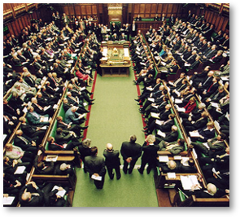
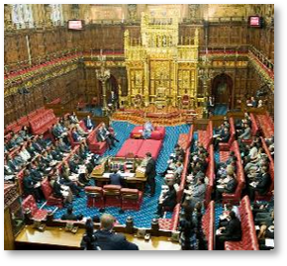
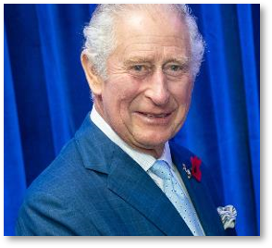
Activity 2:
Who makes the law?
No single person has the power to make and change the law. It is the role of parliament to do this.
House of Commons
House of Lords
The Monarchy
Recap: How are laws made in the UK?
Notes:
Activity 2: Who makes the law? (Optional) Slides 18 – 21: These slides give students a quick refresher on the different roles involved in how laws are made in the UK. If your students already know this content (for example, from KS3 or previous GCSE topics), you can summarise the key points only and skip quickly to Slide 22, Activity 3: The Changing Law..
Ensure at a basic level that students are familiar with the key points below.
You may want to ask students to create their own definitions list based on the information on the slides. This will help them break down the content into manageable pieces before moving to Slide 22, Activity 3: The Changing Law.
The key points they must take away are:
No single person makes the law. Law‑making is shared between the House of Commons, the House of Lords and the Monarch (formally). Understanding this is important before we look at how laws change and why those changes matter.
Parliament makes and changes laws (House of Commons + House of Lords).
The Government proposes many changes to the law, but cannot pass laws alone.
Courts interpret laws and help ensure they are applied fairly.
Citizens influence change through voting, campaigning, petitions, contacting representatives and democratic participation.

Slide 18

Activity 2:
Who makes the law?
The UK is a representative democracy. Citizens vote for who should represent them in parliament at a general election (they are the elected legislature).
650 MPs are elected. Each MP represents a different area of the UK (constituency). MPs belong to different political parties and can also stand as an independent candidate.
Below are current represented political parties in the House of Commons, and the number of seats as of February 2026:
404
Labour
116
Conservative
72
Liberal Democrats
8
Reform UK
4
Green Party
4
Plaid Cymru
9
Scottish National Party
7
Sinn Fein
5
Democratic Unionist Party
The political party that gets the most MPs elected at the general election forms a government. This government is led by the Prime Minister.
Notes:
Activity 2: Who makes the law? (Optional)
Support information:
A political party has one 'seat' in the House of Commons for every constituency they win in a General Election.
Breakdown above correct as of February 2026. For more information see https://members.parliament.uk/parties/commons - includes a useful visual breakdown

Slide 19
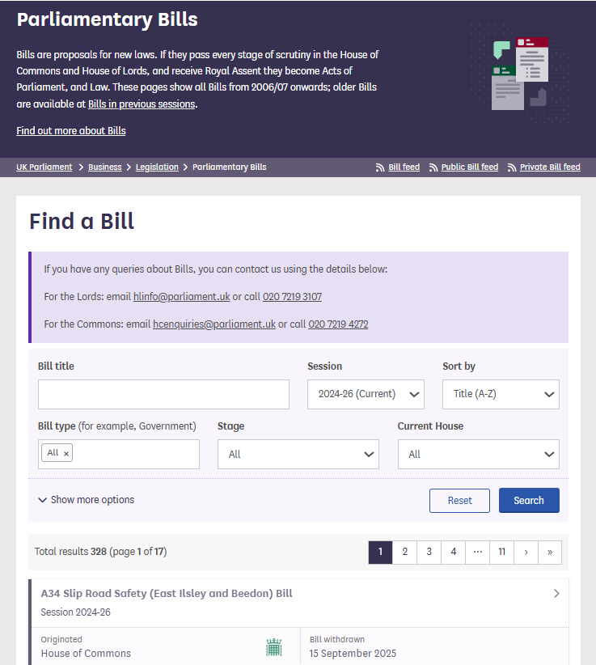
Activity 2:
Who makes the law?
The government drives a lot of the suggestions for new laws and changes to existing laws as it implements its manifesto.
For any new laws to pass they have to be debated and voted on in the House of Commons.
When a law is being debated it is called a bill. There are hundreds of bills being debated at any one time.
Notes:
Activity 2: Who makes the law? (Optional) Prompt questions:
What is the basic role of the House of Commons in making law?
What is a bill? Turn to your partner and define it in your own words.
Why do you think Parliament debates bills instead of just accepting them?

Slide 20
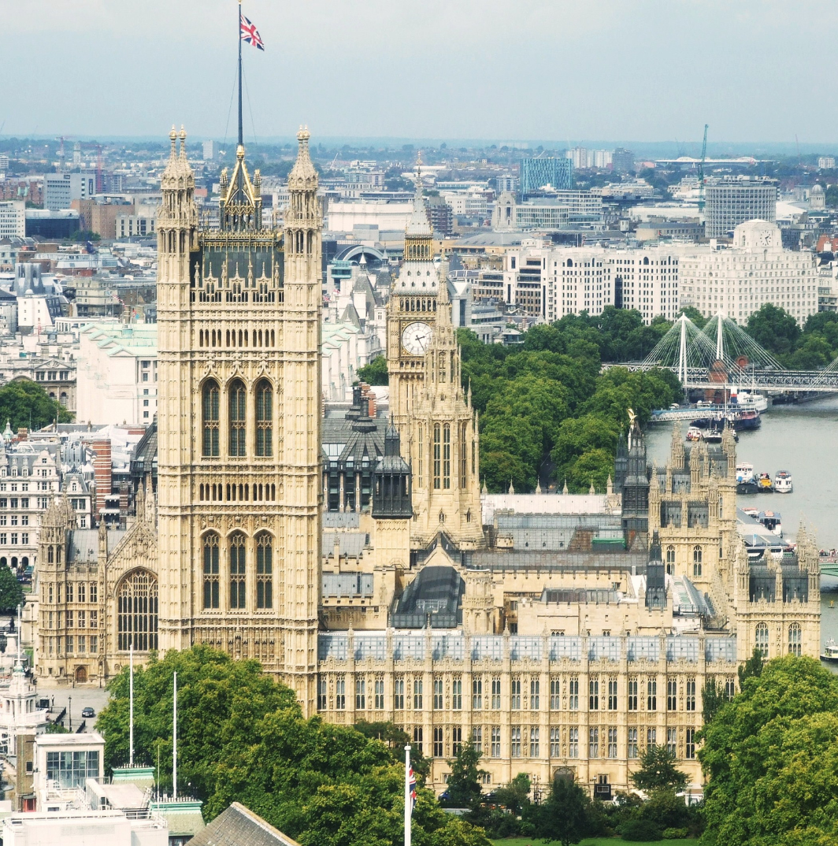
Activity 2:
Who makes the law?
The second chamber of parliament is The House of Lords. It is independent from the House of Commons.
Made up of around 800 peers who are appointed by the King on the advice of the prime minister.
Peers bring expertise from a range of occupations (e.g. business, culture, science, sports, academia, law, education, health and public service).
The House of Lords is responsible for examining bills, questioning government and scrutinising legislation. Members also have to vote on any changes to laws.
Notes:
Activity 2: Who makes the law? (Optional) Prompt consolidation questions: How is the House of Lords different from the House of Commons?

Slide 21
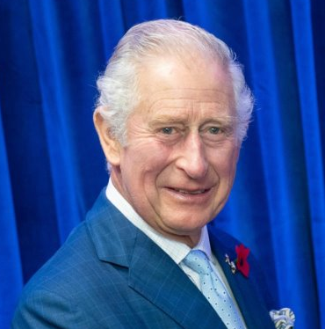
Activity 2:
Who makes the law?
Royal Assent
The final stage of getting any law created or changed. This is more of a formality and usually the monarch always grants Royal Assent. The last time a monarch refused was in 1708.The monarch is not able to introduce any new laws.
King's Consent
The monarch's consent is sought if a proposed parliamentary bill will affect the Crown's prerogatives or interests.
Notes:
Activity 2: Who makes the law? (Optional)

Slide 22

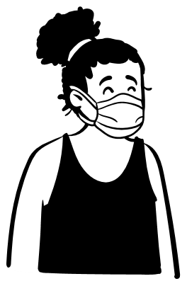
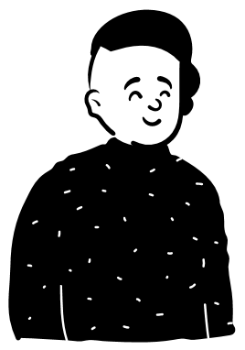
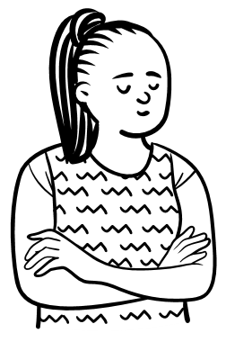

Activity 3:
The Changing Law
Amira
Liam
Jo
As you look at the case studies, decide:
Why was the law changed?
Who does it affect?
What is the impact?
Do you agree with the change? Why/why not?
Laws are constantly changing
Notes:
Activity 3: The Changing Law
Spend 1-2 minutes on this slide. Explain to students that they are now moving from learning who makes the law to looking at how laws change and why change happens. Make clear that they are not being asked to memorise the laws themselves but to analyse:
the reason for the change
the impact on different people
the tensions or trade‑offs that arise
what the example shows about how law‑making works in the UK
Tell students they will examine real examples of changed law and then discuss the consequences.

Slide 23
Case Study 1: The Right to Strike
I'm Amira. I work in a busy hospital and I'm also a member of my union.
Under the Human Rights Act, everyone has the right to join together and peacefully express their views. This includes the right to be part in a strike in some circumstances.
But, that right isn't unlimited. There are times when the law can place restrictions for example, to keep the public safe, prevent disorder or protect other people's rights.
What is a strike? A strike happens when members of a trade union stop working because they are in dispute with their employer and cannot reach an agreement after negotiations.
There are laws about when a strike is allowed, including:
It must relate to a workplace dispute with your own employer.
Union members must vote, and at least half must support striking.
Unions must give notice before a strike takes place.
In 2023, a new law was introduced: the Strikes (Minimum Service Levels) Act. Because I work in the health sector, it affects me directly. The laws says that during a strike, certain essential services – like health, fire and rescue, education, transport, border security and nuclear decommissioning/waste management – must still run at an agreed minimum level. ​
This means that my employer can tell specific workers, including me, that we have to go work during a strike to keep a safe level of service running.​
Notes:
Activity 3: The Changing Law
Spend 5 minutes on this slide.

Slide 24
Case Study 2: The Right to Protest
I'm Liam. I sometimes join peaceful protests with my college group when we want to raise awareness about an issue.
Under the Human Rights Act, everyone has the right to join together and peacefully express their views. It also protects the right to gather peacefully with others which includes marches, rallies, vigils and other types of protest. But, these rights are not unlimited.
What is a protest? A protest is when people come together to express their views or campaign for change. There are laws about how and when protests can take place, including:
Protests must be peaceful.
Authorities can place conditions on time, place, or manner.
Restrictions can be made to protect public safety, prevent disorder or safeguard other people's rights.
In 2023, a new law was introduced: the Public Order Act. It added a number of new offences linked to certain protest actions, including:
'Locking on' - attaching yourself to people, objects or buildings or carrying equipment
Causing serious disruption by tunnelling – digging underground tunnels as part of a protest
Interfering with key national infrastructure, like airports or railways
Obstructing major transport works.
These actions now can result in fines or a prison sentence or both if you are found guilty after a trial.
Notes:
Activity 3: The Changing Law
Spend 5 minutes on this slide.

Slide 25
Case Study 3: The Right to Vote
I'm Jo. I've just turned 18, so I'll be able to vote in the next general election. The Human Rights Act says that citizens must be able to take part in free elections. This means elections have to happen at reasonable intervals, they must be fair, and everyone must be able to cast their vote in secret. Voting laws have changed over many years. Under UK
legislation the maximum term parliament can run for is five years.
What is the right to vote? Elections must be free, fair, held at regular intervals and allow secret voting. Under current legislation, in order to vote in a UK parliamentary election a person must:
Be registered to vote in the constituency;
Be of voting age (18 years old on polling day);
Be either a British citizen, qualifying Commonwealth citizen or a citizen of the Republic of Ireland;
Not be subject to any legal incapacity to vote (e.g. a peer in the House of Lords, a prisoner serving a prison sentence)
In 2022, a new law was introduced: The Elections Act. The Electoral Commission says the aim was to make elections more secure, accessible and transparent.
One of the biggest changes is that voters now need to show an accepted form of photo ID when voting in general elections, by-elections and local elections in England. In Northern Ireland, ID has been required since 2003. If you don't already have photo ID, you can apply for a free voter ID document but if you don't have a valid ID, you won't be allowed to vote on the day.
Notes:
Activity 3: The Changing Law
Spend 5 minutes on this slide.

Slide 26



The Big Challenge 2: Make your voice heard
If you could change a law or create a new one – what would it be?
Step 1: Build your proposal
What law would you change, or what new law would you introduce?
Why does it matter to you or your community?
What are the strongest reasons for your change? What are the main arguments against it?
Who would be affected? Consider different groups of people.
Step 2: Who do you need to influence?
Who would you need to influence? Think about MPs, peers, experts, charities, business leaders, media or community groups.
How would you get your message across? Email, letter, social media or face to face conversation? Explain why you've chosen this method.
Step 3: Make your voice heard
Prepare a short spoken pitch presenting your proposed change and your plan to influence decision‑makers. Present it to your group.
Notes:
The Big Challenge 2: Make Your Voice Heard
Spend 5-7 minutes on this slide.
Students work in pairs or groups of three to plan a law they would change or create. They must show:
clear reasoning
an understanding of different viewpoints
awareness of who is affected
awareness of who holds influence
an appropriate communication method for civic engagement
Encourage students to structure their pitch as:
The change I want to make
Why this change matters
Who it affects
Arguments for and against
Who I need to influence
How I will communicate with them
Students can share their pitches with the class or swap with another group for peer feedback.

Slide 27

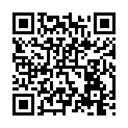
Reflections
Now at the end of the lesson...
Complete a quick class reflection.
It takes less than 5 minutes.
Answer honestly: there are no right or wrong answers.
This helps us understand what you learned and how you feel about the rule of law.
Notes:
Student Reflections
NB: Only you need to scan the QR code or click the green link embedded on the slide. The questions are student facing, are done as a group and act as reflective prompts for your class.
Optional: Screenshot your answers before submitting for your own activity records.

Slide 28

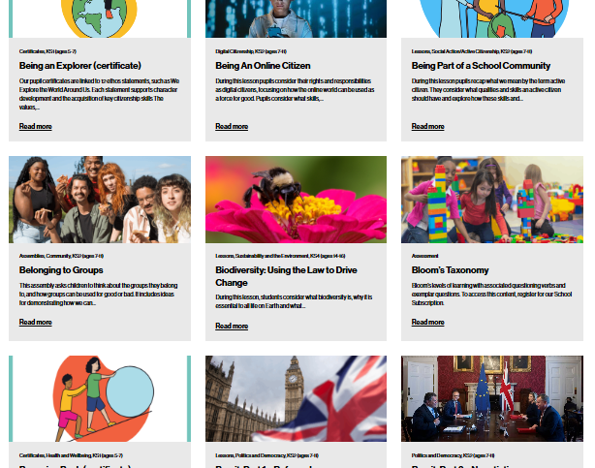

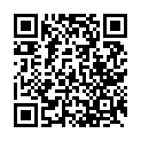
After the session
Your thoughts...
Want more resources?
Tag us!
We have heard what your students think during the lesson, now tell us how you found it as a teacher.
We'd love to hear how you use Young Citizens resources over at Facebook, LinkedIn and Instagram. You can tag us at:
RE
We have a library of over 100 free resources available for you to download right now. Sign up here:
www.surveymonkey.com/r/ZCX3RRS
www.youngcitizens.org/resources
@YoungCitizensUK
#TheBigLegalLesson
Citizenship
PSHE

