Slide 1




The Big
Legal Lesson
Sponsored by
Primary
Spark
Notes:
The Big Legal Lesson: Primary Spark Activities
Thank you for taking part in The Big Legal Lesson 2026. You are joining a network of thousands of teachers across England and Wales who are committed to developing children’s knowledge of the rule of law and their legal rights.
For more The Big Legal Lesson resources and information, please head to www.youngcitizens.org/programmes/the-big-legal-lesson/
To find out more information about Young Citizens and our mission, you can check our website at www.youngcitizens.org

Slide 2






Spark Activity 1: A law is...
What is the difference between a rule and a law?
Think to yourself:
What rules are being followed in this picture?
Why is it important to follow rules?
Talk to your partner:​
Share another example of a rule you must follow. Is your example a home rule, a school rule, or a law? Why do you think so?
Together as a group:
Finish the sentences:
A rule is...
A law is...
Idea for Action:​
For the rest of the day, see how many times you can spot rules or laws being used around you. How many can your class find altogether?
Notes:
Spark Activity 1: A law is...
Purpose: To help pupils identify rules in a picture and begin to distinguish rules from laws.
Useful definitions / reminders for teachers:
A rule is something a group agrees to do (like at home or school).
A law is a rule that everyone in the country must follow.
Examples from KS1 and KS2 materials:
Home rules: bedtime, sharing toys.
School rules: uniform, lining up.
Laws: wearing a seatbelt, not stealing, children must get an education.
Teacher prompt if needed: Can this rule be different in different families or schools? If yes, it’s probably not a law.

Slide 3
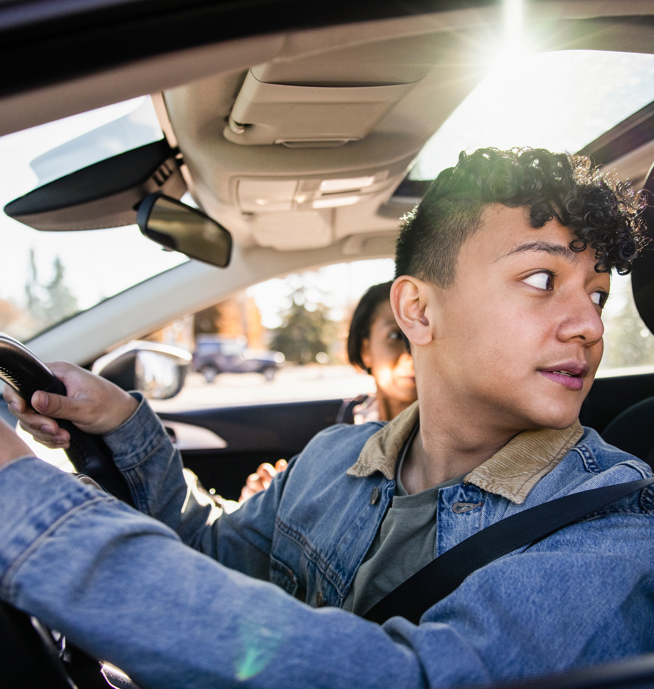
Spark Activity 2: Seatbelts & Safety
How do laws keep you safe?
Think to yourself:
What can you spot in the picture that helps keep you safe?
Talk to your partner:​
Why do you think there is a law that says everyone must wear a seatbelt?
Together as a group:
Share reasons why this law exists. Does the law apply to grown‑ups, children, and even people like the prime minister?
Idea for Action:​
As a class, create a big “The Law Helps Us…” wall with drawings showing everyday examples.
Notes:
Spark Activity 2: Seatbelts & Safety
Purpose: To help pupils notice a law in action and understand that laws help keep everyone safe.
Useful definitions / reminders for teachers:
The KS1 and KS2 lessons explain that laws are rules everyone in the country must follow.
The example given in both KS1 and KS2 is that everyone must wear a seatbelt in a car. This law keeps people safe.
Laws apply to all people: children, adults, teachers, and even people in powerful jobs like the prime minister.

Slide 4
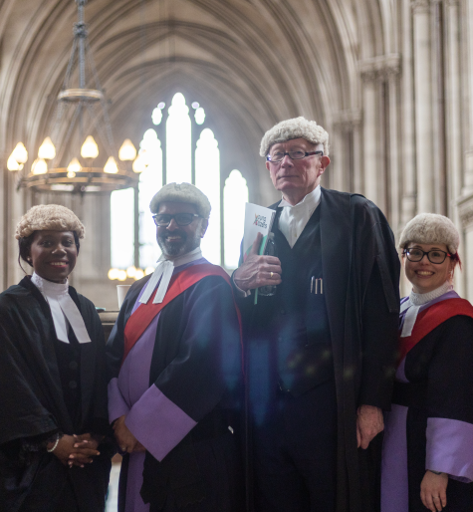
Spark Activity 3: The Judge
Who helps us with the law?
Think to yourself:
What are these people's jobs?
What clues can you spot in this picture?
Talk to your partner:​
Why do you think this person wears special clothes? What might they do in a court?
Together as a group:
Share your ideas: What do you think a judge’s job is?
Idea for Action:​
Name 2 other people who are involved with the law. What do you think they do?
Notes:
Spark Activity 3: The Judge
Purpose: To help pupils infer what a judge does.
Useful definitions / reminders for teachers:
Key points:
A judge works in a court.
A judge applies the law and makes sure people are treated fairly when something goes wrong or someone breaks the law.
Judges sometimes wear special clothes (robes/wigs) as part of their role. They are like their 'uniform' for work.
Optional links to other roles:
A lawyer gives advice and helps people understand the law.
The police help keep people safe and make sure laws are followed.
MPs help make laws in Parliament.

Slide 5



Spark Activity 4: Your new law
What do you want to change?
Think to yourself:
Is there something you wish was fairer or safer for everyone?
Talk to your partner:​
Together, make a new law that might help fix this problem.
My new law is...
We need it because...
It would help because...
Together as a group:
Share your ideas: How would it help? Why do we need it?
Idea for Action:​
Create a poster to explain your new law to people. Remember to write down why it is important.
Notes:
Spark Activity 4: Your new law
The full version of this activity is contained in both the KS1 & KS2 lessons.

Slide 6


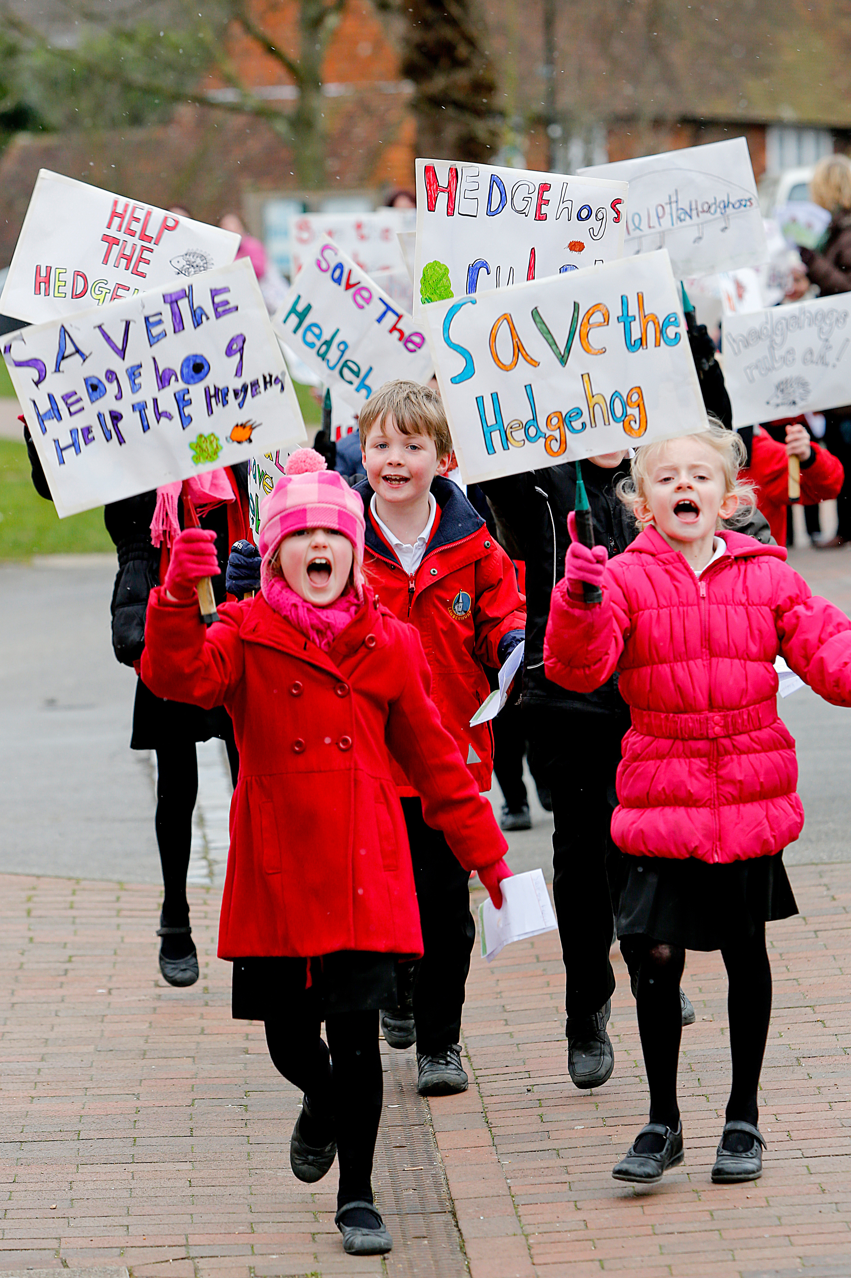
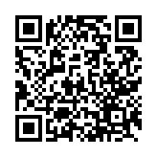
After the session
Your thoughts...
Take Citizenship Beyond the Classroom
Tell us how you found this resource as a teacher.
Give your pupils the chance to lead real change with our Make a Difference Challenge 2026.
Join the Summer of Social Action.
This immersive programme is designed for primary schools to turn learning into action.
Here’s what happens:
Spark Change: Pupils choose an issue they care about.
Plan It, Do It: They design and deliver their own social action project.
Shout About It: Celebrate their impact at a regional showcase this July.
Secure your place:
RE
www.surveymonkey.com/r/Z2352VM
Citizenship
PSHE
www.youngcitizens.org/programmes/make-a-difference-challenge/

