Slide 1




The Big
Legal Lesson
Sponsored by
Secondary Spark
Notes:
The Big Legal Lesson: Secondary Spark Activities
Thank you for taking part in The Big Legal Lesson 2026. You are joining a network of thousands of teachers across England and Wales who are committed to developing children’s knowledge of the rule of law and their legal rights. For more The Big Legal Lesson resources and information, please head to www.youngcitizens.org/programmes/the-big-legal-lesson/
To find out more information about Young Citizens and our mission, you can check our website at www.youngcitizens.org

Slide 2


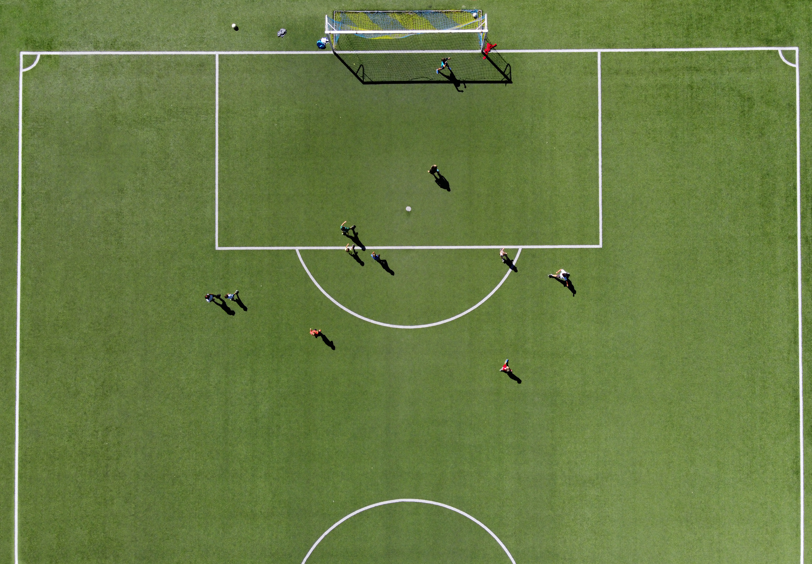



Spark Activity 1: The Rule of Law
What is it?
Think to yourself:
What's your favourite game or sport? What would happen if the rules of the game only applied to one side?
Talk to your partner:
How does this help explain why societies need shared rules that apply to everyone?
Watch this video to find out more about the rule oflaw
Together as a group:
Watch this video to find out more about the rule of law: https://www.youtube.com/watch?v=DGpOGxlU-z8 (UK Judiciary)
Idea for Action:
Create your own definition of the rule of law:
What is it and why does it matter?
Notes:
Spark Activity 1: The Rule of Law

Slide 3

Spark Activity 2: The law in your day
How do laws shape everyday actions?
Think to yourself:
List three things you usually do before 9am. Which of these involve rules?
Crossing the road
Talk to your partner:​
Why do you think rules (and laws) need to be clear and easy for everyone to follow?
Buying something in a shop
Together as a group:
Look at the examples on the slide. Pick one. What laws might be connected to it? Why do you think that law exists?
Using your phone on the way to school
Idea for Action:​
Which everyday laws do you notice the most? Which do you notice the least, and why?
Notes:
Spark Activity 2: The law in your day

Slide 4
Spark Activity 3: Who makes laws?
Why do we need separation of powers?
Think to yourself:
Think of a group activity (sports team, school council, group project). What happens if one person makes all the decisions?
Parliament
Talk to your partner:​
Why might it be useful for different people to have different responsibilities when decisions affect everyone?
The Government
Justice System
Together as a group:
Look at the list. Match each role to their function. Why is it important that these functions are separate?
Interprets and upholds the law
Makes and changes laws
Idea for Action:​
Find a news story about a new law being introduced. Can you spot who is involved in the process?
Puts laws into practice and makes policy
Notes:
Spark Activity 3: Who makes laws? Matched roles and functions:
Parliament – makes and changes laws
The Government – puts laws into practice and makes policy
Justice System – interprets and upholds the law [
Why it is important these functions are separate:
It stops any one group from having too much power, because no single group can make the laws, enforce the laws, and judge whether they’ve been followed.
It helps keep decisions fair, since different groups check and balance one another.
It means that rules are created, applied, and judged independently, reducing the chance of unfair decisions or misuse of power.

Slide 5
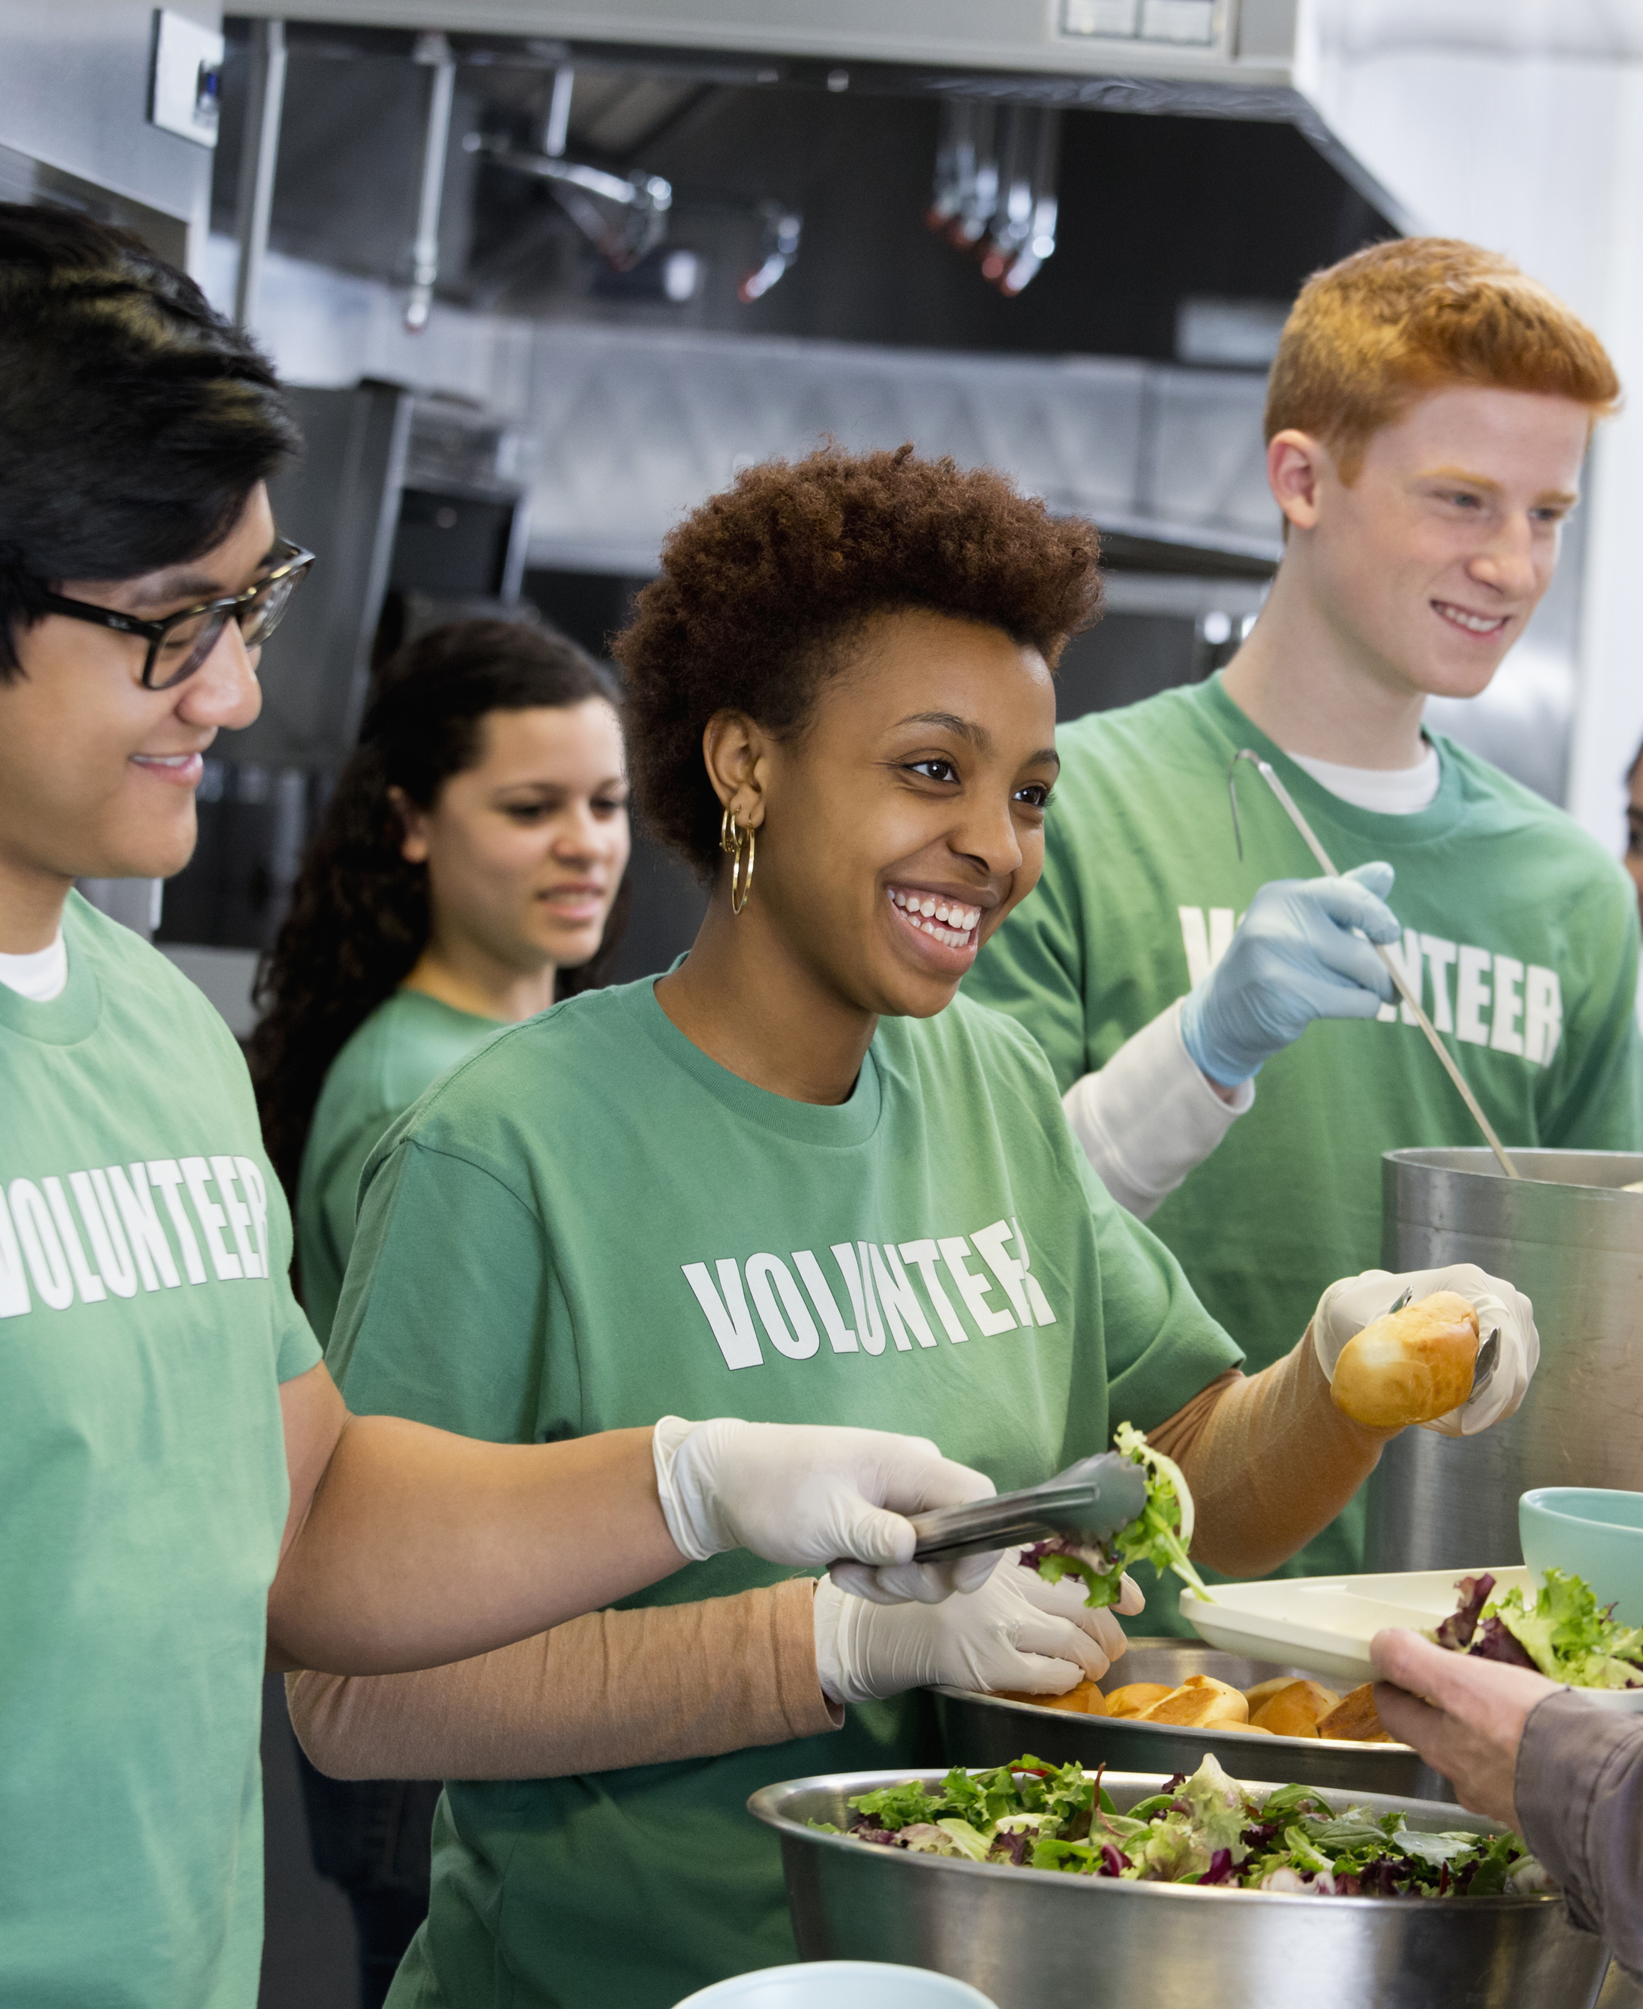
Spark Activity 4 : Your voice
How can people share their views to influence change?
Think to yourself:
When have you shared an opinion about something you wanted to change (in school, at home, or in your community)?
Talk to your partner:​
List the ways citizens can influence change in their societies and communities (e.g. volunteering, writing to their MP...)
Together as a group:
Which method is easiest for young people to use? Why might using more than one method at the same time be even more powerful?
Idea for Action:​
Decide one thing you would like to improve in your community or school. Which method above would you choose to share your view, and why?
Notes:
Spark Activity 4: Your voice

Slide 6



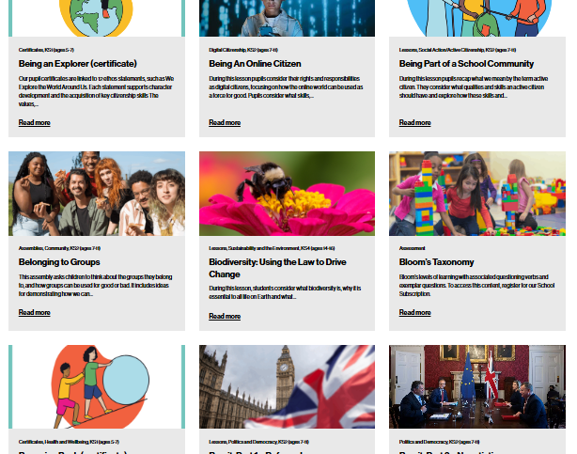

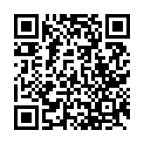
After the session
Your thoughts...
Want more resources?
Tag us!
Tell us how you found this resource as a teacher.
We'd love to hear how you use Young Citizens resources over at Facebook, LinkedIn and Instagram. You can tag us at:
RE
We have a library of over 100 free resources available for you to download right now. Sign up here:
www.surveymonkey.com/r/ZCX3RRS
www.youngcitizens.org/resources
www.surveymonkey.com/r/ZCX3RRS
Citizenship
PSHE
@YoungCitizensUK

